Slide 1

General Mathematics
ADE 101
Unit 2
LECTURE No. 10
Basic Algebra and Algebraic Operations

Slide 2
Today’s Objectives
Students and Teachers will be able to
Understand What is Basic Algebra?
Know the basic algebraic operations?
Solve the algebraic equations

Slide 3
KNOWLEDGE TEST
Q. 1 Suppose I have $3 in my pocket and $5 on the desk. How much money do I have altogether?
Q. 2 I went to store with $12 and spent $5 there. How much I have left?

Slide 4
KNOWLEDGE TEST
Q. 3 I have $5 in my pocket. My friend has 3 times more than I do. How much does my friend have?
Q. 4 I have $28 and I want to divide equally between the 4 people. How much would each get?

Slide 5
Q. 1 I have some money in my pocket and $5 on the desk, altogether I have $8. How much do I have?

Slide 6
Q. 2 I went to store with some money and spent $5 there, I have $7 left. How much amount in my pocket?

Slide 7
Q. 3 I have some amount in my pocket. My friend has 3 times more than I do. The amount has is $15. How much do I have in my pocket?

Slide 8
Q. 4 I have some amount and I want to divide equally between the 4 people such that each of them gets $7. How much I originally have to start with?

Slide 9
$? + $5 = $8
$? - $5 = $7
$? × 3 = $15
$? ÷ 4 = $7

Slide 10
$? + $5 = $8
$?- $5 = $7
$? × $3 = $15
$? ÷ $4 = $7

Slide 11
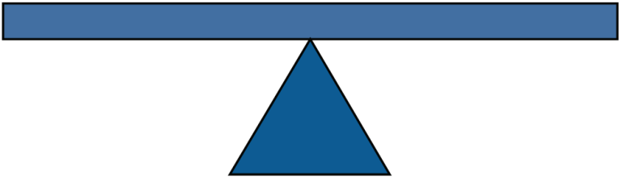
$3 + $5 = $8
$12 - $5 = $7
$5 × 3 = $15
$28 ÷ 4 = $7

Slide 12
$? + $5 = $8

Slide 13
$? - $5 = $7

Slide 14
$? × 3 = $15

Slide 15
$? ÷ 4 = $7

Slide 16
Rule for Solving Equations

Slide 17
Equations Involving
More than one Operations
I have $9 and I want to multiply that by 2 then add $3 more to it. How much would I have altogether?

Slide 18
Equations Involving
More than one Operations
I have some amount and I want to multiply that by 2 then add $3 more to it so that it equals to $21. How much did I have to start with?

Slide 19
Equations Involving
More than one Operations
Suppose I want to find a number so that when I divide it by 6 than subtract 4 from it, it would be equal to 1. what would that number be?

Slide 20
If there are 2 bananas on the counter and 3 bananas on the table. How many altogether in that room?

Slide 21
If there are 2 bananas on the counter and 3 apples on the table. How many altogether in that room?

Slide 22
Add 2x to 14
Subtract 14 from 5a
Multiply 2 by 2k
Divide 8x by 24y
Add 2x to twice 3y

Slide 23
I want to multiply a number by 2 than add 3 times the same number to it so that it equals to 35. What is that number?

Slide 24
I want to find the number such that when I multiply it by 8 than subtract 2 times the same number so that I equals to 30 minus 12?

Slide 25
Simplify
9x – 30 = 2x +5

Slide 26
Simplify
8x – 10 = 2x +20

Slide 27
Simplify
2(6+5) = ?

Slide 28
Simplify
7(6+x) = ?
5(4-6x) = ?

Slide 29
Simplify
2(2x-1) = 3(6-2x)

Slide 30
Assignment
Solve
(x – 1) + x + (x + 1)
3(x + 2) = 18
3(x + 2) = 5(x – 7)
2x = 5(x – 7)
2x + 9 = 5(x – 7)

Slide 31
The greatest enemy of understanding is coverage. As long as you are determined to cover everything, you actually ensure that most kids are not going to understand. You’ve got to take enough time to get kids deeply involved in something so they can think about it in lots of different ways and apply it – not just at school but at home and on the street and so on.

Slide 32
Thank You

