Slide 1
Networks & Security Issues
ADE100- Computer Literacy
Lecture 09

Slide 2
Knowledge test
What is the purpose of search engines?
List few URLs of websites you know.
Which Boolean operators are used in the web search?
What is the purpose of NEAR operator?
What is the purpose of advanced search?
What are sponsored listings?

Slide 3
Topics covered
Introduction to LAN, WAN and Wireless networks
Sharing on networks and network-related security issues
Firewalls
Security
  Protection against virus and spam emails
  What is hacking and protecting against it

Slide 4
Computer Network
Computer Networks
  Set of technologies that connects computers to share information
  Allows communication and collaboration between users
  Network computers are also called clients, nodes, workstations or servers.
  Share files, resources (printers, disk, modems) and programs
Example: Internet

Slide 5
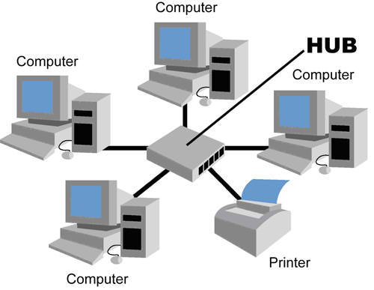
Local Area Network- LAN
Local Area Network (LAN)
  Contains printers, servers and computers
  Systems are close to each other
  Contained in one office or building
  Organizations often have several LANS
Examples
  A network inside home
  Computer Lab

Slide 6
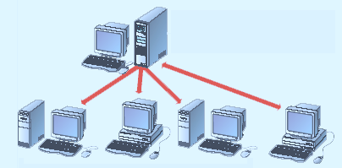
Sharing on a LAN
File server contains documents used by other computers.

Slide 7
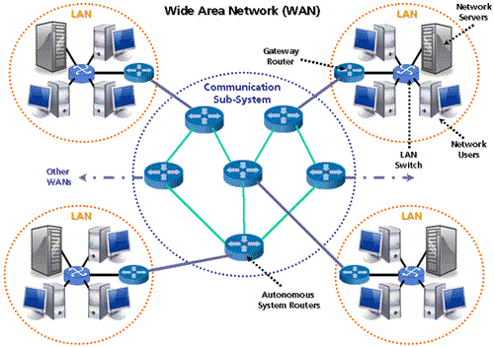
Wide Area Networks- WAN
Wide Area Networks (WAN)
  Two or more LANs connected
  Over a large geographic area
  Typically use public or leased lines
    Phone lines
    Satellite
Examples
  PTCL
  Internet

Slide 8
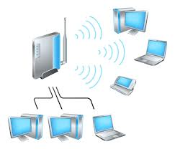
Wireless Networks
Data transmitted through the air
LANs use radio waves
WANs use microwave signals
Easy to setup
Difficult to secure

Slide 9
Sharing on Networks
Using networks we can Share various software and hardware resources.
  Files and folders
  Disk drives
  CD/DVD drives
  Application programs
  Printers
  Fax machine, etc.

Slide 10
Sharing a Folder
Select and right click a Folder
Make it available for sharing
Give permission for the selected users or everyone to access the folder

Slide 11
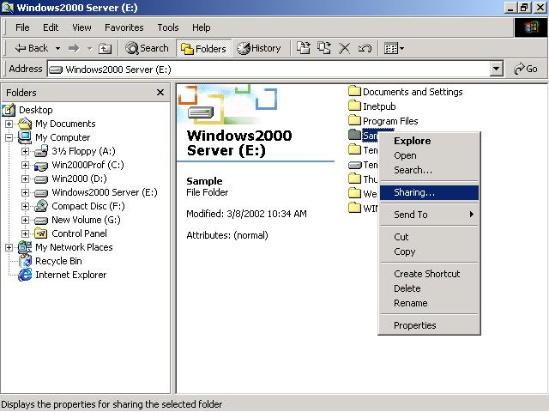
Sharing a folder

Slide 12
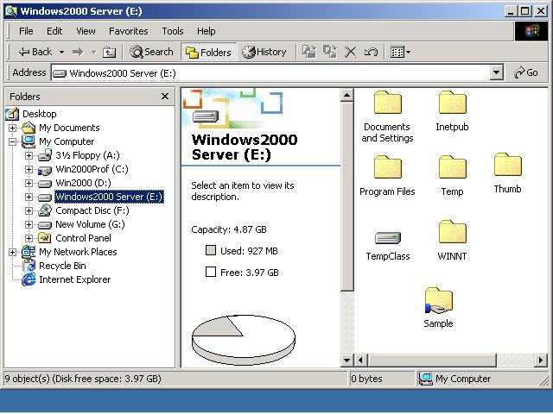
Shared Folder Indication

Slide 13
Popular network security issues
Finding a way into the network
  Unauthorized access to a network server
  Implement firewalls to prevent it
TCP attacks
  If an attacker learns the associated TCP state for the connection, then the connection can be hijacked
  Attacker can insert malicious data and the recipient will believe it came from the original source
  E.g. instead of downloading and running new program, you download a virus and execute it

Slide 14
Popular Network Security issues
Denial of Service
  Makes a network service unusable
  usually by overloading the server or network
Social issues
  People can be just as dangerous as unprotected computer systems
  People can be threatened, harmed, tortured, etc. to give up valuable information
Examples
  Using someone’s credit card illegally
  Installing money-stealing worm on the company systems from inside the company

Slide 15
Firewall
A firewall is a system that
  Sits at some point of connectivity between a site it protects and the rest of the network.
  Implemented as an “appliance” or part of a router
  “Personal Firewall” may be implemented on an end user machine
Firewall-based security depends on the
  Firewall being the only connectivity to the site from outside
    There should be no way to bypass the firewall via other gateways, wireless connections, or dial-up connections.

Slide 16
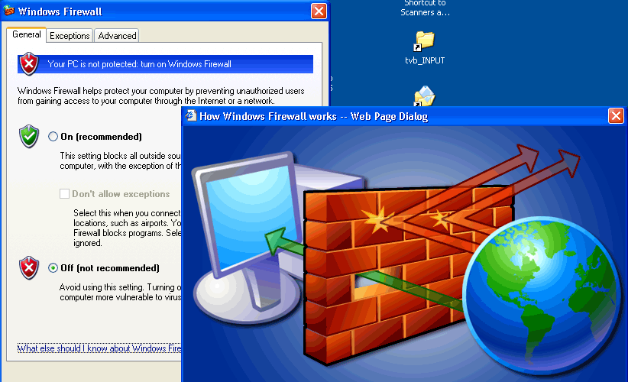
Firewall

Slide 17
Computer security
Computer security
  Protection of computers and its data from any loss or illegal access
  For example, an online business must ensure that credit card & customer information remain secure and confidential
Computer crime
  Any illegal access or misuse of computers & its data
  If it occurs over the Internet then called cybercrime

Slide 18
Computer viruses
Computer virus
  A computer program that negatively effects the working of a computer
  Alters computers data without the permission of its actual users
Types of Computer Viruses
Polymorphic virus
  Modifies itself each time it affects other program or files
  Changes its code pattern each time so called polymorphic
Stealth virus
  Infects a file or a program but size and date of creation of file is not changed

Slide 19
Types of computer viruses
Boot sector virus
  Activates whenever a computer system boots up
File virus
  Attaches with the program files and activates when these program files are run
Macro virus
  Attached with the file of an application program like word, excel
  Uses macro language of that application
  When you open a document that contains an infected macro, the virus loads into the memory

Slide 20
Types of computer viruses
Worm
  Copies itself repeatedly in memory or hard disk until memory become full
  Computer stops working and needs restart again and again
Trojan horse
  Hides itself with common computer files like zip files
  When the infected files are opened the virus activates

Slide 21
Security techniques
Some popular security techniques are:
Antivirus
  A computer program which finds out viruses
  Removes or repairs the infected files
  Several antivirus programs are available
  Norton, MacAfee, Avast, AVG, Panda, etc.
Quarantine
  Separate area on hard disk that contains infected files that cannot be deleted due to some reason
  Quarantined files do not damage other files

Slide 22
Security techniques
Unauthorized access
  Means accessing a computer system without the permission of its actual user
  Usernames and passwords should be used
Firewalls
  Consist of hardware and/or software to prevent unauthorized access of a network or computer
  Proxy server is used to implement firewalls on the networks
  Personal firewall is a program installed on your PC

Slide 23
Security techniques
Biometric devices
  Read personal characteristics like fingerprints, hand structure, facial features and voice, etc.
  Authenticate users to access computers
  Translate personal characteristics into digital data that is matched to already stored user data
  If record is matched then gives access otherwise access is denied

Slide 24

Email spam
Unsolicited Commercial Email (UCE), also known as "spam" or "junk email"
  Email that is “unwanted, “inappropriate” and no longer wanted…”
NO!!

Slide 25
Protection from email spam
Spammers
  Collect your email address
  Verify that it is a valid address before they start sending spam emails to you.
To reduce the possibility of receiving spam emails,
  you must protect your email address/account and your computer.
Some important tips to avoid spam emails
  Be careful in disclosing your email address or personal information.

Slide 26
Protection from email spam
Do not disclose your personal information
  Too readily, including your email addresses
Check the privacy policy of websites when filling out web registration forms, online surveys
  Look for options that allow you to unsubscribe from receiving emails on offers
Do not publish your email address on
  Public websites, contact directories, membership directories, or chat rooms.

Slide 27
Protection from spam emails
When checking your emails:
  Don't be caught by the spammers' favorite tricks, such as the use of subject headings like "Remember me?“
  Simply delete emails from unknown senders or doubtful sources
  Check the "sent" folder or outgoing mailbox of your email program (or webmail account) to see if there are any outgoing messages that were not sent by you.
  If there are such messages, your computer may have been hacked and used by spammers to send emails from your computer.
    You should disconnect from the Internet immediately and scan your computer with anti-virus or anti-spyware software

Slide 28
Computer security measures
Tips for protecting your computer:
  Use anti-spam solutions offered by ISPs or
  Install email filters to reduce the amount of spam emails you receive
  Install and enable anti-virus software and keep it up to date
  Enable real-time detection to scan for viruses
  Schedule a full system scan to run regularly, based on operational needs
  Install and enable personal firewall software
  Apply the latest security patches/hot-fixes released by product vendors to the operating systems and/or applications installed in your computer.

Slide 29
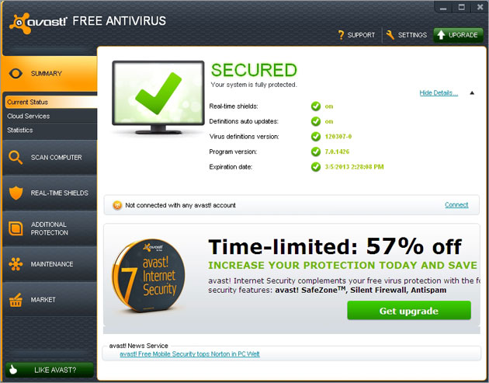
Antivirus

Slide 30
Hacking
Hacking
  A disadvantage of internet
  Accessing the data stored on the computers across the Internet by illegal means
Hackers, crackers
  Malicious(evil) hackers sometimes called crackers
  Damage websites and delete their contents
  Retrieve critical data of different organizations and governments

Slide 31
Hacking process
Hackers
  Ping your computer to know that it is turned ON and connected to the internet
  In Pinging they send a message to a system, if it responds , the sender knows that your computer is active and connected to the network
  Experts say a typical PC gets pinged several times weekly
  Once an invader (cracker) finds way to access your system then there is no limit to the damage
  Files containing important data can be moved, copied, renamed or deleted.

Slide 32
Protecting against hacking
You can take few basic steps to prevent hacking your system.
  Plug windows’ security holes
    Means turn OFF file and printer sharing
  Get a personal firewall
    Hardware or software tool that enable to restrict unauthorized access
  Ask your ISP for help
    Check your ISP’s security related information
    If still you are not clear then call them

Slide 33
Protecting against hacking
Use passwords and manage them effectively
  Windows enable you to manage password-protect a variety of resources
  If you use any network features then you should password-protect them
  change your passwords frequently.
  Use passwords that cannot be easily guessed

Slide 34
Activity- (15 minutes)
View and explore your computer’s network settings.
View and explore your system firewall settings.
View, explore and use different options of your antivirus program.

Slide 35
Group discussion- (15 minutes)
Make a group of two or three students and then discuss with other groups the following topics.
  Your experiences about using Internet as a computer network?
    Did you face any problem while connecting the internet & how you solved it?
    Did you face any security issue ever? If yes then how you resolved this issue.
  How can a network help a small business to save money on printing?

Slide 36
Further reading
Introduction to computers, 7/e by Peter Norton
  Chapter 7A- Network basics
PM Series, Introduction to Information Technology by Riaz Shahid
  Chapter 6: Networks and Security issues

Slide 37
Thanks
End of Lecture 09

Slide 38
Allah Hafiz

