Slide 1
Internet Basics
ADE100- Computer Literacy
Lecture 08
Sajid Riaz

Slide 2
Knowledge test
What was the purpose of ARPANET?
What do you understand by the term Internet?
List the names of three internet browsers?
What happens when you provide a URL for your web browser?
What is the purpose of bookmarks?

Slide 3
Topics covered
Search engines
Search for information
  (search tips, etc.)
Using specialized websites

Slide 4
Searching the web
It is not always easy to find what you need on the web
Tens of millions of unique websites
Search tools can be used to search successfully
The two most common search tools are
  Directories
  Search engines

Slide 5
Searching the web
Directories
  Search by selecting categories of subjects
  When you select a category or subcategory then a list of sites related to your search are displayed
  Such as ‘companies-construction-contractors-builders’
  For example, LookSmart directory at www.looksmart.com

Slide 6
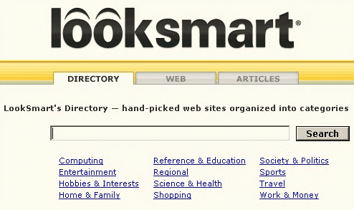
LookSmart directory

Slide 7
Searching the web
Search engines
  Search for information by entering one or more keywords
  The engine then displays a list of related web pages
  This type of lookup is called Keyword search.
  Some allow you to search on a single word
  While some allow you to search for multiple words like “scanner and printer”
  Example: Google search engine at www.google.com
  similarly yahoo & msn search engines

Slide 8
Hybrid search tools
Both types of search tools (directories & search engines) are commonly called search engines while it is not technically correct.
Most type of search tools provide both styles of search
  LookSmart provides a box for “keyword search” and a list of categories for “directory-style search”

Slide 9
Using a directory
Problem:
  Suppose you want to find websites that provide information about latest digital cameras.
  You may want to buy a new camera.
Solution:
  Launch your browser
  Enter URL in address box, www.looksmart.com and press Enter key
  LookSmart page will open, Click computing category on home page, a new page will open with a list of subcategories
  Click Hardware subcategory, a new page appears with a list of hardware subcategories

Slide 10
Using a directory
Solution
  Choose peripherals->input devices->digital cameras-> guides and directories
  A new page will appear with a list of sites providing information about buying digital cameras
  Browse through websites and click anyone.

Slide 11
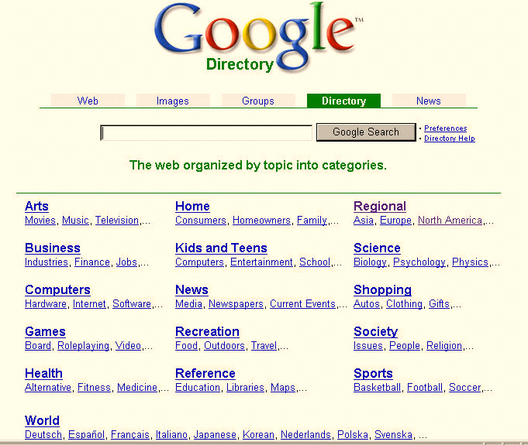
Google directory

Slide 12
Using search engines
Problem:
  Suppose you want to find some information about Laser jet printers.
  You know different types of printers in a wide range of prices.
  You know that you want to buy a color printer.
Solution
  Launch your web browser
  In the address bar, write URL www.google.com and press enter
  The home page will appear, in the search textbox write “laser jet printers” including double quotes and click search button

Slide 13
Using search engines
Solution
  A new page will appear with a list of webpages that contain information about laser jet printers
  The list may consist of hundreds of thousands of pages
  You may change your search string to narrow down your search like “hp color laser jet printers”
  Note that search results will be less and more accurate than previous search
  The quotation marks tells that treat these words as a single phrase rather individual words

Slide 14
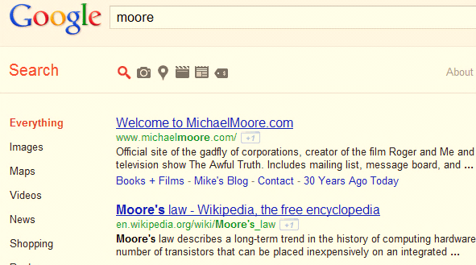
Search results of a search engine

Slide 15
Search Tips
Quote the exact phrase
Use the keyword AND
Use the keyword NEAR
Avoid common words
Use the site’s advanced tools

Slide 16
Using Boolean operators
Many but not all accept Boolean operators
Named after “George Boole” in 19th century
Three basic Boolean operators are used: AND, OR, and NOT.
Simply include them in the search text box between words
A few search engine also accepts NEAR operator. It determines the closeness of your keywords.
  For example, “printer NEAR color” with a closeness of 10 words.
  Looks for pages that include both terms but the terms are not more than 10 words apart.

Slide 17
Using Boolean operators
Operator | Search criteria | Effect
AND | Printer AND color | Looks only for pages that include both terms rather single term.
OR | Printer OR color | Looks for pages that include either or both of terms.
NOT | Printer NOT color | Looks for the term printer but do not include term color.
For example, (dog OR canine) AND cancer
Looks for pages that include either “dog,” “canine,” or both and then search for pages that also include cancer keyword.

Slide 18
Using Boolean operators
Some search engines also use symbols
  Plus sign (+) for AND operator
  Minus sign (-) for NOT operator
Many search engines use Boolean logic by default i.e. you may not need to include an operator in some searches
  For example, dog canine
The best way to determine how any search engine works is to study Help related pages.
  Help section tells you that how you can use operators with that search engine.

Slide 19
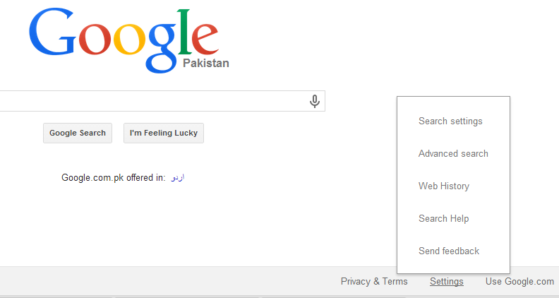
Google search engine help

Slide 20
Using Advanced Search
Advanced search
  Avoids duplicate and irrelevant results
  Also called advanced tools
  Helps to refine your search to provide best results
  Allows both “phrase-based search” or use of “Boolean operators”
  For example, yahoo advanced search
    Provides a separate form that lets you use multiple words and phrases

Slide 21
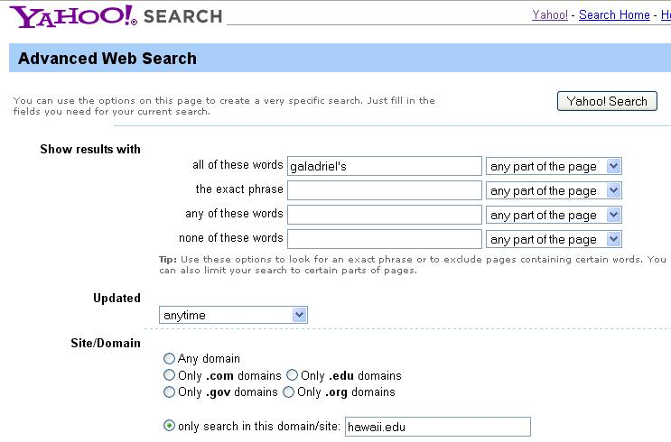
Example of advanced search

Slide 22
Using a Metasearch engine
Metasearch engine
  Search several websites at once
  Use multiple search engines simultaneously to look up sites relevant to search keywords
  Useful when you are not sure which keywords to use or if you need a long list of related sites
Examples
  Mamma at www.mamma.com
  Dogpile at www.dogpile.com

Slide 23
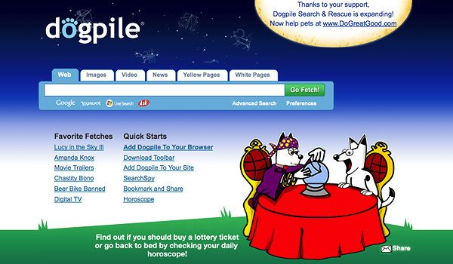
Example of Metasearch engine

Slide 24
Sponsored versus Nonsponsored links
Sponsored links
  Sites pay for better search results
  Sites owners pay a search engine to place the site at the top of the list
  Controversial because they are not always the most relevant to the user needs
  Some search engines display sponsored links separately
Nonsponsored links
  Do not purchase listings

Slide 25
Using site-specific search tools
Site-specific search tools
  Large websites have their own internal search
  May let you search outside that particular site
    For example, ZDNet’s site- www.zdnet.com
    You can enter one or more keywords and decide whether you want to search this site or entire web
Examples
  Microsoft corporation- www.microsoft.com
  CNN- www.cnn.com
  Netscape communications- www.netscape.com

Slide 26
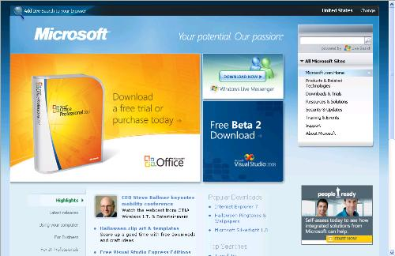
Example of site-specific search

Slide 27
Using specialized websites
www.wikipedia.com
Encyclopedia to explore information any topic
www.proteacher.com
This website has teaching ideas and resources, lesson plans etc. for elementary school
www.moneyinstructor.com
This website has worksheets, lessons and activities for teaching money, business and life skills.

Slide 28
Using specialized websites
www.educationworld.com
Educational research blogs, templates, tutorials, worksheets, lesson plans are many other articles with very good ideas for teachers are available on this site
www.pbs.org
A variety of videos, on culture and society, history topics, science and nature, etc. are available on this site
www.teachingideas.co.uk
Lesson ideas, plans, activities, resources which can be used by teachers in their classrooms are available on this site

Slide 29
Using specialized websites
www.learner.org
This site offers Teachers’ professional development and classroom resources and activities across the curriculum
www.geography-site.co.uk
A comprehensive site exploring geography with online lessons, revision sheets and easy to read information about geography topics
www.teachervision.fen.com/diversity/teacher resources/33631.html
Teachers could use the resources on this site to teach students to respect differences among people in their community and around the world

Slide 30
Activity- (20 minutes)
View and explore the following websites.
  www.educationworld.com
  www.proteacher.com
Pick a topic like introduction to computers and search the web for information about it.
  Change keywords by using Boolean operators
View, explore and use advanced search option in www.yahoo.com
Visit www.olx.com and find information about mobile phones.

Slide 31
Further reading
Introduction to computers, 7/e by Peter Norton
  Lesson 8A: The Internet and World Wide Web

Slide 32
Thanks
End of Lecture 08

Slide 33
Allah Hafiz

