Slide 1
Internet Basics
ADE100- Computer Literacy
Lecture 07

Slide 2
Knowledge test
What do you know about disk format?
What is disk fragmentation?
What is the purpose of device manager?
What happens when we perform disk clean up?
What do you mean by burning a CD?

Slide 3
Topics covered
Introduction to Internet and World Wide Web
Internet browsing applications
Web addresses and links
Interfacing with the Internet browser window

Slide 4
Internet
Internet
  A huge network of networks
  A global communication system that links together thousands of individual networks
Internet provide services
  To exchange messages and communicate in real time (seeing messages & responses immediately)
  To share data, programs and access limitless store of information

Slide 5
History of Internet
1969 – ARPANET
  Advanced Research Project Agency
  Developed by U.S Department of Defense
  Connected universities and defense bases
  The aim was to share computing resources
  Initially four primary host computers like servers
1973 – ARPANET
  Connected to Europe

Slide 6
History of Internet
Mid 1980s
  NSFNet (National Science Foundation)
  NSF funded the project when DOD stopped funding
  NSFNet is higher-capacity network than ARPANET
  Internet was the link between ARPANET, NSFNet and other networks (internetworking)
  Network between supercomputers
  Used for academic research
  No commercial traffic allowed
  A network backbone connects other elements of networks
Notes:
Discussion point
Have students discuss the pros and cons of no central control for the Internet. Some discussion points can include copyright issues, free speech, advertisements and information access to all.

Slide 7
History of Internet
1990s
  ARPANET shut down
  NSFNet was discontinued
  Commercial networks take over

Slide 8
Today and the Future
100,000 new web sites per month
More than 50% of U.S. households online
Access is available throughout the U.S.
Eventually access will be global

Slide 9
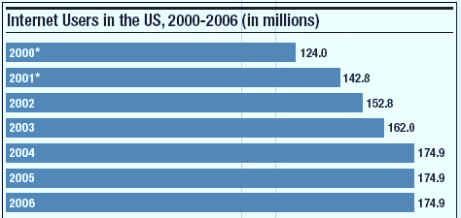
U.S. Internet Growth

Slide 10
Major Services of Internet
The World Wide Web (WWW)
  Developed in 1993 by Tim-Berners Lee at European Particle Physics Lab in Geneva, Switzerland
  Web of interconnected information/documents
  Required a browser to read documents
  Web is a service (a system of accessing documents) that is supported by the internet
Electronic mail (e-mail)
  Instantaneous transmission of documents

Slide 11
Major Services of Internet
News
  Often called newsgroups
  Electronic discussions on several topics
File Transfer Protocol (FTP)
  Sends and receives files
Notes:
Teaching tip
Show a typical news group to the students in class. Be sure that you have connected and downloaded all posts before trying the demonstration.
Demonstrate the use of ftp to change a web site.

Slide 12
Major Services of Internet
Chat
  Public real time conversation
Instant messaging
  Private real time conversation
Peer-to-peer services
  Allows sharing of files among users
  Napster and Kazaa are examples
  Illegal to share copyrighted material
Notes:
Discussion point
Recently the pop artist Madonna posted several copies of her songs on Kazaa and other file sharing services. Instead of music, she talked at length about copyright infringement through music sharing. In retaliation, hackers hit her website and temporarily made her songs free to purchase. Who is right?

Slide 13
Accessing The Internet
Internet Service Provider (ISP)
  Company that provides Internet access
Dialup
  Connects to Internet through phone line
  Modem connects to the phone line
  Slow connection
High-speed access
  Connect through a special line
  2 – 25 times faster than dialup
  DSL, Cable are common

Slide 14
Understanding the Internet
The Internet allows accessing resources
The Web simplifies the Internet
The Web connects documents
  Hypertext creates links between documents
  Documents are stored on a web server
  HTTP delivers documents
Notes:
Teaching tip
Find out who has a web presence. If the site is appropriate, display it in class. Have the student discuss what is needed to establish and maintain a web presence.

Slide 15
Understanding the Internet
Web site is a collection of documents
  Document is a web page
  Pages are published to the web
HTML- Hypertext Markup Language
  Creates web pages
  Describes how pages should look
  Content enclosed in tags
  <tag> content </tag>
Notes:
Teaching tip
Show your students how to access the HTML of an appropriate web site.

Slide 16
Understanding The Internet
Browsers
  Read and translate HTML documents
  Display web content
Uniform Resource Locator (URL)
  Address of a web page in a special format
  Syntax/format: type://address/path
    Type: type of server in which file is located
    Address: address of the server
    Path: location of file on the server
Notes:
Teaching Tip
Dissect the URL provided.

Slide 17
URL
Address of a server that uses HTTP
Site is run by a Govt. agency- Library of Congress (LOC)
This site is on part of internet known as WWW.
Finds specific pages about ongoing exhibits @ Library.
Browser will open a folder exhibits and then a subfolder treasures

Slide 18
Understanding The Internet
Helper applications
  ‘Plug-ins’ required to run special contents online like special formats of audio & video files.
    Adobe flash player
  Enhance a browser’s functionality
Streaming audio and video
  Sends the file in small chunks
  Chunks downloaded while others play
Notes:
Teaching point
Direct the students to several different streaming video sites. Www.launch.com and www.apple.com/QuickTime are two excellent examples. Be sure your classroom browsers have the appropriate plug-ins.

Slide 19
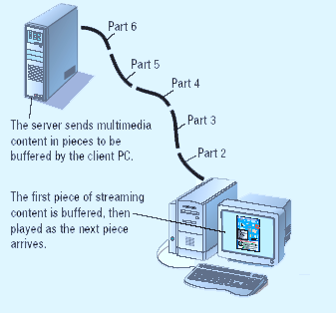
Streaming Audio

Slide 20
Using a Browser And WWW
Browser starts on the home page
Navigating the web
  Enter a URL in the browser
  Click a link
  Links are typically blue underlined words
  Image maps are picture links
When finished, close the browser

Slide 21
Interfacing with Internet Browsers
Internet browser
  A program that allows to access the web pages
  Displays web contents like audio, video, images, animations, etc.
Examples
  Internet explorer
  Google chrome
  Mozilla Firefox
  Apple safari
  Netscape

Slide 22
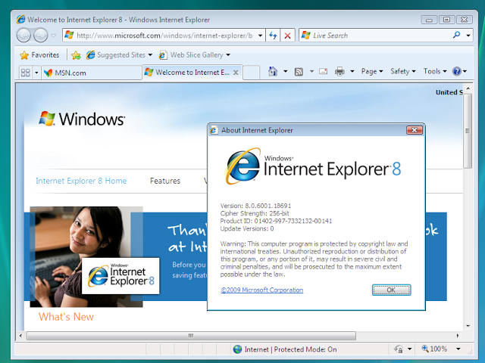
Internet explorer

Slide 23
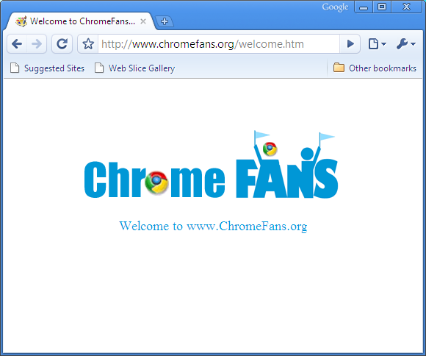
Google chrome

Slide 24
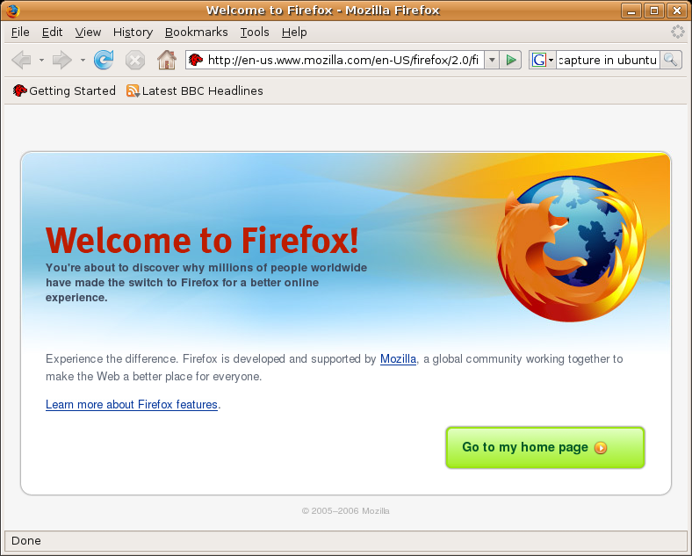
Mozilla Firefox

Slide 25
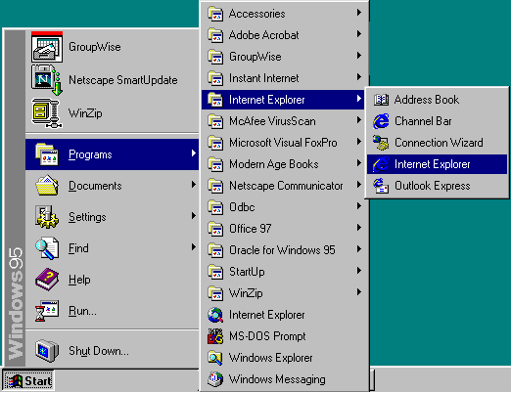
Launching your browser
You can open your browser from
  Start menu
  Quick launch
  Desktop shortcut

Slide 26
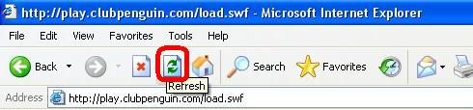
Refreshing a webpage
Refresh a web page
  Reloads web page if it does not display properly

Slide 27
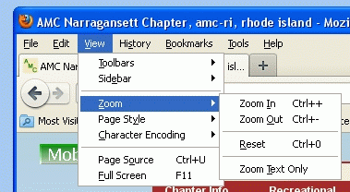
Zoom a web page
Zoom a web page
  Decreases or increases the size of contents on the web page

Slide 28
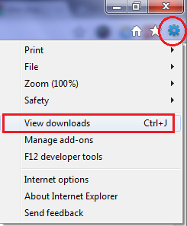
View your downloads

Slide 29
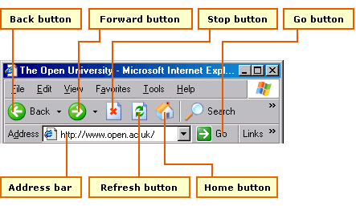
Navigating the web

Slide 30
Navigating the web
Navigating the web means
  Moving from one web page/website to another
Different ways to navigate the web
Using URLS
  Every website has a unique address
  Browser finds the URL page and transfer to your PC
  Several ways to enter URL
    Type URL in address box
    Click a hyperlink
    open from Favorites list

Slide 31
Navigating the web
Using hyperlinks
  Hyperlink is a part of webpage, linked to a URL
  May appear as text, image, button or arrow
  Usually underlined
  When your mouse pointer touches hyperlink text, the pointer shape changes to resemble a hand with a pointing index finger
Using browser navigation tools
  Bookmarks
  Back and forward buttons
  Choose a URL from history list in the address box

Slide 32
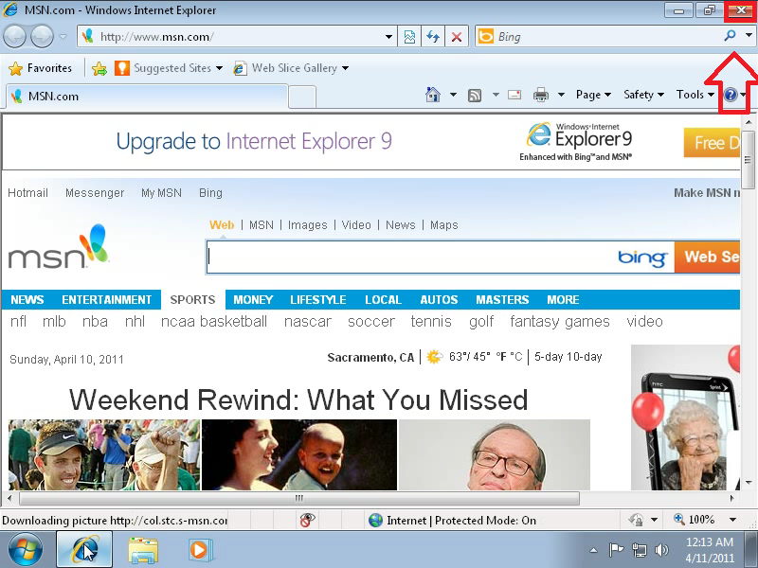
Closing your browser

Slide 33
Getting help with your browser
Open browser’s Help menu
Choose Contents and Index (depending on browser, it may be Contents, Help Contents or something similar)
A Help window will appear listing all the topics
Select a topic of your interest and its help will be opened.
When done then click Close button

Slide 34
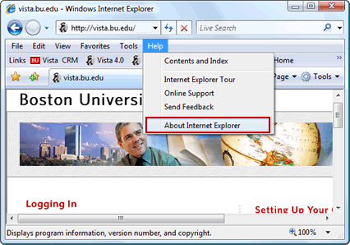
Getting Browser Help

Slide 35
Activity- (20 minutes)
Open and explore menu bar, toolbars, scroll bars and buttons of your browser.
Enter some URLs you know from address box.
Choose a URL from your favorites and bookmarks.
Move from your current webpage to the previous and then next page you currently viewed.
Go to your home web page.
Refresh or reload a web page.

Slide 36
Activity- (20 minutes)
Zoom in and Zoom out your web page.
View your browser settings.

Slide 37
Further reading
Introduction to Computers, 7/e by Peter Norton
  Lesson 8A: The Internet and the World Wide Web

Slide 38
Thanks
End of Lecture 07

Slide 39
Allah Hafiz

