Slide 1
Interfacing with Computer
ADE100- Computer Literacy
Lecture 06

Slide 2
Knowledge test
What is the difference between drives and folders.
What is the purpose of file extensions? Give two examples.
What is the purpose of windows explorer?
Differentiate between cut and copy.
What is the purpose of Read-Only file attribute.

Slide 3
Topics covered
Types of storage devices
Practically knowing and accessing storage devices/drives
Data transfer between different storage devices

Slide 4
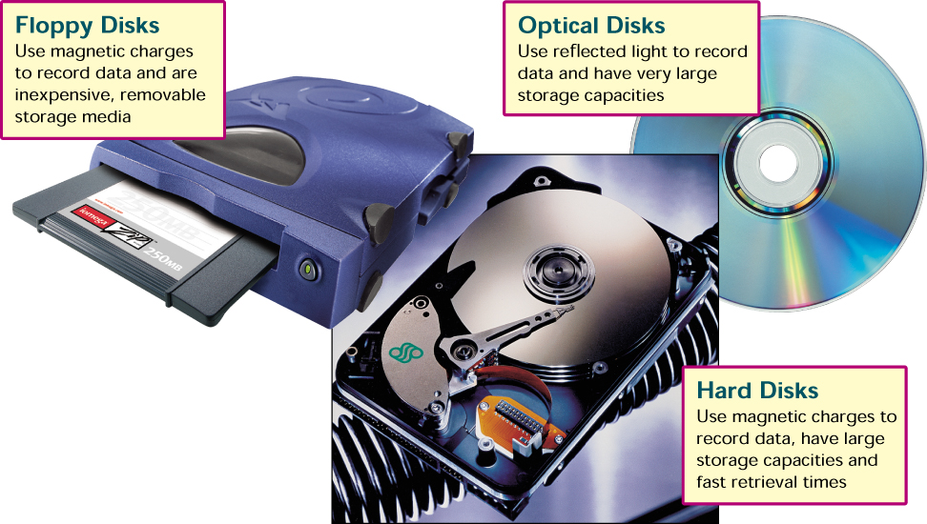
Storage devices

Slide 5
Measuring & Improving Drive Performance
Average access time
  Also known as seek time
  Time to find desired data
  Measured in milliseconds
  Depends on two factors
    RPM- Revolutions Per Minute
    Time to access a track
  Hard drive between 6 and 12 milliseconds
  CD between 80 and 800 milliseconds
Notes:
Teaching tip
To provide contrast, present the speed of memory as measured in the nanoseconds, or billionth of a second. Then discuss virtual RAM as defined earlier in the text. More RAM, less virtual RAM makes a faster machine.

Slide 6
Drive Performance
Data transfer rate
  How fast data can be read
  Measured in Bps or bps
  Hard drive ranges from 15 to 160MBps
  CD ROMS depend on X factor
    24x CD transfers 24 x 150KBps
  Floppy disks transfer at 45KBps
Notes:
Insider information
Most hard disks do not list the time to access a track. This is a good topic to tread lightly with.

Slide 7
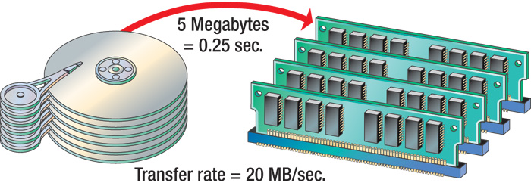
Data Transfer Rate

Slide 8
Optimizing Performance
Disk optimization (boosting)
  Handled by operating system tools
  Routine disk maintenance
  Optimization should be run monthly

Slide 9
Optimizing Performance
Clean up unnecessary files
  Delete temp files
  Uninstall unused programs
  Delete obsolete data files
  Files should be cleaned weekly
Notes:
Teaching tip
Figure 6B.3 on page 249 shows the disk cleanup utility for Windows XP.

Slide 10
Optimizing Performance
Scan a disk for errors
  Bad spots on the media
  Find and fix the error
    Move data to a good spot
    Mark the spot as bad
  Disks should be scanned monthly

Slide 11
Optimizing Performance
Defragment a disk
  Files fragment when resaved
  Fragmented files load slower
  Defragment puts the fragments together
  Disks should be defragged monthly
Notes:
Insider information
Windows 9x required the screen saver to be disabled before running scan or defrag. Failing to disable the screen saver could lead to catastrophic data loss!

Slide 12
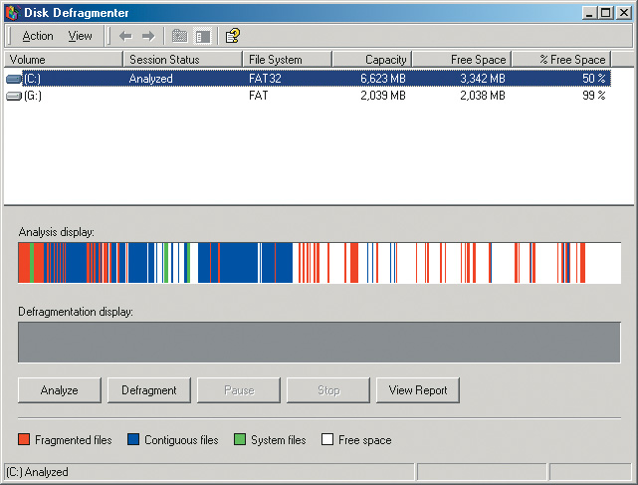
Defragment

Slide 13
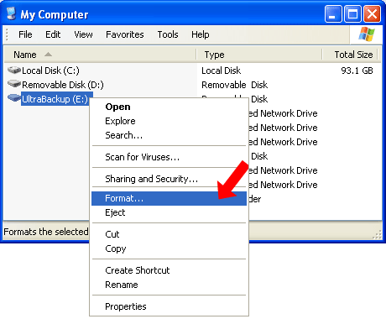
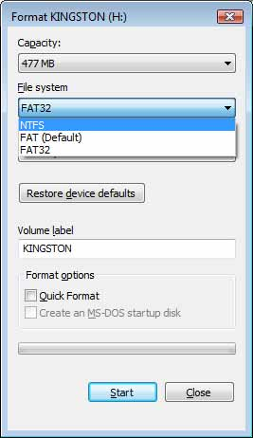
Formatting a disk

Slide 14
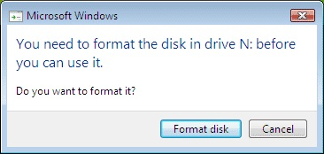
Formatting a disk
Login with administrator account
Open My Computer
Select a drive like USB-flash drive, right click and select Format option from the menu
Format dialog box will appear, you may change file system NTFS or FAT-32
You may change volume label then select quick format option
Click start button

Slide 15
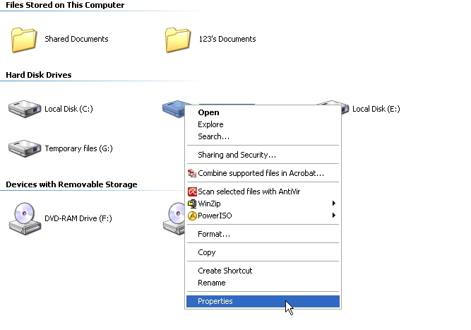
Viewing drive properties

Slide 16
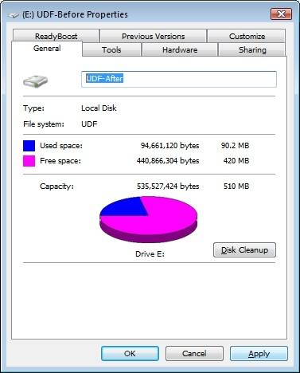
Rename volume label of a disk
Login with administrator for this action
Right click drive icon on My Computer
Select properties from menu

Slide 17
Viewing device manager
Right click My Computer
Select Manage option from menu
Select device manager from computer management window

Slide 18
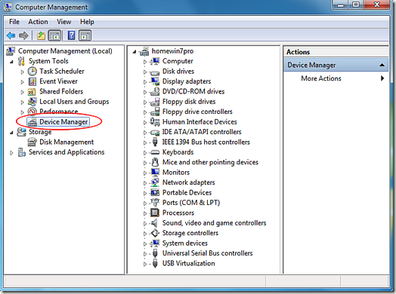
Device manager

Slide 19
Activity- (20 minutes)
View Device Manager and properties of any device.
View properties of a drive and change its volume label.
Format your USB-flash drive.
Defragment one of your disk drive.
Perform disk clean up operation on the drive in which windows is installed.

Slide 20
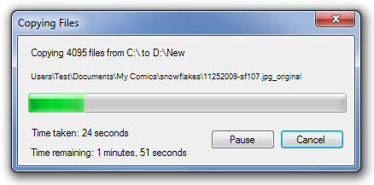
Copy to/from hard disk

Slide 21
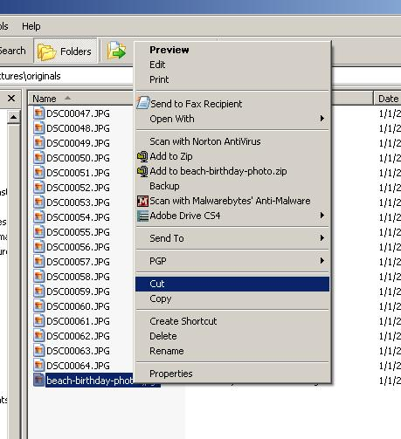
Moving to/from hard disk

Slide 22
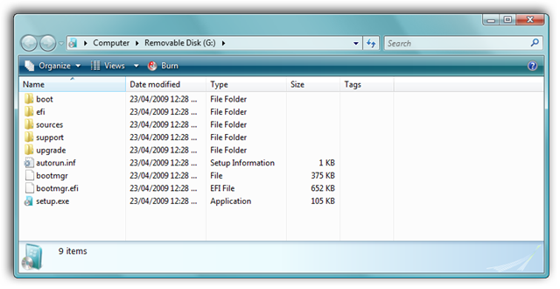
Copying from USB-flash drive

Slide 23
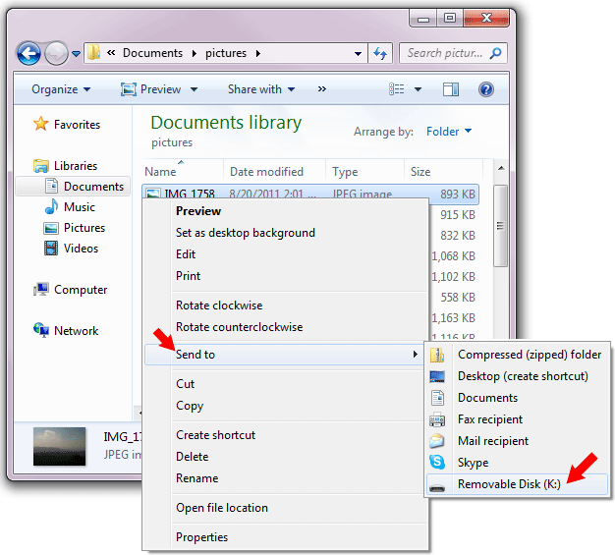
Copying to USB-flash drive

Slide 24
Playing files from CD-ROM
Insert CD-ROM in the CD drive
Wait if Auto run then opens automatically OR
Open My Computer and double click the CD drive icon
Navigate through files and folders and find your desired file
Double click the file, file will be opened if that program is installed in your computer

Slide 25
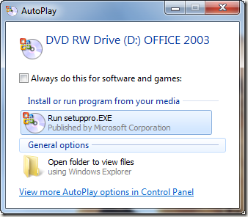
Playing a CD-ROM

Slide 26
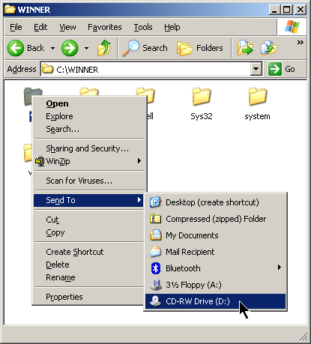
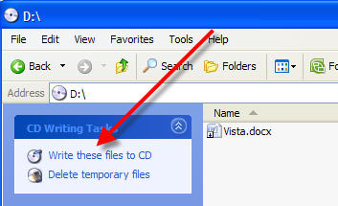
Writing files to a CD-R
Step 1
Step 2

Slide 27
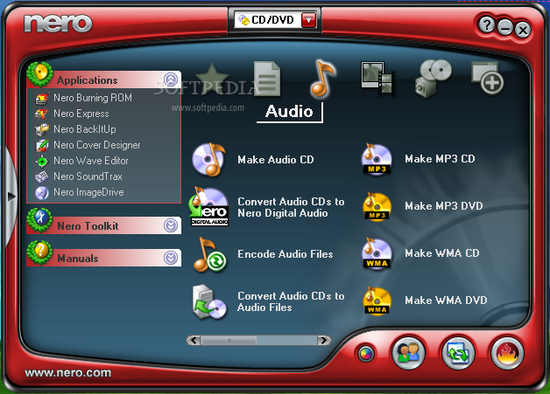
CD/DVD burner program

Slide 28
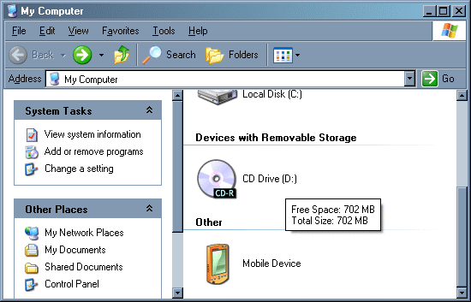
Copy files from CD

Slide 29
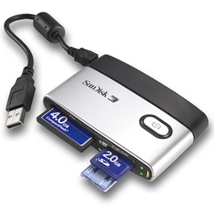
Copying to/from memory card
Memory card
  Stores data in Gigabytes
  Needs a card reader
Copying data
  Connect like USB-flash drive
  Select & copy files from memory card
  Paste them in a hard disk drive
  Similarly you can transfer files to memory card from hard disk

Slide 30
Activity- (20 minutes)
Copy files/folders from one drive to another drive on the hard disk.
Drag and drop a folder from one location to another.
Copy files from a CD/DVD to hard disk drive.
Copy files to/from hard disk to/from USB-flash drive.
Write files to a CD-R using CD-writer.

Slide 31
Thanks
End of Lecture 06

Slide 32
Allah Hafiz

