Slide 1
Interfacing with Computer
ADE100- Computer Literacy
Lecture 05

Slide 2
Knowledge test
Differentiate between icons and shortcuts.
Name five icons of control panel and their functions.
What is the purpose of start menu?
What is help and support center?
How can you change a default printer?
What are the elements of taskbar?

Slide 3
Topics covered
Concept of files and folders
File and folder properties

Slide 4
Drives, folders and files
Drives
  Store data
  At least two drives, A:\ for floppy & C:\ for hard disk
  A,B,C,D,E,F drive letters
  A & B for floppy drives, C D E F for hard drive
  Last drive letter for CD/DVD drive
Folders
  Organize data stored on the drives
  Files of a program are stored in its own set of folders
  Store similar files in a folder
  Directory is the path given to a folder on a drive e.g. C:\My Documents

Slide 5
Drives, folders and files
File
  Collection of related data stored under a single name
  The information you create using a program is stored in data files
  The instructions used to run a program are stored in program files
File extensions
  Ending letters associated with a file
  Tells the type of file and the application in which it can be opened

Slide 6
File extensions
.doc = Microsoft word document
.xls = Microsoft excel document
.ppt = Microsoft power point
.mdb = Microsoft Access database
.bmp = Windows bitmap pictures
.wav = Sound file
.html or .htm = Internet document

Slide 7
Filing Cabinet Analogy
Disks can be thought of as drawers in a filing cabinet
At present, we have a cabinet in which we could start throwing files into the various drawers,
  But there would soon be a large number of program and data files, with no order or plan

Slide 8
Managing files and folders
Files or documents
  Organized by storing in folders
Disks contain folders that hold files
  USB drives
  Compact discs (CDs)
  Digital video discs (DVDs)
  Hard disks
Removable disks are inserted into a drive
New Perspectives on Microsoft Office Excel 2007

Slide 9
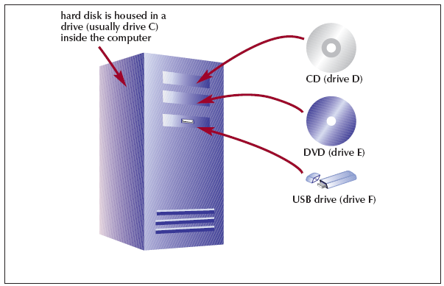
Organizing Files and Folders
New Perspectives on Microsoft Office Excel 2007
Notes:
Figure 1

Slide 10
Need for Organizing Files & Folders
Windows organize files & folders in a hierarchy, or file system like FAT, NTFS
Root directory
  Stores the folders and important files that it needs to Turn ON the computer
Subfolders
  Folders stored within other folders
New Perspectives on Microsoft Office Excel 2007

Slide 11
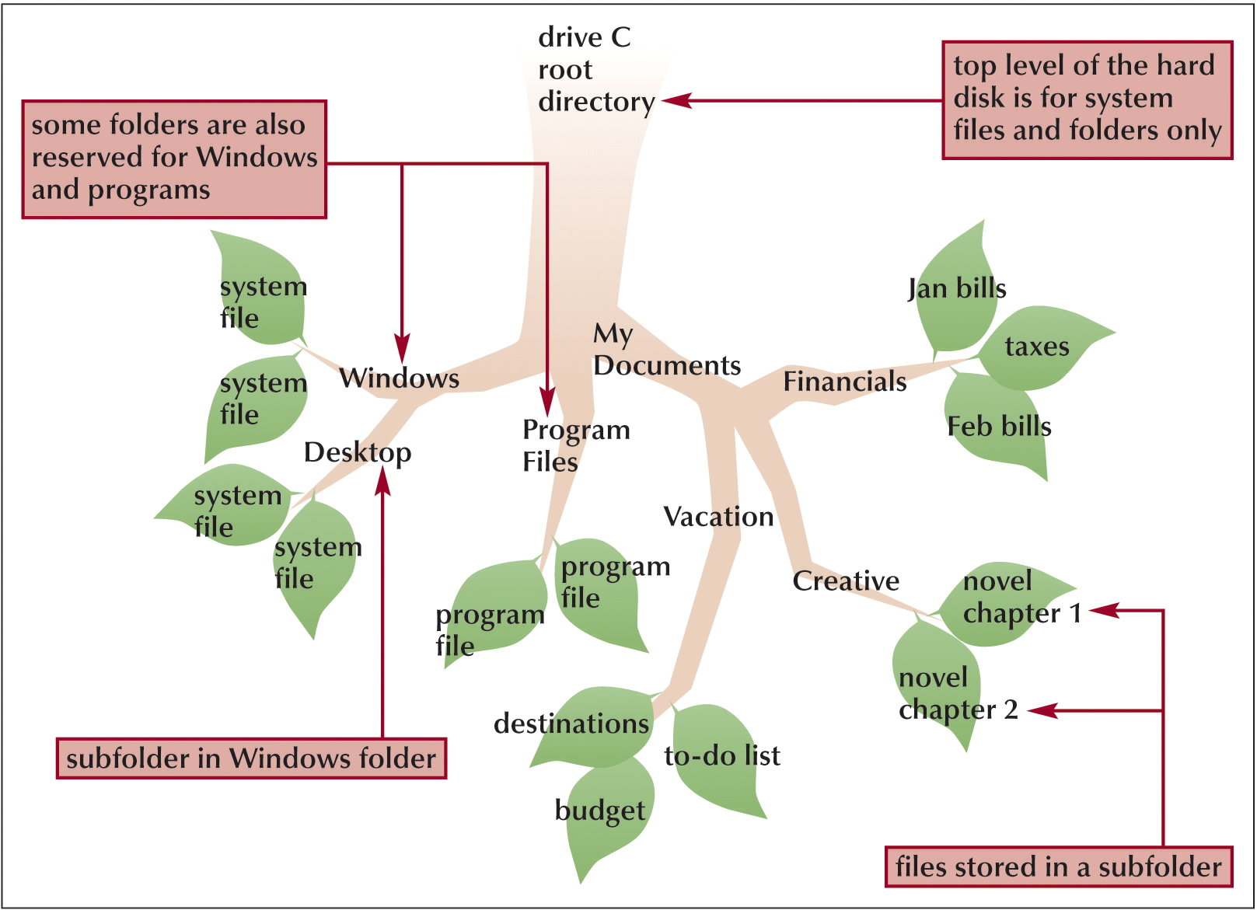
Need for Organizing Files & Folders
New Perspectives on Microsoft Office Excel 2007
Notes:
Figure 2

Slide 12
Strategies for Organizing Files & Folders
Type of disk you use to store files
  Determines how you organize those files
Storing files on removable media
  Allows you to use simpler organization
The larger the medium,
  The more levels of folders you should use
Documents folder
You should have a backup or duplicate copy of important files
New Perspectives on Microsoft Office Excel 2007

Slide 13
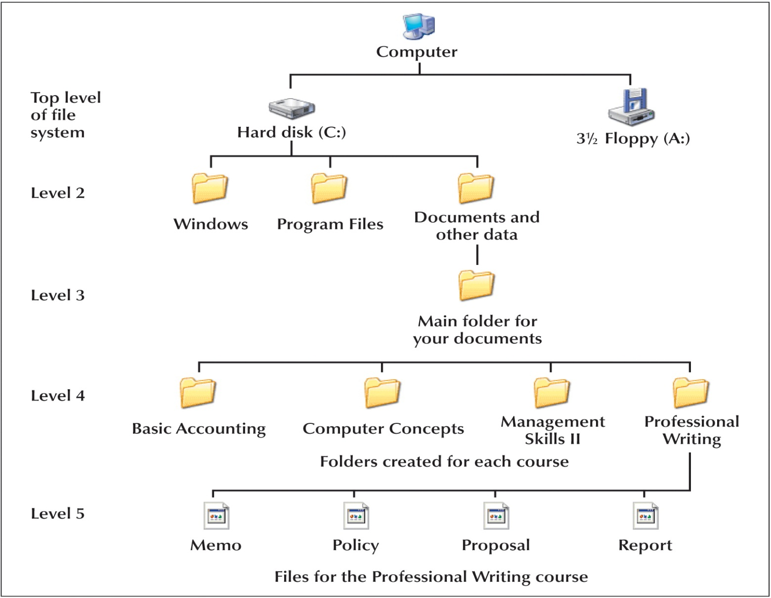
Strategies for Organizing Files & Folders

Slide 14
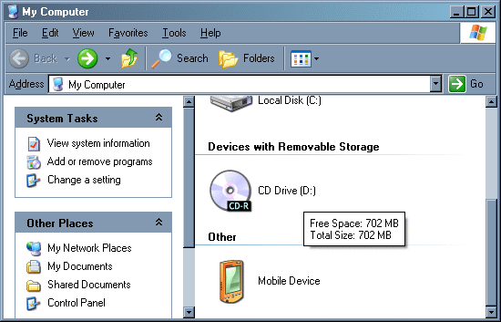
My Computer

Slide 15
Windows Explorer
Windows Explorer shows the files, folders, and drives on your computer
  Panes
    Explorer bar
    Folders pane
  Expand icon
  Collapse icon
My Computer shows the drives on your computer

Slide 16
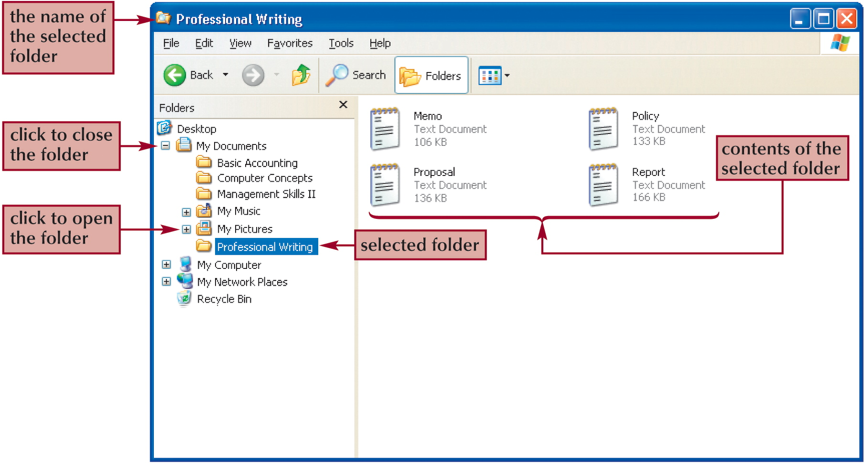
Windows Explorer

Slide 17
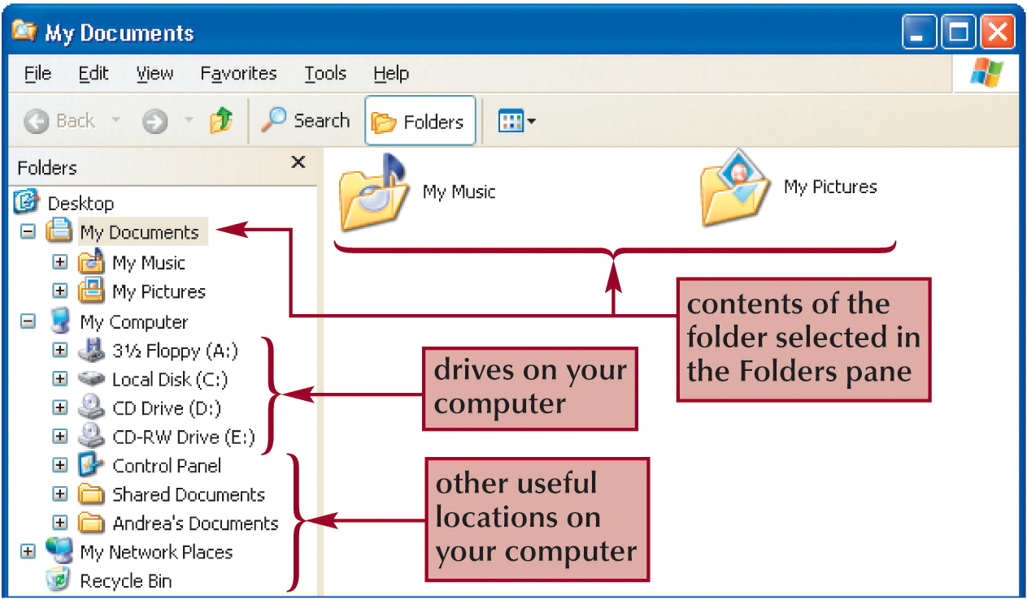
My Documents folder

Slide 18
Navigating to Your Data Files
The file path
  Indicates the location of file on your computer
Example: A:\FM\Tutorial\Holiday.bmp
  A: is the drive name
  FM is the top-level folder on drive A
  Tutorial is a subfolder in the FM folder
  Holiday.bmp is the full filename

Slide 19
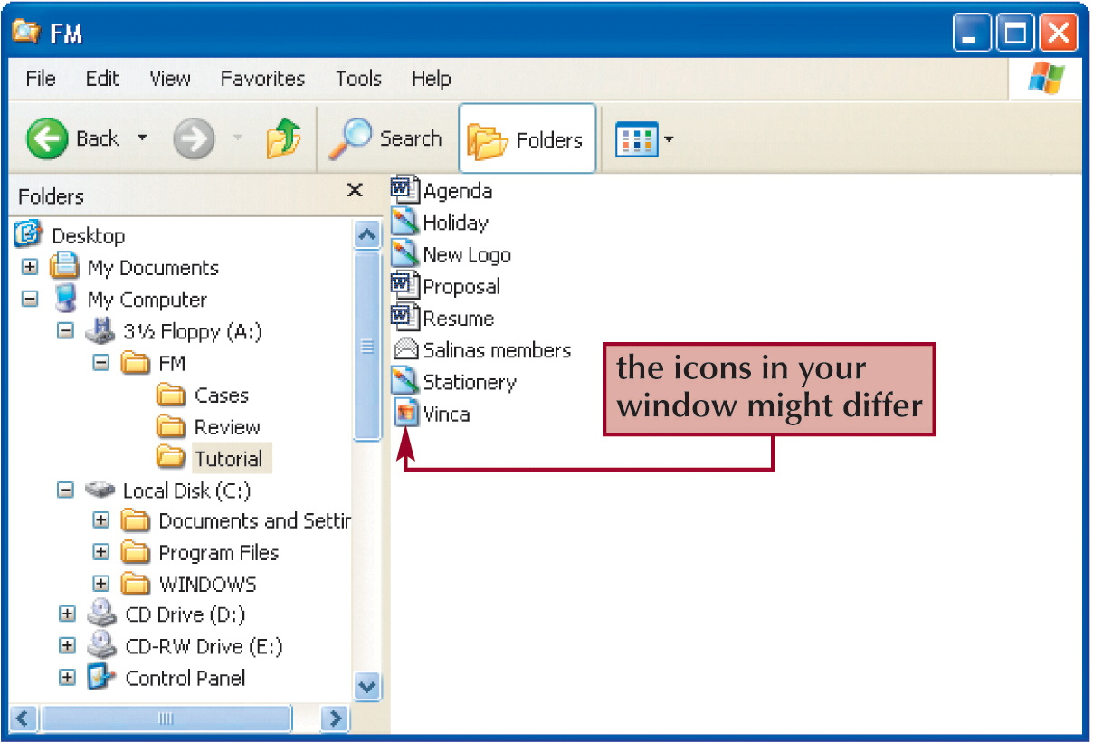
Navigating to Your Data Files

Slide 20
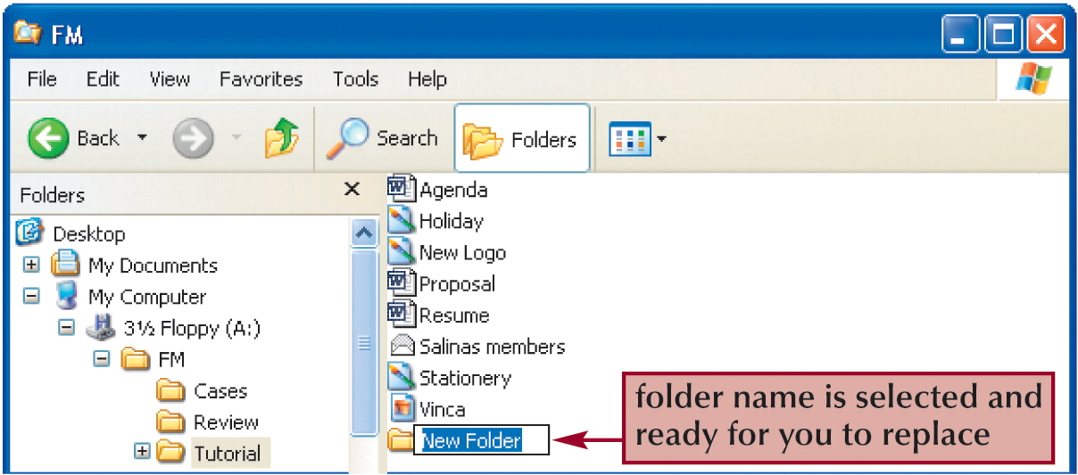
Operations on files & folders
Creating a NEW Folders
  Click File on the menu bar
  Point to New to display the submenu
  Click the folder and rename it

Slide 21
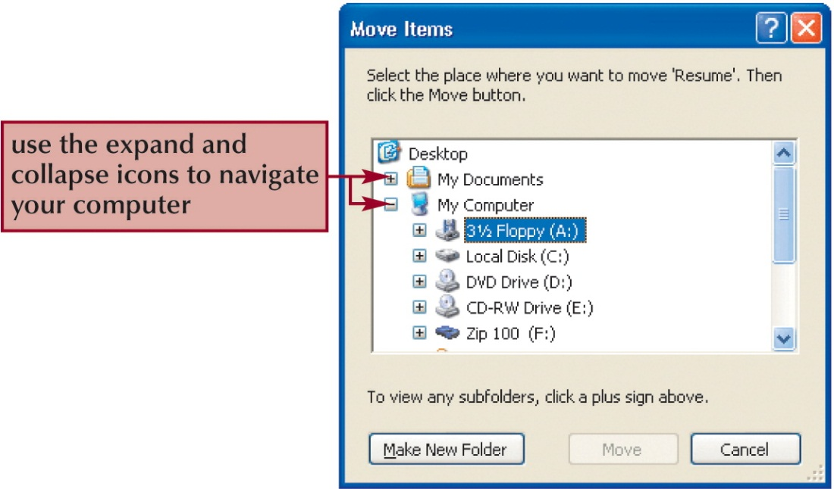
Operations on files & folders
Moving and copying files & folders
  Moving a file removes from its current location and places it in a new location you specify
  Copying places the file in both locations

Slide 22
Operations on files & folders
Naming & Renaming files
  Filename consists of
    Main part of the filename
    Dot
    File extension
Example: abc.txt, myfile.docx
Folder names have no extensions
  For example, My Documents, My Pictures

Slide 23
Operations on files & folders
Deleting files and folders
  The Recycle Bin is an area on your hard disk & holds deleted files until you remove them permanently

Slide 24
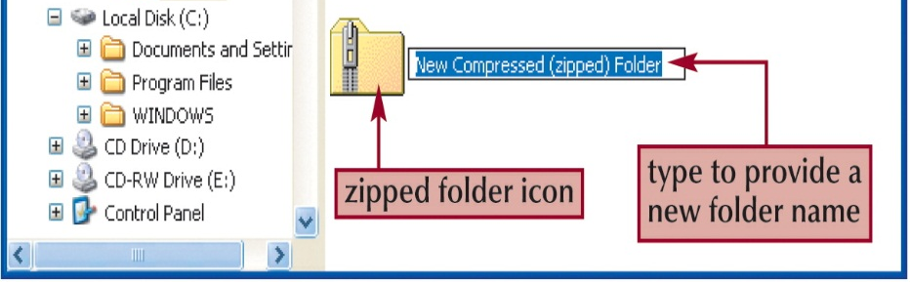
Operations on files and folders
Files stored in a compressed (zipped) folder
  Takes up less disk space
  Allows you to transfer files more quickly
Extracting a file
  Creates an uncompressed copy of the file in a folder you specify
  While the original file remains in the compressed folder
Compression programs
  WinZip
  WinRAR

Slide 25
Arrangement of files and folders
Files, folders and icons can be arranged in four different ways
By name
  Sorts in ascending alphabetical order by filename
By type
  Sorts in ascending alphabetical order by file type
By size
  Sorts in ascending alphabetical order by name
  Then arranges by size, smallest at the top of list
By date
  Sorts folders by descending order
  Then sorts files similarly, newest files at the top

Slide 26
How to arrange files and folders
Open a folder
Right click at a blank place. A context menu will appear
Select arrange icons from menu. A submenu will appear.
Select your option and click it

Slide 27
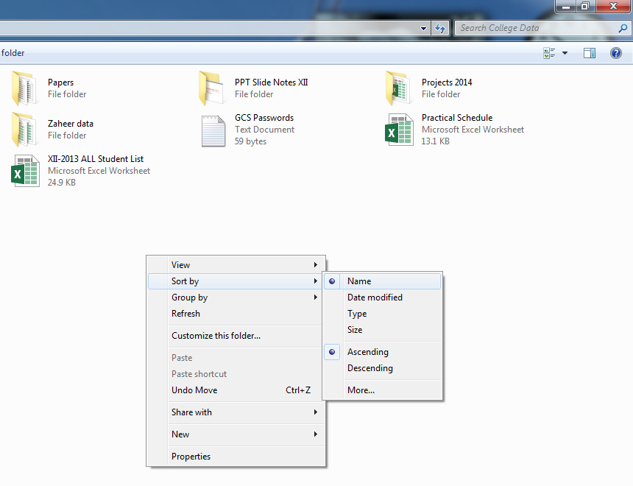
Arranging files and folders

Slide 28
Attributes of files and folders
Files and folders have four special attributes
Read-only
  Prevents changes to files and folders
Hidden
  Hides the files
Archive
  Marks files that have been changed after last backup
System
  Prevents the display of files and folders required by the system

Slide 29
Viewing attributes of file or folder
Right click on the icon, file or folder. A shortcut menu will appear.
Choose Properties from the menu.
Click the General tab to see the current setting for attributes

Slide 30
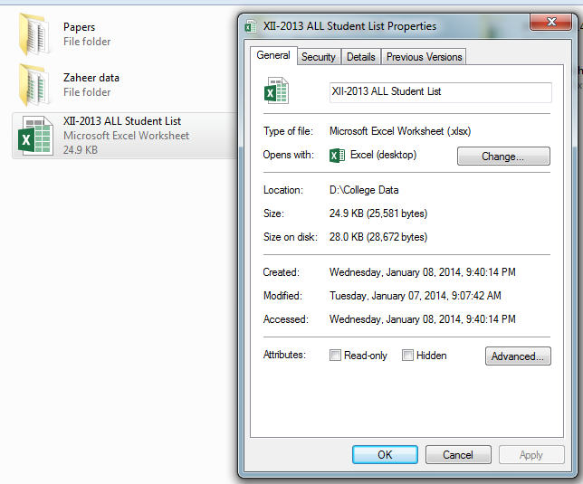
Attributes of files and folders

Slide 31
Changing the attributes of files or folders
Right click on the icon, file or folder. A shortcut menu will appear.
Choose Properties from the menu.
Click the General tab to see the current setting for attributes
Check or uncheck the properties box in Attributes section

Slide 32
Making files invisible
Open any folder window and choose Tools and then Folder Options
Click on the View tab
Select Do not show hidden files and folders and then click OK

Slide 33
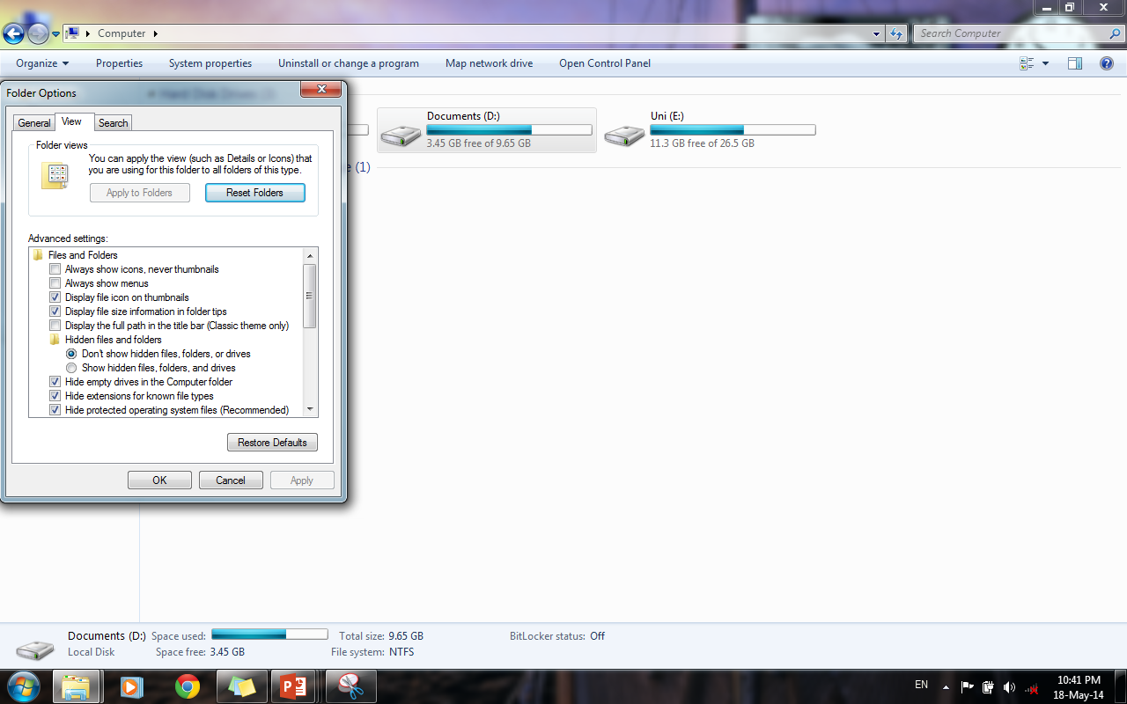
Making files invisible

Slide 34
Making hidden file visible
Open any folder window and choose Tools and then Folder Options
Click on the View tab
Select Show hidden files and folders option and click OK

Slide 35
Activity- (20 minutes)
Open and explore My Computer and Windows Explorer.
Create a folder on your desktop. Name it and then rename it.
Create a file in any program and then save it with your name.
View and change attributes of a file or folder.
Hide and unhide your files and folders.
Arrange files and folders by name, size, type and date.

Slide 36
Activity- (20 minutes)
Create a compressed folder using WinZip or WinRAR. Now un-compress this folder to view its contents.
Copy and move a file/folder to another folder.
Open a picture from My Pictures folder.

Slide 37
Thanks
End of Lecture 05

Slide 38
Allah Hafiz

