Slide 1
Interfacing with Computer
Associate Degree in Education (ADE)
Lecture 04
Sajid Riaz

Slide 2
Knowledge test
What are the main functions of an operating system?
What is the difference between DOS and Windows?
What is the difference between toolbar & menu bar?
What happens when you minimize a window?
What is the purpose of title bar?

Slide 3
Topics covered
Working with the operating system
  Start/shut down (menu, purpose, etc.)
  User window (menu, status)
  Basic concepts of desktop
  Control panel
  Using help in windows
  Using printers in windows

Slide 4
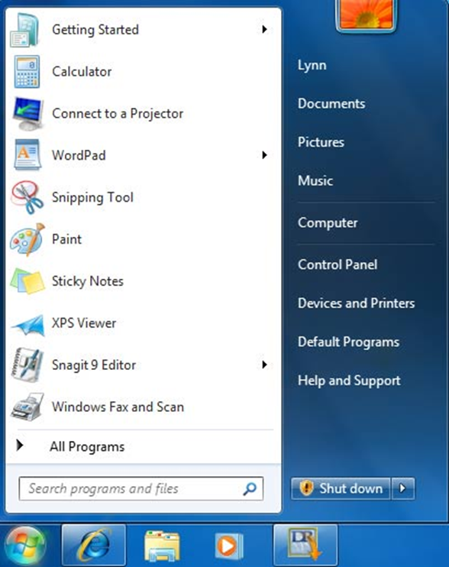
Start menu

Slide 5
Start menu
Start menu
  Activate when you click start button on taskbar
  Used to open documents, programs & change your computer settings, find help and shut down computer
Popular commands are:
  All programs
  Log off, Turn off computer
  Computer, Documents
  Pictures, Music
  Search, Run

Slide 6
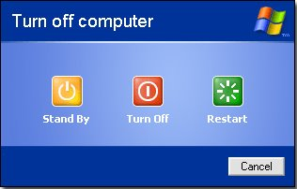
Shutdown dialog box of Win XP
Turn off
  Close the windows & shutdown your computer properly
Restart
  Close the windows & restart computer once again
  Used normally when install a new program or hardware
Standby
  Puts windows XP in an idle state

Slide 7
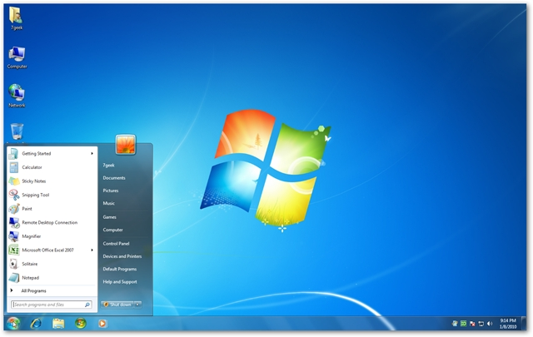
Windows desktop

Slide 8
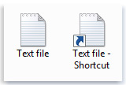
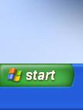
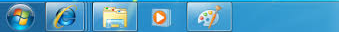
Windows desktop
Windows desktop
  Colored area on the screen
  The surface of screen look like a desk with objects like your personal desk so called desktop.
  It is the interface of windows which allows to interact with the computer.
Elements of desktop
  Icons
  Shortcuts
  Start button
  Taskbar

Slide 9
Desktop elements
Icons
  Graphical images
  Application icons, folder icons, file icons, drive icons
Shortcuts
  Graphical images that hold the address of a particular file
Start button
  Activates start menu
Taskbar
  Appears at the bottom of your screen.

Slide 10
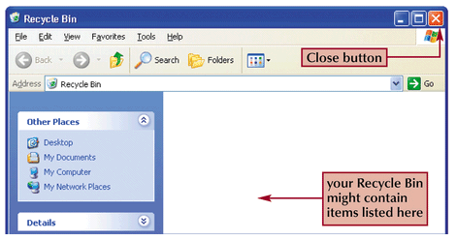
Recycle bin

Slide 11
Recycle bin
Restore
  Restores deleted files to their original locations
Empty recycle bin
  Delete all files and folders permanently
Size
  10% of your drive where windows is installed

Slide 12
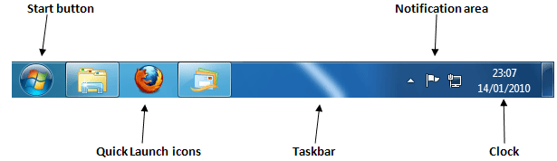
Elements of Taskbar

Slide 13
Taskbar elements
Quick launch toolbar
  Gives fast access to your frequently used programs
Task buttons
  Appears when you minimize a window
System tray
  Acts like a bin on the taskbar for active programs running in the background
  Such as antivirus, volume control, clock

Slide 14
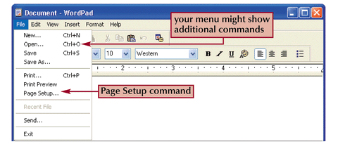
Menu bar and its status
Displays the program menu
You send commands to the program through menus
Disable

Slide 15
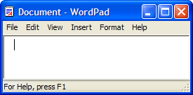
Status bar
Provides information about the status of your program
Status bar

Slide 16
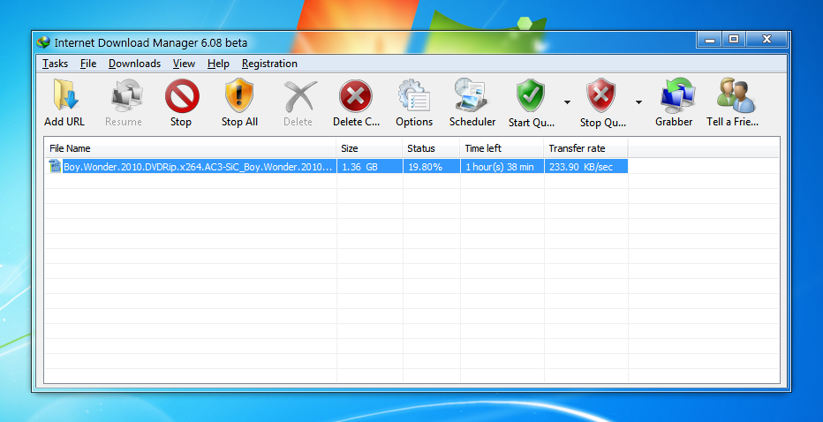
Toolbar
Occurs normally below the menu bar
Used to send commands to the program
Provide a quick access to commands

Slide 17
Activity- (15 minutes)
Open and explore start menu. Open different programs using this menu.
View and explore your desktop items like icons, shortcuts and taskbar.
Use different shutdown options of start menu.
Delete some files and folders and then restore them from recycle bin.
Delete some files and folders and empty your recycle bin.

Slide 18
Activity- (15 minutes)
Open Microsoft word and click different menus in menu bar and explore their working.
Open Microsoft word and move your mouse on icons and then use some icons to determine their functionality.
Note: Repeat these tasks two or three times.

Slide 19
Control Panel
Most important component of windows
The operation room from where you can configure your computer
  Change colors, add/remove software & hardware,
  Add/remove users, fonts, etc.

Slide 20
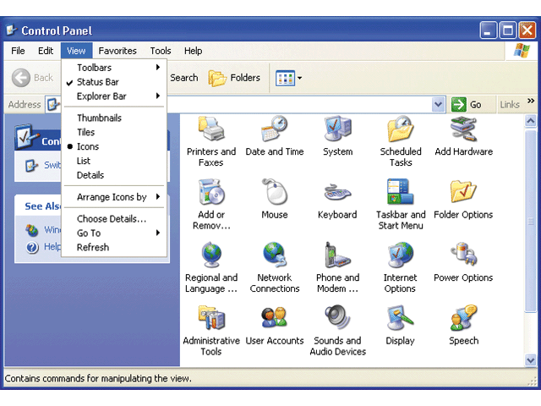
Control Panel window

Slide 21
Elements of control panel
Add hardware
Add/remove programs
Date/time
Fonts
Display
Internet options
Keyboard
Modem
Mouse
Printers
Sound
System
User Accounts
Region & language

Slide 22
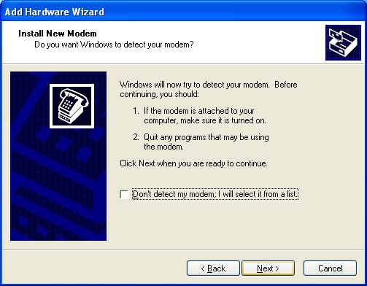
Add hardware

Slide 23
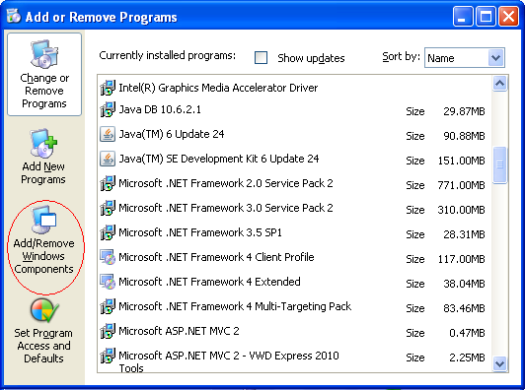
Add or Remove Programs

Slide 24
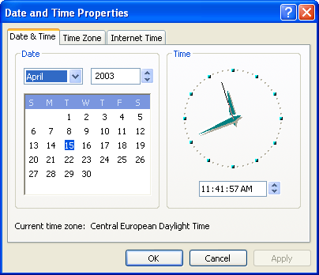
Date & time

Slide 25
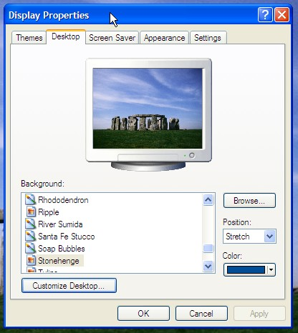
Display properties: Desktop tab

Slide 26
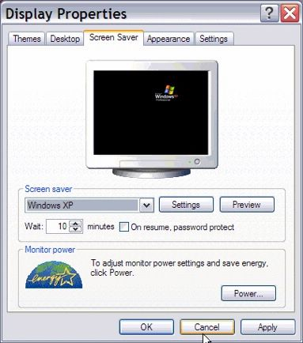
Display properties: Screen saver tab

Slide 27
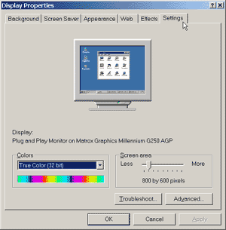
Display properties: Settings tab

Slide 28
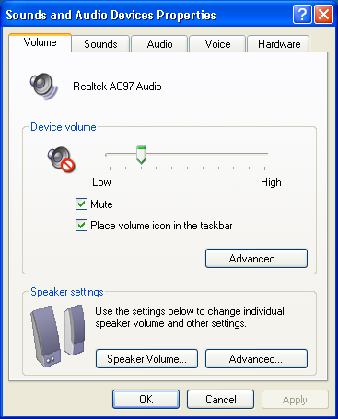
Sound

Slide 29
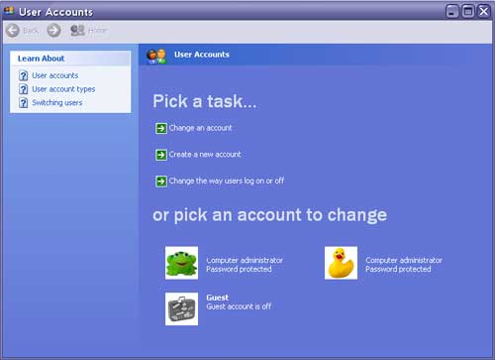
User Accounts

Slide 30
Using Help in Windows
Help and support center

Slide 31
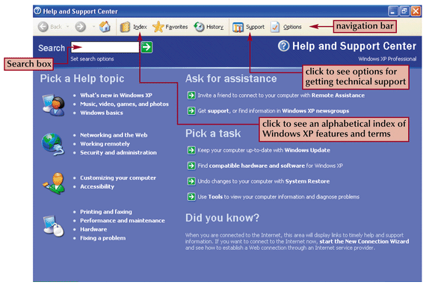
Help & support center window

Slide 32
Using Help
Windows Help
  Provides on-screen information about programs
  Available by
    Clicking the Start button and selecting Help and Support from the Start menu
    Or press F1 on the desktop
Windows Help and Support Center window
  Provides access to
    Help files stored on the computer
    Help information stored on Microsoft’s Web site

Slide 33
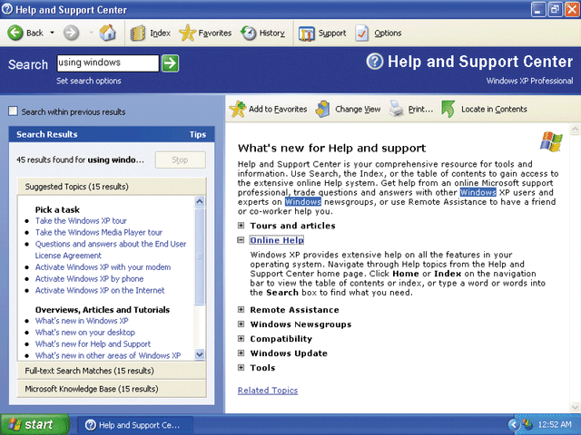
Search in help window

Slide 34
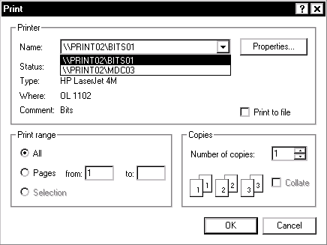
Selecting a printer

Slide 35
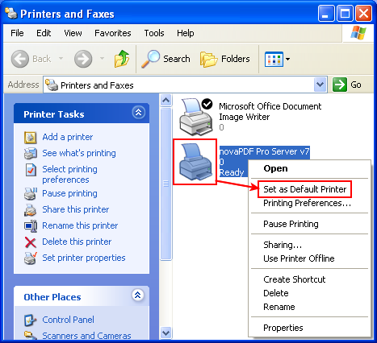
Changing a default printer

Slide 36
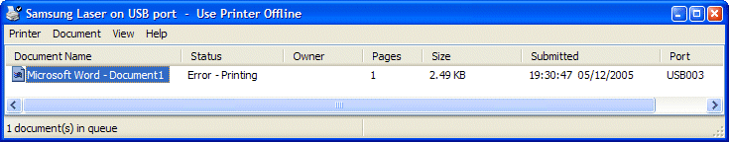
Checking the status of a printer
Select printers &faxes from control panel
Double click a printer to display its printing status

Slide 37
Activity- (20 min)
Open control panel and do the following actions:
  Install a new hardware
  Install/uninstall a program
  Change your system date and time
  Change your desktop background.
  Set or change a screen saver
  Change your monitor resolution
  Change your sound to mute
  Create a new user account and then remove it
Use help and support center of windows
  Search help for a particular topic like installing a hardware

Slide 38
Activity- (20 min)
Use printers
  Install a printer
  Select a printer
  Change your default printer
  Check the status of your printer

Slide 39
Further reading
Computer Applications in Business by Tasleem Mustafa published by it series.
  Chapter 6: Windows operating system
  Chapter 7: Managing Windows 2000 Professional

Slide 40
Thanks
End of Lecture 04

Slide 41
Allah Hafiz

