Slide 1
Computer Ethics & Computer Assisted Instructions
ADE100- Computer Literacy
Lecture 32

Slide 2
Knowledge test
What do you understand by CAD?
How computers are used in business?
How computers are used for communication?

Slide 3
Topics covered
Computer Ethics
  Code of ethics
  Computer crime
  Copyright law and fair-use guidelines and plagiarism
Computer-Assisted Instructions
  Computer as a teacher
  Use of computer-assisted instruction
  Online education (Example: Virtual University of Pakistan)

Slide 4

Quote from Aristotle
“Man, when perfected, is the best of the animals, but when separated from law and justice, he is the worst of all”

Slide 5

Computer ethics
Ethics
  The branch of philosophy concerned with what’s right and what’s wrong.
Computer ethics
  Deals with moral issues and the ethical principles for computer professionals.

Slide 6

Code of ethics
A professional code of ethics states
  The principles and core values that are essential to the work of a particular occupational group.
Association of Computing Machinery ACM
  Founded in 1947, has a code of ethics and professional conduct. See: http://www.acm.org/constitution/code.html

Slide 7
Code of ethics
Association of Information Technology Professionals
  AITP founded in 1996
  Provides quality IT-related education
  Information on relevant IT issues, and forums for networking with experienced peers and other IT professionals.
  The AITP also has a code of ethics
  http://www.aitp.org/join/SCOH17CodeEthicsStdsCdt.pdf

Slide 8
Code of ethics
Computer Society of the Institute of Electrical and Electronics Engineers (IEEE – CS)
  Founded in 1946
  The Software Engineering Code of Ethics and Professional Practice: http://www.acm.org/serving/se/code.htm
Project Management Institute (PMI)
  Established in 1969
  PMI Member Code of Ethics:
  http://www.pmi.org/info/AP_MemEthStandards.pdf

Slide 9

Common ethical issues for IT users
Software Piracy
  A common violation occurs when employees copy software from their work computers for use at home
Inappropriate Use of Computing Resources
  Some employees use their work computers to surf popular Web sites that have nothing to do with their jobs.

Slide 10
Common ethical issues of IT users
A Survey Report
Half of Fortune 500 companies have dealt with at least one incident related to
  Visiting unethical sites in the workplace over the past 12 months, according to a survey released today.
Corporations are taking the problem seriously:
  And fired the offenders in 44% of the cases
  And disciplined those responsible in 41% of the instances

Slide 11
Common ethical issues
Inappropriate Sharing of Information:
  Organizations stored vast amount of information that can be classified as private or confidential.
  Private data describes individual employees– for example, salary, attendance, performance rating, health record.
  Confidential information describes a company and its operations: sales, promotion plans, research and development.
  Sharing this information with unauthorized party, even unintentionally, has violated someone’s privacy or created the potential that company information could fall into the hands of competitors.

Slide 12

Computer crime
Computer crime or Cybercrime
  Any crime that involves a computer and a network.
  The computer may have been used in the commission of a crime, or it may be the target.
  Net crime is criminal exploitation of the Internet.

Slide 13

Computer crimes
Computer is used to commit a crime:
  Child abuse, threatening email
  Assuming someone’s identity, sexual harassment,
  Defamation (abusive attack on someone), spam,
  Phishing (stealing credit card password)
Computer as a target of a crime:
  Viruses, worms, industrial espionage (undercover)
  Software piracy, hacking

Slide 14

Hackers are everywhere
Deleting data for fun
  A lot of bored 16 year olds late at night
Turning computers into zombies (dead bodies)
  To commit crimes
  Take down networks
  Distribute porn
  Harass someone
Ethical/white hat hackers exist too
  Help break into networks to prevent crimes

Slide 15
Computer crime: Real case
in April 2004, the Sasser worm
  Hit IT systems around the world hard and fast
  Didn’t spread through e-mail, but moved undetected across the Internet from computer to computer
  Exploited the weakness in Windows XP and 2000
By the first week of May, American Express, the Associated Press, the British Coast Guard, universities and hospitals reported that
  Sasser worm has swamped their systems
Delta Airlines cancelled around 40 flights and delayed many others

Slide 16
Sasser worm
Microsoft posted a $250,000 reward
By mid-May, authorities arrested Sven Jaschan, a German teenager.
Jaschan confessed and was convicted after a three-day trial
He could receive up to five years in prison, but because he was tried as a minor,
  the court suspended his 21-month sentence, leaving him with only 30 hours of community service.

Slide 17
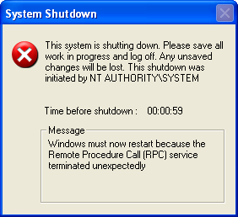

Sasser worm
Just a few month after Jaschan’s indictment,
  The Securepoint, a German IT security company hired him as a programmer
Lawyers disagree over punishment in Sasser trial

Slide 18
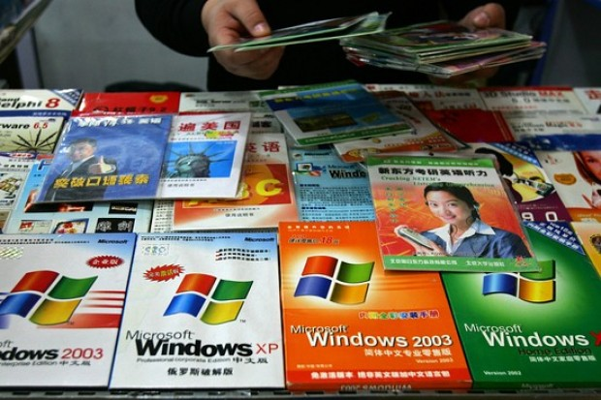
Compute crime
Software Piracy
  Selling software that contains all or part of a commercial software program
  Using shareware beyond its evaluation period
  Violating the terms of a software license
  Making copies of site-licensed programs for personal use
  Giving or selling commercial software to others

Slide 19

Computer crime
Copyright infringement
  An increasing number of Internet users are making illegal copies of music.
Copyright violators use:
  “It’s OK to download MP3 files if I only keep them for 24 hours.”
  “It’s free advertising for the group.”
  “It’s legal because I don’t charge any money for sharing them.”

Slide 20

Copyright law
Copyright law
  Protect drama, literature, music, graphics, architecture, sculptures, and other "intellectual works".
  These laws are designed to ensure that an artist is recognized and compensated for his work.
  They also prevent other people from passing the work off as their own.
  The person or company who holds the copyright is the only one legally able to reproduce, change, publish, sell, distribute, or perform the copyrighted material.
  Therefore, it is important to correctly cite any work you use that is not your own so that you do not violate copyright laws.

Slide 21
Software and copyright
Public domain software can be copied, sold, and modified.
Shareware is copyrighted software that can be used without a license for a specified time.
  Trial versions can be copied.
  When the evaluation period ends, a registration fee is paid for continued use of the software.
Commercial software is copyrighted.
  You must purchase the software to use it.
  Organizations purchase a site license to the uses of software on all of their computers

Slide 22
Fair-use guidelines
Give credit to the author
You paraphrase or quote small portions of someone else’s work,
  Provided that you give proper credit to the author for the material you use
If you don’t give credit,
  You will probably give at least some of your readers the impression that the material you borrowed originated with you.
  That’s bad. It’s so bad, it has a name, plagiarism, and it’s a form of fraud.

Slide 23
Fair-use guidelines
Online material and copyright
  The copyright holder has the same rights regardless of the format of the work (e.g., online, Web-based, CD-ROM).
  The right to copy the work remains with the owner, this includes a copy to your computer.
  If you make a copy for your personal use, it is likely to be regarded as fair use.
  If you post it to a public Web site, it is unlikely to be considered fair use

Slide 24

Fair-use guidelines
Online material and copyright
  Check if the copyright holder provides information on how his/her document or computer program may be used.
  If possible, get permission from the copyright holder and keep a record of the permission granted.
  If you intend to use something repeatedly, get permission.

Slide 25

Plagiarism
Plagiarism is the unauthorized and/or uncited use of someone else’s intellectual property.
  Intellectual property rights refer to an individual’s ownership over original works.
Copyright infringement is plagiarism of copyrighted material.
Legal implications of plagiarism:
  Dismissal from school
  Lawsuits (court cases)

Slide 26
Topics covered
Computer Ethics
  Code of ethics
  Computer crime
  Copyright law and fair-use guidelines and plagiarism
Computer-Assisted Instructions
  Computer as a teacher
  Use of computer-assisted instruction
  Online education (Example: Virtual University of Pakistan)

Slide 27
Computer-Assisted Instruction- CAI
Use of computer in education is referred by many names such as:
  • Computer Assisted Instruction (CAI)
  • Computer Aided Instruction (CAI)
  • Computer Assisted Learning (CAL)
  • Computer Based Education (CBE)
  • Computer Based Instruction (CBI)
  • Computer Enriched Instruction (CEI)
  • Computer Managed Instruction (CMI)

Slide 28
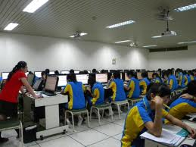
New Terminology
New terminology
  Web Based Training (WBT)
  Web Based Learning (WBL)
  Web Based Instruction (WBI)

Slide 29
What is CAI?
Computer-Assisted Instruction (CAI)
  Most often refers to drill-and-practice, tutorial, or simulation activities
  A self-learning technique, usually offline/online, involving interaction of the student with programmed instructional materials.
  An interactive instructional technique whereby a computer is used to present the instructional material and monitor the learning that takes place.
  Uses a combination of text, graphics, sound and video in enhancing the learning process.

Slide 30
Typical CAI Provides
Text or multimedia content
Multiple-choice questions
Problems
Immediate feedback
Notes on incorrect responses
Summarizes students' performance
Exercises for practice
Worksheets and tests.

Slide 31
Common categories of CAI
Drill and Practice
  A form of CAI that provides exercises designed to increase fluency in a new skill or body of knowledge
Simulation
  A form of CAI that provides a simplified representation of a real situation, phenomenon, or process.

Slide 32
Common categories of CAI
Instructional game
  Usually another type of CAI (e.g., drill and practice or simulation) modified to include gaming elements.
Problem solving
  CAI program that is designed to foster thinking or problem solving skills, but does not fit into one of the other categories.
Other
  Many applications, particularly those that have been developed in recent years, are not easily classified into one of the preceding categories

Slide 33
Computer as a teacher: Tutorials
A form of CBI in which the computer assumes the role of a tutor
  Introducing content, providing practice, and assessing learning
Tutorials are used to introduce new content
  To learners in much the same manner that a human teacher might.

Slide 34
Computer as a teacher: Tutorials
Because tutorials present content to students, they can be used in any area of the curriculum for:
  Remediation, when learners lack necessary background knowledge.
  Enrichment, when learners wish to go beyond the basics.
  Introduction of content to all learners (freeing the instructor to do other things).

Slide 35
Computer as a teacher: Tutorials
Good for verbal and conceptual learning.
May require significant investment of students’ time.
Can be effectively used by individuals or groups of 2-3 students.
Should be followed by opportunities for student application of knowledge.

Slide 36

Online education
Online Learning
  Sometimes referred to as e-learning
  Internet-based education
  A form of distance education.
Online courses are delivered
  Over the Internet and can be accessed from a computer with a Web browser e.g. IE, Chrome, etc.

Slide 37
Virtual University of Pakistan
The Virtual University (VU)
  Pakistan’s first University based completely on modern Information and Communication Technologies,
  Established by the Government as a public sector, not-for-profit institution
  It’s mission: to provide extremely affordable world class education to aspiring students all over the country.
  Using free-to-air satellite television broadcasts and the Internet, the Virtual University allows students to follow its rigorous programs regardless of their physical locations.

Slide 38
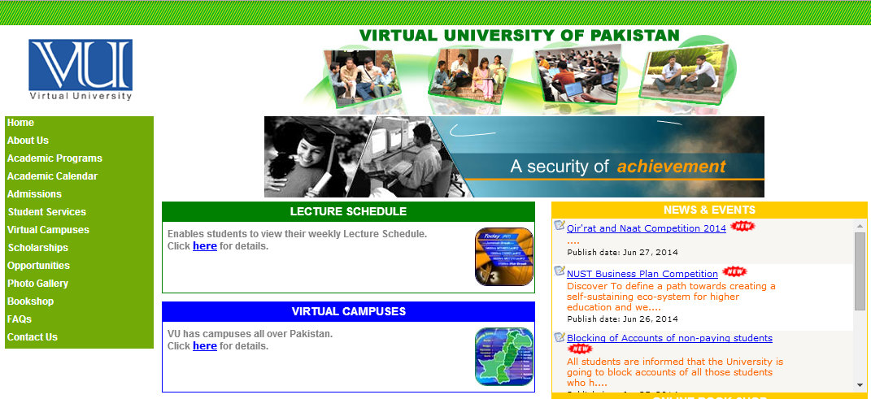
Virtual University of Pakistan

Slide 39
VU of Pakistan
  The Virtual University
    It aims at alleviating the lack of capacity in the existing universities while simultaneously tackling the acute shortage of qualified professors in the country.
    By identifying the top Professors of the country, regardless of their institutional affiliations, and requesting them to develop and deliver hand-crafted courses,
    The Virtual University aims at providing the very best courses to not only its own students but also to students of all other universities in the country.

Slide 40
Summary
Computer Ethics
  Code of ethics, Computer crime
  Copyright law and fair-use guidelines
  Plagiarism
Computer-Assisted Instructions
  Computer as a teacher
  Use of computer-assisted instruction
  Online education
  (Example: Virtual University of Pakistan)

Slide 41
Self Assessment
Self assessment tool, “Basic computer skills- assessment checklist”
  Use it to assess your computer skills
  Identify the skills that still need to be practiced
  Try to improve your skills more with more practice

Slide 42
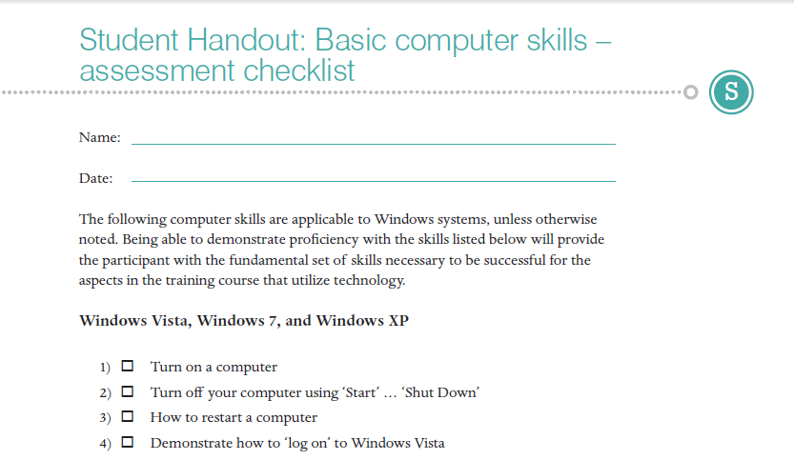
Assessment checklist

Slide 43
Thanks
End of your course

Slide 44
Allah Hafiz

