Slide 1
Working In The Information Society
ADE100- Computer Literacy
Lecture 31

Slide 2
Knowledge test
Can you transfer files from your cell phone via email?
What is the purpose of real player?
Who is the manufacturer of QuickTime player?

Slide 3
Topics covered
Uses of computer
  At workplace
  In community
  For communication
  In education & research, literacy
  For entertainment

Slide 4
Computers at workplace
In most places of business a Computer is a standard.
For example,
  Auto Repair Shops
  Computers are used for diagnostic repairs
  Inventory of parts and supplies
  Customer billing

Slide 5
Computers at workplace
Food service industry
  Computers are utilized for inventory control.
  Major restaurants have computerized databases for ordering food supplies and maintaining a quality inventory.
  Food Recipes are available at ones fingertips, or the click of the mouse.

Slide 6
Cosmetology
Hair Salons/Cosmetology uses computers for:
  Client database containing: colors perms (wavy pattern of hair) highlighting recommendations
  Client Scheduling
  Customer sales and services are computer generated

Slide 7
Flower Shops and Greenhouses
Florist Shops/Greenhouses use computers for numerous tasks
Computer knowledge for inventory of plants and flowers
Growing seasons of Crop Cultures
Pesticide Prevention

Slide 8
Banking/Office
Banks use computers:
  To access client account’s information
  Transfer of funds
  Account balances
  Customer service databases
  ATM
  Credit cards
  To issue Bank statement

Slide 9
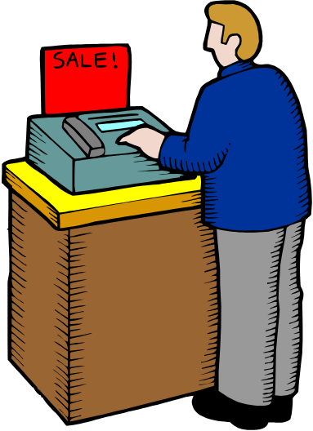
Retail sale
Keeping track of inventory
Completing a sale with customers
Organizing merchandise sold by day
Keeping track of commission

Slide 10
Automated production system
Many car factories are completely computerized.
Cars are assembled by computer-controlled robots.
  Very popular system in industry
  They work quickly than humans

Slide 11
Design systems
Computer Aided Design- CAD
  Many products are designed using CAD
  Computer programs are used to design the model of a product.
  When design is completed then actual product is manufactured

Slide 12
Stock control
Stock control system
  In many companies, it is computerized.
  Keeps record of no. of items in the stock
  Alerts the user when an item is finished in the stock

Slide 13
Accounts/Payroll
Accounts system
  In most large organizations, computerized accounts system
  It maintains daily transactions of a company
  It can maintain daily book, trial balance, and other information of accounts
Payroll system
  Calculates the pay, bonus and other information of employees

Slide 14
Word processing
A word processing program like MS Word
  Used to develop Letters, applications and other documents
  Used in business to generate different kinds of documents like experience letters, etc.

Slide 15
Spreadsheets
Spreadsheet program like MS Excel
  Used for calculations
  Provides worksheets to enter data
  Allows to use formulas and functions for complex calculations
  Create charts and graphs to display your data visually

Slide 16
Presentation
Presentation program like MS PowerPoint
  You can Produce professional presentations
  You can Print these presentations
  Directly used on multimedia projector
  Also used to display on computer screen

Slide 17
Graphics
A graphics program like CorelDraw is used to
  Produce advertisements, posters, brochures
  Create company logos
  Design different types of materials to promote an organization

Slide 18
Topics covered
Uses of computer
  At workplace
For communication
In community
In education & research, literacy
For entertainment

Slide 19
Computers For Communication
Internet
  Internet is the main source of communication
  You can use broadband physical lines or wireless media
  Online blogs and forums for discussions
  Instant messaging
  Share files and information

Slide 20
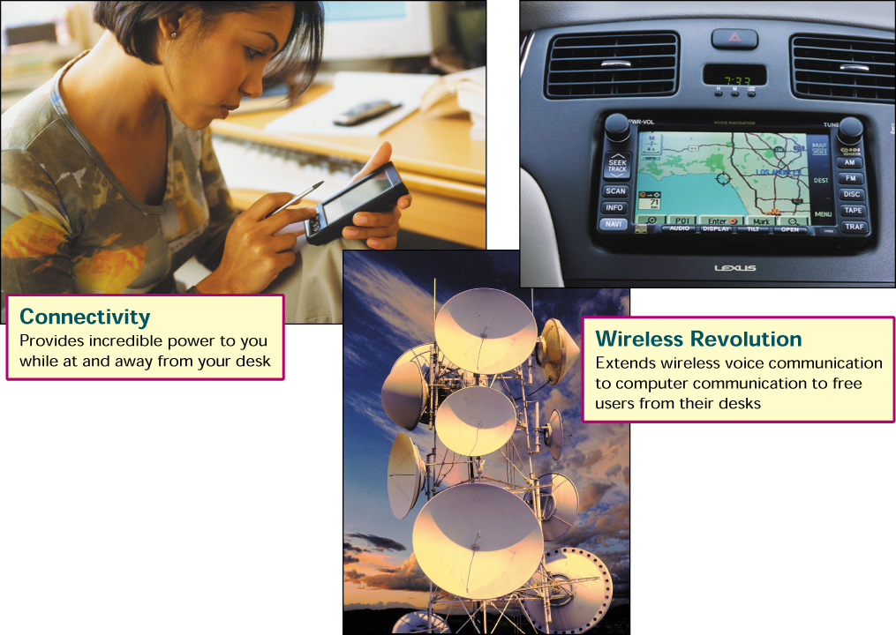
Communication today

Slide 21
Computers in Communication
Fax
  We can send fax from the computer
  Different software are used
  Quality of fax is also higher
  It is also possible to receive a fax directly to a computer
Telephone & Cell phones
  Telephone and cell phones are very popular source of communication
  Very fast and less expensive

Slide 22
Computers in Communication
Many companies use video conferencing to deal with other companies.
In video conferencing,
  People residing at different locations can talk with one another.
  They can see one another.
Very useful in this busy age.
Prevents a lot of time and cost

Slide 23
Computers in Communication
Email
  Very fast and effective way of communication between people using internet
  Send/receive messages
  Send/receive files as an attachment
Chatting
  You can chat with your friends on the internet
  Audio or video chat
  Send/receive text messages
  Share files

Slide 24
Computers in Travelling
Global Positioning system- GPS
  Locates your vehicle’s location
The cars have “Onboard Navigation System” which can
  Track the vehicle if it is stolen
  Provide emergency services
  Provide directions
  Provide roadside assistance
  Perform remote diagnostic if a warning light appears on the dashboard
  To make hotel and restaurant reservations

Slide 25
Topics covered
Uses of computer
  At workplace
  For communication
In community
In education & research, literacy
For entertainment

Slide 26
Computers in health community
Hospital Information System- HIS
  Supports all hospital functions and activities such as patient records, scheduling, administration, charge-back and billing
  Often links to or includes clinical information systems such as RIS- Radiology Information System

Slide 27
Hospital Information System
Registration
Consulting
Ward
Nursing
Stores & Purchase
Diet & Kitchen
Pharmacy
And more...
OT
Blood Bank
Laboratory
Radiology

Slide 28
Computers in health community
Hospital administration
  Hospital is an important organization
  To computerize hospital accounts, payroll and stock system
  Keep record of different kinds of medicines, their distribution and use in different wards
Recording medical history
  Store medical history of patients
  Store important facts about the patients
  Keep record of past treatment, suggested medicines and their results, of a patient
  Very effective & helpful for doctors

Slide 29
Computers in health community
Monitoring systems
  Serious patients need to monitor continuously
  Needed in operation theatres- (OT) and intensive care units- (ICU)
Life support systems
  Used to help the disable persons
  Many devices for deaf people to hear
  Scientists are trying to develop a device that can help blind people to see

Slide 30
Computers in health community
Diagnosis of diseases
  Software are used to store different diseases and their symptoms
  Diagnosis is possible by entering the symptoms of patient
  Computerized devices for several laboratory test like blood test, ECG, Ultra sound, etc.

Slide 31
Topics covered
Uses of computer
  At workplace
  For communication
  In community
In education & research, literacy
For entertainment

Slide 32
Computers in Education
Computer-Based Training- CBT
  A different program supplied on CD-ROM
  These programs include text, graphics and sound
  Audio and video lectures are recorded on the CDs
  Low cost solution for educating people
  You can train a large no. of people easily
Online education
  Many websites provide online education
  Download educational material, books and tutorials
  Some universities provide online lectures for students
  Students can ask questions through email

Slide 33
Computers in education
Research
  Computers are also used for research purpose
  Share research material through the internet
  Various websites for research activities e.g. ieeexplore, science direct, springerlink, ACM, etc.
  Young researchers or students can get benefit from these websites.
  They can download research articles on the subject of their interest.
Literacy
  Computer also improves our Read & Write skills

Slide 34
Topics covered
Uses of computer
  At workplace
  For communication
  In community
  In education & research, literacy
For entertainment

Slide 35
Computers for Entertainment
Computer games
  Used for playing games at home
  Source of entertainment and recreation
  Various kinds of games are available e.g. racing games, flying games, fighting games, etc.
  Improve mental capability and thinking power
Playing music
  Computers can store huge amount of audio & video files
  Watch movies, live TV channels and shows

Slide 36
Summary
Uses of computer
At workplace
  Food service industry, flower shop, retail market, CAD
For communication
  Telephone, cell phones, email, chat, internet, etc.
In community
  Medical field
In education & research, literacy
  Online education, computer-based training, research
For entertainment
  Playing music, movies, games, etc.

Slide 37
Further reading
Computer Applications in Business by Tasleem Mustafa
  Chapter no. 1
  Topic: Uses of Computers

Slide 38
Group discussion- 20 minutes
Make a group of two or three students.
Discuss the applications and uses of computers in the daily life.
Discuss how do you use computer in the daily life.
Share your ideas with other groups.

Slide 39
Thanks
End of Lecture 31

Slide 40
Allah Hafiz

