Slide 1
Using Multimedia Digital Devices With A Computer
ADE100- Computer Literacy
Lecture 30

Slide 2
Knowledge test
What do you understand by megapixel in digital camera?
What is Android mobile phone?
What happens if you compress a multimedia file? Does the quality compromise or not.

Slide 3
Topics covered
Transferring images and videos to computer from mobile devices
  (mobile phone, camera)
Using multimedia applications
  (Examples: Real Player, Windows Media Player, Quick Time Player, etc.) to play educational audio & video clips

Slide 4
Data transfer b/w cell phone & computer
Transferring data between a cell phone and computer using
  Android USB
  iPhone WiFi Sync
  Email
  Memory card reader
  Bluetooth

Slide 5
Data transfer using Android USB
Use a data cable to connect your phone to your computer's USB port.
  If you didn't get a data cable with your phone, check out the manufacturer's website or somewhere like eBay to buy one.
Make sure your memory card is in your phone.
Touch the USB Connected notification on your phone's screen.
Select Mount.
Find the removable storage drive on your computer.
  On a Mac, the drive will appear on your desktop
  On a PC, check My Computer

Slide 6
Android USB contd.
Drag and drop the files you want from your phone to your computer.
When you're finished, go to Notifications and select Turn Off USB Storage.
Disconnect the data cable from your phone and your computer.

Slide 7
Data transfer using iPhone WiFi Sync
If you are using iOS 5.0 or higher, you can transfer data automatically using iTunes Synch over WiFi.
  This will automatically sync your photos, tones, books, music, movies, podcasts and apps every time your phone is powered and connected to the same wifi network as your computer.

Slide 8
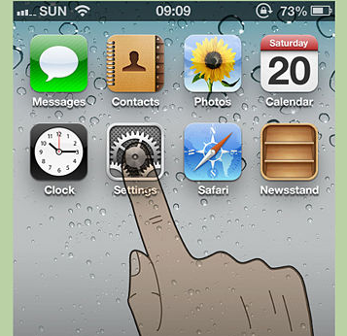
Using iPhone WiFi Sync: Step 1
  For more details: Go to "Settings" on the home screen of your iPhone.

Slide 9
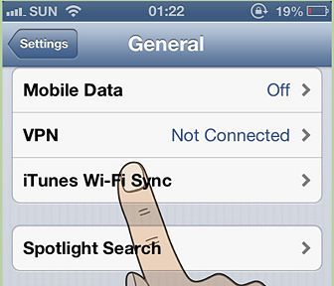
Using iPhone WiFi Sync: Step 2
Click "General", then "iTunes Sync" button.

Slide 10
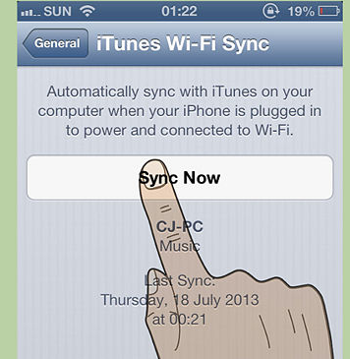
Using iPhone WiFi Sync: Step 3
Press "Sync now".

Slide 11
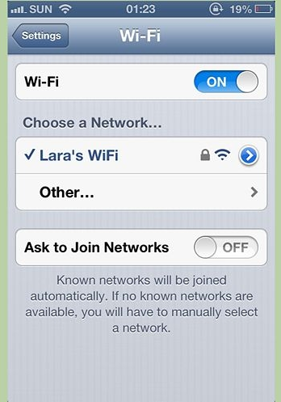
Data transfer using Email
Step 1:
  Find a free WiFi network, or connect to your home WiFi with your phone.

Slide 12
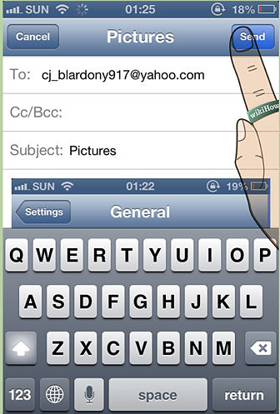
Email: Step 2
Email yourself the data from your phone.
  Because you're using Wi-Fi, you won't be charged by your mobile service provider.

Slide 13
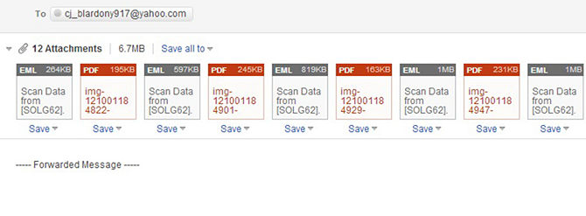
Email: Step 3
Open the email on the computer where you want to store the data.

Slide 14
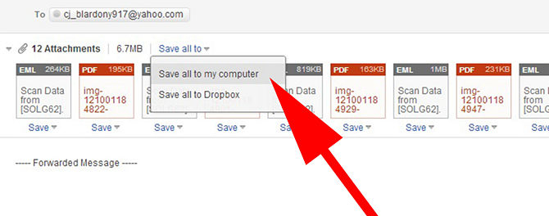
Email: Step 4
Select ‘Download’

Slide 15
Using memory card reader
Insert a memory card into your phone.
  Check to see if you can insert a memory card into your phone.
  Many phones use a micro memory card that comes with the phone and can be inserted and removed.
Make sure your phone saves data to the memory card rather than to the device.
Plug in your memory card into a memory card reader.
  In some cases, your memory card reader may be too big for a micro memory card.
  In this case, you can get an adapter in which you can insert your micro memory card.
  You can then insert the adapter into the memory card reader.

Slide 16
Using memory card reader
Plug the memory card reader into your computer.
  It connects via the USB port.
Transfer the data to your computer.
  You can look for the memory card reader as a removable disk in Finder or My Computer.
  If you're on a Mac, open iPhoto, go to File>Import to Library and select the photos you wish to import within the memory card.

Slide 17
Using Bluetooth
Activate your phone's Bluetooth.
  If you're unsure about how to do this, look under Settings or Controls.
Purchase a Bluetooth adapter.
  If your computer does not have the hardware for a Bluetooth/Infrared connection, then buy the adapter, sometimes called a 'dongle'.
  The common adapter plugs into a USB port.
  If you're on a budget, look for a used one online - they can be quite inexpensive.

Slide 18
Using Bluetooth
Bluetooth adapter
  The adapter has software for the connection process, which lets you transfer files from the computer to your phone, or vice versa.
  Some computers, such as MacBooks, are already outfitted with Bluetooth devices, and won't require one of these cables.
  If you're unsure about whether or not your computer has this capability, search for the information online.

Slide 19
Using Bluetooth
Make sure Bluetooth is turned ‘ON’ on both your computer and your phone.
  If you have a Mac, you can make sure your Bluetooth is on by clicking on the Bluetooth symbol on the right side of the upper toolbar.
  The symbol should be to the left of the Date and Time and should look like some triangles.
  On a Vista, go to Control Panel -> Network and Internet Connection -> Bluetooth Devices.

Slide 20
Using Bluetooth
Make sure you are standing within 30 feet of your computer.
  Bluetooth does not work more than 30 feet away.
On your phone, find the data you wish to transfer.
Go to the menu, and select Copy or Send.
Choose the Bluetooth option.

Slide 21
Using Bluetooth
Once you confirm that you want to enable Bluetooth,
  The Bluetooth menu in the phone will pop up automatically.
Select the "Look for Devices" option.
Select your device from the list that appears.
A request will be sent to your device asking for you to accept the sent picture.
Accept the request, and the data will be sent.

Slide 22
Transferring images b/w digital camera and computer
Many cameras come with software to download pictures from your camera to your hard drive.
But you can transfer the pictures using either the camera’s software, or your operating system.

Slide 23
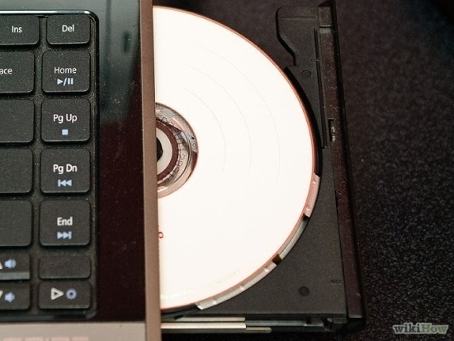
Transferring using camera software
Step 1: Run the software that came with your camera.
  Insert the CD into your computer and go through the setup steps.
  If you bought the used camera, or if you don't have the CD, you can probably find one on eBay.
  You might even be able to find it available for download on the camera manufacturer’s website.

Slide 24
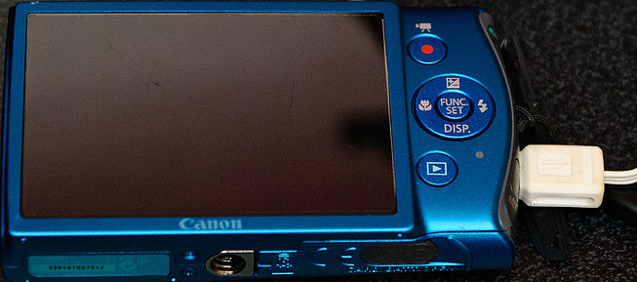
Using camera software: step 2
Connect the camera to the computer.
  Most of the time, you'll hear a sound or something will pop-up if the camera is connected properly and working.

Slide 25
Using camera software: step 3
Sync the camera to the computer and transfer the pictures.
  With most camera software, as soon as you connect the camera to the computer,
    Something will pop up asking if you would like to sync the pictures to the computer.
  After that it's pretty self-explanatory.
  If nothing pops up or it was never supposed to pop up in the first place, find and open the camera software.

Slide 26
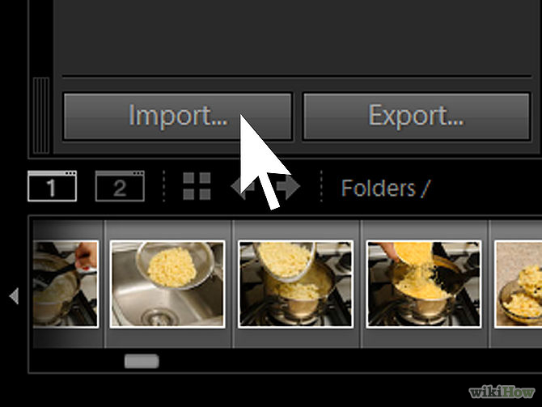
Using camera soft: step 3

Slide 27
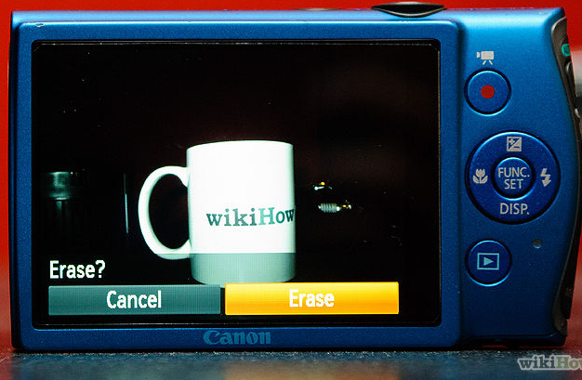
Using camera soft: step 4
Delete pictures from camera’s memory.
  Now that the pictures should be safely on your hard drive
  The software should have an option for you to delete the files on the camera.

Slide 28
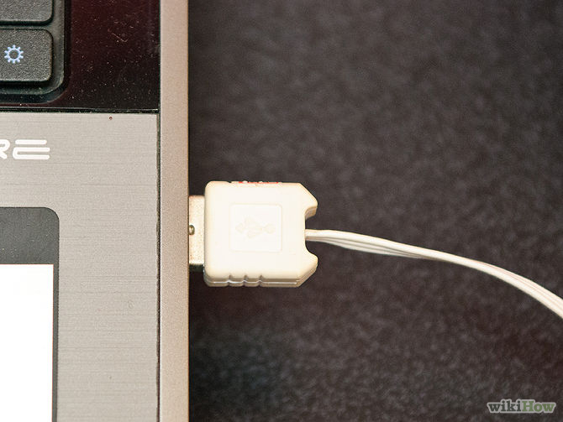
Transferring media files using OS
Step 1: If the camera has a USB connection, just connect it to the computer.
  If your computer has a memory card reader, it is even more convenient to plug the memory card in directly.

Slide 29
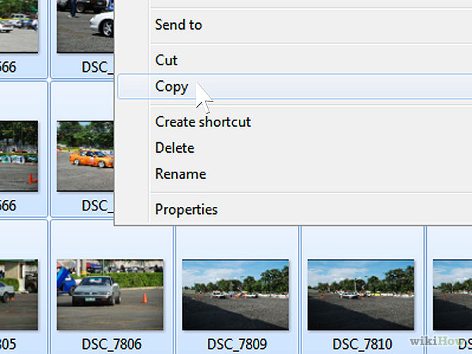
Transferring camera files using OS
Step 2: Open the camera folder, find the picture files, and copy them to your desired location.

Slide 30
Transferring camera files using OS
Step 3: Remove the files from the camera’s memory.
  After you are sure that files are safely on your computer’s hard drive, delete the originals on your memory card.
  Some cameras allow you to transfer files but do not support writing changes to the memory card(i.e. deleting).
  In this case you may need to clean the card using the camera controls (most cameras have a button or a sequence of buttons to clear the card).

Slide 31
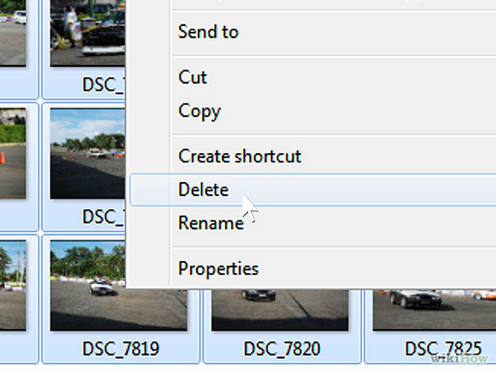
Deleting Camera files: step 3

Slide 32
Topics covered
Transferring images and videos to computer from mobile devices
  (mobile phone, camera)
Using multimedia applications
  (Examples: Real Player, Windows Media Player, Quick Time Player, etc.) to play educational audio & video clips

Slide 33
RealPlayer
RealPlayer is a universal media player that
  Automatically recognizes the file format of the video or audio file you want to play.
  So you can count on it to reliably play the most popular audio and video file formats
    Including avi, mp4, mp3, wma, wav, flv, MPEG, and more.

Slide 34
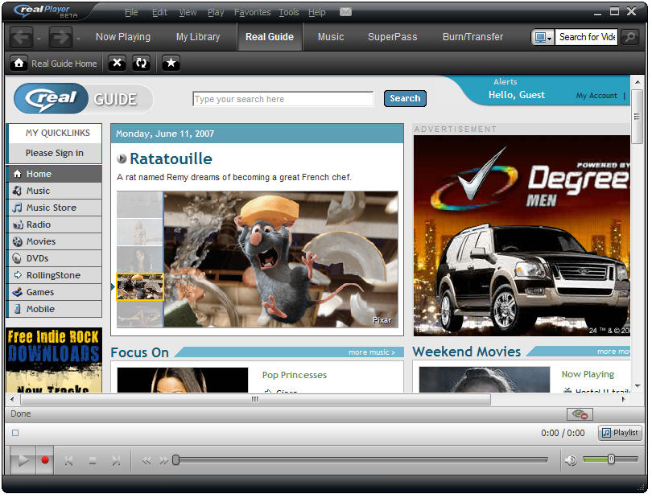
RealPlayer interface

Slide 35
Downloading media files using RealPlayer
Using RealPlayer’s video downloader software,
  You can download your favorite free online videos from hundreds of web sites.
  RealPlayer also lets you convert and play virtually any file type.
  It's free and it's easy to use.
Step 1: Download the latest free version of RealPlayer.
  Go to RealPlayer.com and click the big orange button at the top.

Slide 36
Downloading in RealPlayer
Step 2: Install the software.
  On a PC, double-click the .exe file.
  As you run the install, you must agree to the usage terms and decide whether or not to include other features (e.g. a weather toolbar) with your installation.
  When you first launch RealPlayer, it will give you the license agreement to approve. Click Accept to continue.
  Select the formats for which you want to make RealPlayer the default media player.

Slide 37
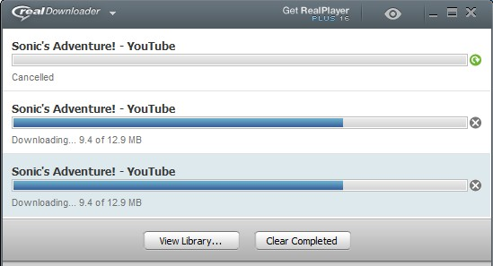
Downloading in RealPlayer
Step 3: Close your web browser.
  Toward the end of the installation, the installer will ask you to close your web browser in order to properly install RealPlayer’s One-Click Video Download function.
  Since you will need this in the ending steps, be sure to close your browser when prompted.

Slide 38
Downloading in RealPlayer
Step 4: Reopen your browser.
  Find a video you want to add to your RealPlayer library.
  On a PC, float your mouse over the video until a "Download This Video" button pops up above the upper right-hand corner of the video.
  Click on the "Download This Video" button and RealPlayer will download the video into your RealPlayer library.
  When you click the Download button, the video will be saved to your library.

Slide 39
Windows Media Player
Windows Media Player (abbreviated WMP)
  A media player and media library application developed by Microsoft
  Built-in product of MS Windows
  Used for playing audio, video and viewing images on PC running the Windows operating system,
  As well as on Pocket PC and Windows Mobile-based devices

Slide 40
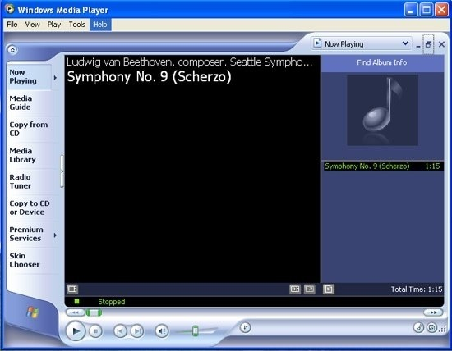
Windows Media Player

Slide 41
QuickTime Player
QuickTime Player
  Developed by Apple
  A powerful multimedia technology with a built-in media player,
  QuickTime lets you view Internet video, HD movie trailers, and personal media in a wide range of file formats.
  And it lets you enjoy them in remarkably high quality.

Slide 42
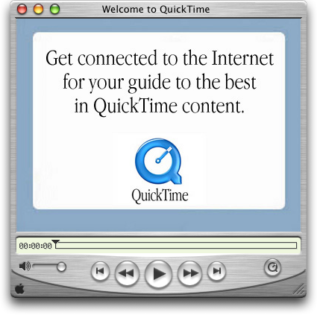
QuickTime Player

Slide 43
Summary
Transferring files between cell phones and computer
  Using Android USB, iPhone WiFi Sync, Email, Memory card reader, Bluetooth
Transferring files between digicam and computer
  From built-in camera software
  From operating system of computer
Using multimedia applications
  RealPlayer & real video downloader
  Windows Media player
  QuickTime Player

Slide 44
Activity- 20 minutes
Transfer data between your mobile phone and computer using USB cable.
Transfer files using digital camera to your computer using USB cable.
View and explore Windows Media Player or any other.
Play a video in Windows Media Player or in any other multimedia program.

Slide 45
Thanks
End of Lecture 30

Slide 46
Allah Hafiz

