Slide 1
Computer Software
Associate Degree in Education (ADE)
Lecture 03
By Sajid Riaz

Slide 2
Knowledge test
What is an input and different forms of input?
What is ergonomics?
How can you configure a mouse?
What is an output and its different forms?
What is refresh rate?
What is RAM & ROM?
Differentiate between combo and super drive?

Slide 3
Topics covered
Operating system software introduction
Application software usage and its types
  Word processing, spreadsheets, multimedia, etc.
Hands on activities on:
  User window (minimizing, maximizing, closing a window, menu, status and other bars etc.)

Slide 4
Computer Software
System software & application software

Slide 5
Activity- (10 minutes)
Which kind of software you or your family ever use?
What is the purpose of using these software?
Can you tell some software names?
Share your experiences with your classmates about these software?

Slide 6
Software
Software
  Tell the computer what to do
  Also called a program
  Thousands of programs exist

Slide 7
Types of software
System software
  Perform general operation like copying a file
Examples:
  Operating system- (windows)
  Network operating system- (Windows server)
Application software
  Perform a particular task like video player
Examples:
  Microsoft office: (word, power point, excel)
  Windows media player, Skype, MS paint, etc.

Slide 8
Operating system (OS)
Operating system
  Tells the computer how to use its own components
  Examples are DOS, Windows, Linux, Macintosh
Functions of an OS:
  Provide a user interface: desktop
  Run programs: application programs
  Manage hardware devices: resource sharing
  Organized file storage: R/w operations

Slide 9
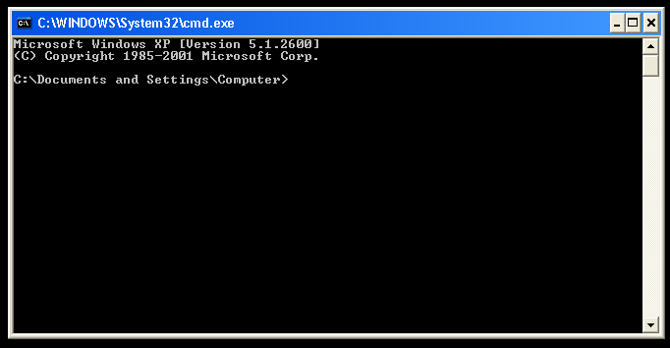
DOS

Slide 10
DOS
Disk Operating System
Developed by Microsoft
Command Line Interface- CLI
Provides prompt line on the screen
Commands are entered manually from keyboard
Difficult to use
Single user OS
Most recent versions are DOS 7.0 and DOS 8.0

Slide 11
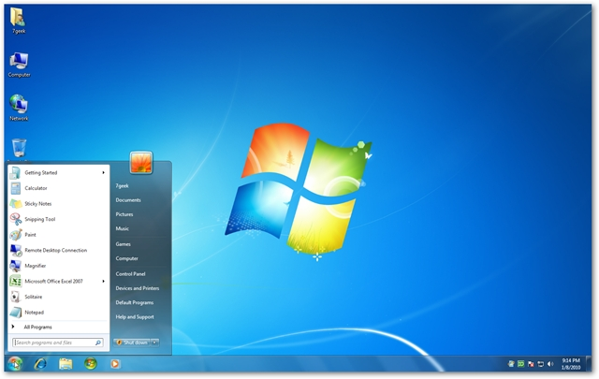
Windows

Slide 12
Windows
Graphical User Interface- GUI
Provides graphical images on the screen
Developed by Microsoft
Attractive interface
Easy to interact with the computer
Multitasking
Multiuser
Recent versions are windows 7 and window 8.1

Slide 13
Application software
Application software
  Tells the computer how to perform specific tasks
  Such as word processing or drawing
  Thousand of applications are available
Examples
  Word processing- letters, brochures, CV
  Spreadsheets- budget or balance sheets
  Database management- telephone directory
  Presentation programs- electronic slides
  Graphic programs- photo editing, movie making

Slide 14
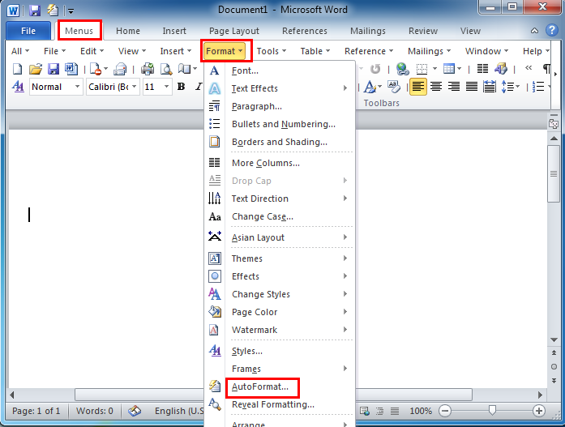
MS word

Slide 15
Word processing
Create and edit documents like letters, reports, essays, etc.
Allows document editing and formatting
Editing is entering, deleting, copying or moving text
Formatting makes document more attractive before printing
Common examples are MS word, word perfect, word pad, notepad, etc.

Slide 16
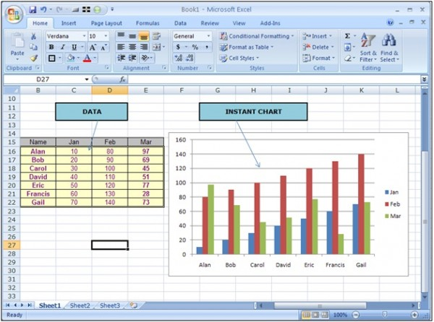
MS Excel

Slide 17
Spreadsheet
Store date in rows and columns
Electronic sheets
Data is entered in cells
Intersection of a row and column is called a cell
Each cell has a cell address like A1, C4
Automatically perform calculations using formulas
Commonly used for business applications such as
  Financial calculations and recording transactions.

Slide 18
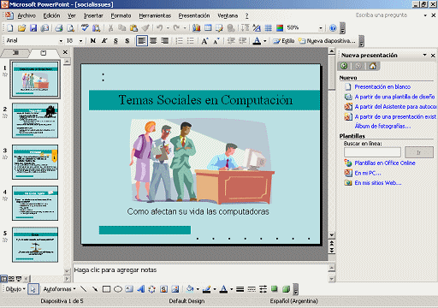
MS Power Point

Slide 19
Presentation graphics software
Create slides for making presentations
Have pre-drawn clipart images and can be used in the slides
Common example is power point program.

Slide 20
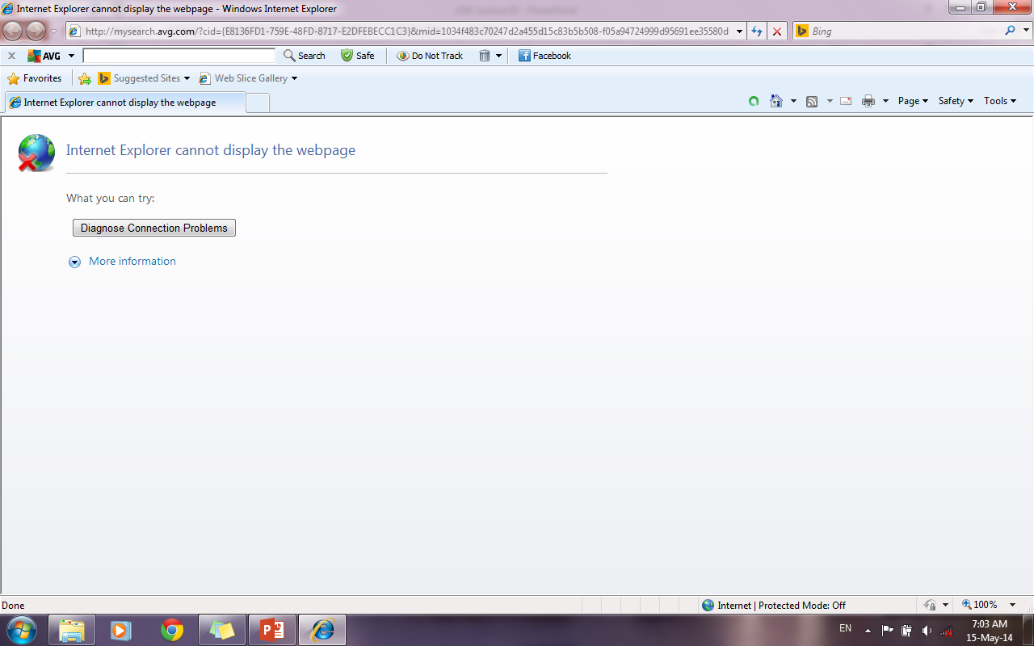
Internet explorer

Slide 21
Communication software
Exchange information electronically
Send and receive information over the internet
File transfer from one computer to another
Common example is browsers or messengers
  Internet explorer, Skype

Slide 22
Interfacing with computer
Interfacing with user windows

Slide 23
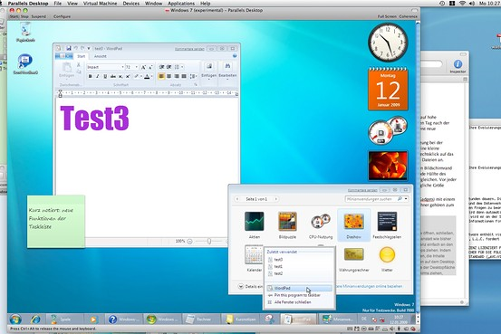
Windows
Most widely used OS
Attractive
Easy to learn and use
Graphical User Interface (GUI)
  All windows support use of mouse, icons & menus

Slide 24
Elements of Windows OS
Icons
  Graphic representation of programs, drives, files & folders
Application windows
  Each contains a program like word, excel
Menus
  Contain a list of commands of a program like File, Edit, Insert, View, Help
Dialog boxes
  A rectangular window, request or display information like open dialog box, save dialog box

Slide 25
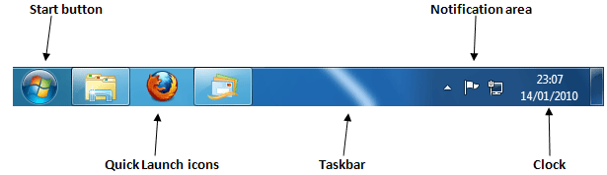
Taskbar

Slide 26
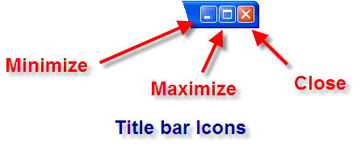
Title bar icons

Slide 27
Title bar icons
Minimizing a window
  Use minimize button to temporarily hide the window from view.
  The title will appear on the taskbar.
Maximizing a window
  The window fills the entire screen
Closing a window
  Exit the window and close the program

Slide 28
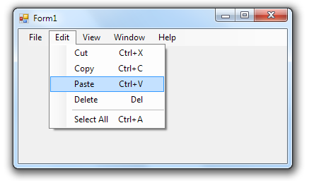
Menu bar

Slide 29
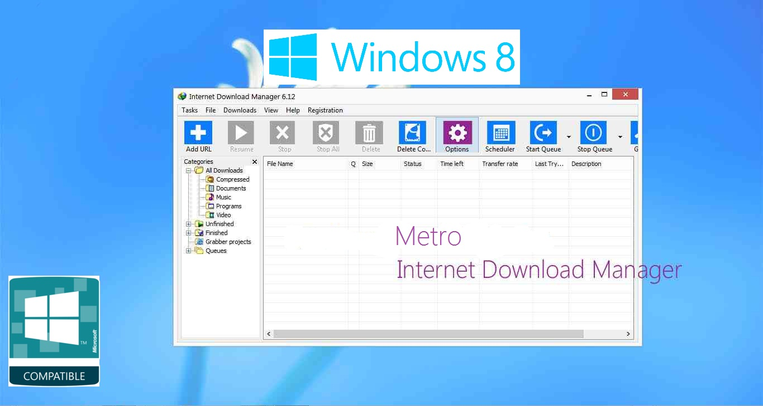
Toolbar

Slide 30
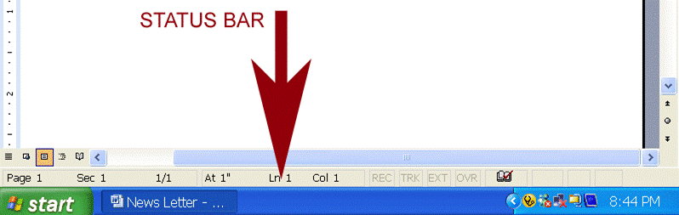
Status bar

Slide 31
Activity- (20 minutes)
Identify and explore menu bar, toolbars, taskbar, icons in different program windows like Microsoft word, power point, excel, etc.
Open and explore DOS operating system from start menu. (Hint: Start > Accessories > Command Prompt)
View different folders in the windows like control panel, My documents, My pictures etc.
Note: You may take help from your book.

Slide 32
Activity- (10 minutes)
Make a group of two or three students and share your experiences of using these computer programs with all other groups.
Try to learn from your own and others’ experiences.

Slide 33
Further reading
Introduction to computers by Peter Norton, 7th edition
  1B- Software brings the machine to life
  7A- operating system Basics
Computer Applications in Business by Tasleem Mustafa published by it series.
  Chapter 6: Windows operating system

Slide 34
Thanks
End of lecture 03

Slide 35
Allah Hafiz

