Slide 1
Using Multimedia Digital Devices With A Computer
ADE100- Computer Literacy
Lecture 29

Slide 2
Knowledge test
What is the purpose of Google drive?
Which kind of documents can be created using Google docs?
What is publishing the document?
What is the purpose of comments?

Slide 3
Topics covered
Introduction and examples of digital devices
  Camera, mobile phone, digital voice recorders, etc.
Using a digital camera and other technologies i.e. mobile phones to download images and videos

Slide 4
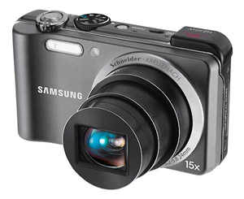
Digital Camera
Digital Camera
  A camera that takes video or still photographs (or both) digitally by recording images on a light-sensitive sensor

Slide 5
Digital Photos Overview
Digital Photos are made up of pixels (picture elements).
DPI vs. PPI
  DPI- Dots Per Inch (How a printer prints the image)
  PPI- Pixels Per Inch (How a monitor displays an image)
The resolution of a digital photo is its pixel dimensions.
Digital Cameras use megapixels to specify the pixel dimensions of its photos.

Slide 6
Megapixels
A higher megapixel rating does not always mean higher quality photos.
A camera’s megapixel rating will help you
  To determine the largest size of prints
  You can expect to make without sacrificing the quality of the image

Slide 7



Megapixels
The 8 megapixel will not produce a better quality 8” x 10” print than the 4 megapixel.
4 megapixel
2400 x 1800
8 megapixel
8” x 10” print
4000 x 2000

Slide 8
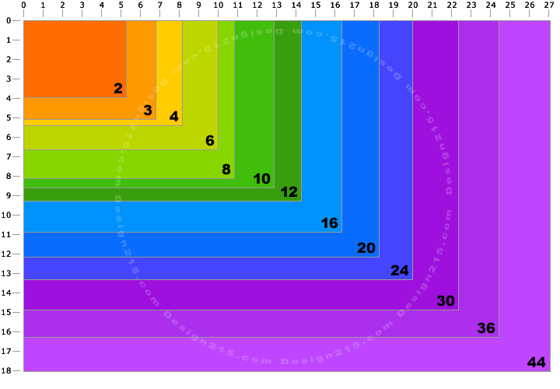
Megapixels vs. print size

Slide 9
Types of Digital Cameras
Ultra Compact Digital Cameras
Compact Digital Cameras
Advanced Digital Cameras
Digital Single Lens Reflex (DSLR) Cameras

Slide 10
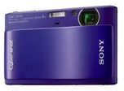
Ultra Compact Digital Camera
Typically a small and inexpensive camera.
Can easily be carried in a pocket or purse.
Usually have fewer features than the higher end cameras.

Slide 11
Compact Digital Cameras
The typical digital camera used for taking most pictures by consumers.
Includes most of the features the average person would need.

Slide 12
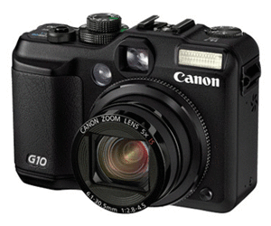
Advanced Digital Camera
Designed for the more skilled or hobbyist photographer.
Usually has higher quality lens and zoom.

Slide 13
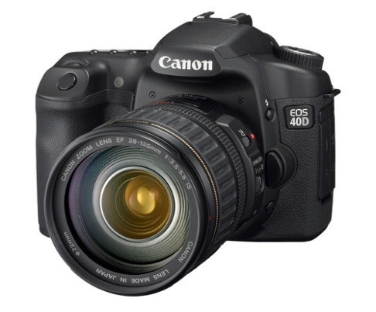
DSLR Camera
Digital SLR- Single Lens Reflex
  Top of the line camera, primarily used by professionals
  Include high quality lenses, and often interchangeable
  Often accepts other accessories such as filters
  Produce very high resolution photos.

Slide 14
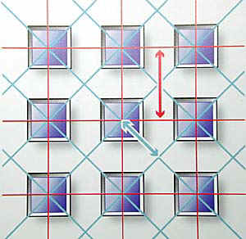
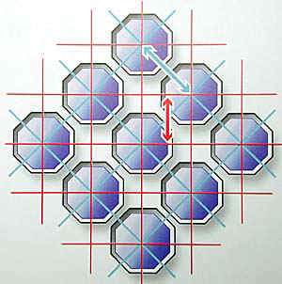
Pixels

Slide 15
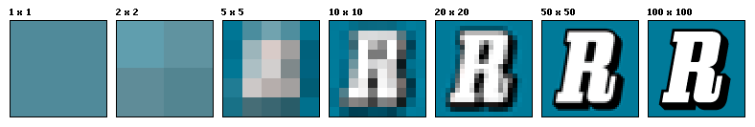
Image size or Resolution
More pixels add detail and sharpen edges

Slide 16
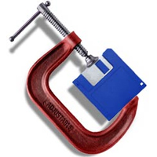
Compression
The rate of compression affects image quality.
More compression lessens the file size but poor quality of image
No compression, more space required but high quality image

Slide 17
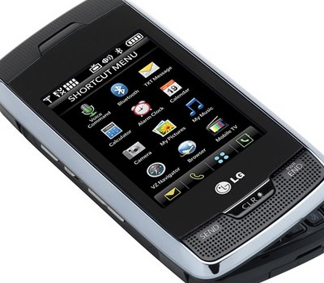
Mobile phones
The world is flat!
Bringing people together.....?
Changing the way things work.

Slide 18
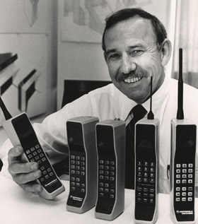
History
The first official mobile phone used by Swedish police in 1946
  Could make 6 phone calls before car's battery was exhausted
Development of first cell phone
  Creation of towers/cells at Bell Labs in 1947
1983 Motorola DynaTAC 8000X made commercially available: (2 lbs, $3500)
1991 Motorola MicroTac Lite the lightest phone: ($1000)

Slide 19
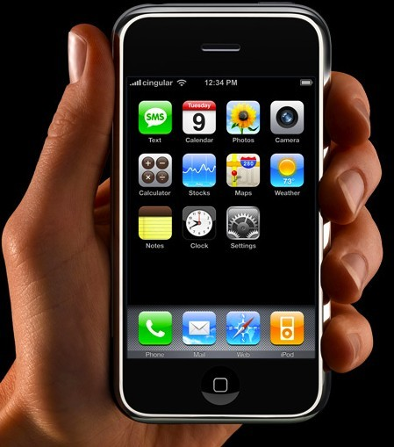
History cont.
2nd generation: from the early 1990's
  smaller, better batteries, huge increase in popularity
3rd generation:
  Include 2Mb of maximum data rate indoors and 384kb for outdoor use
  Include internet access and other modern innovations
1993 IBM developed first smart phone, Simon

Slide 20
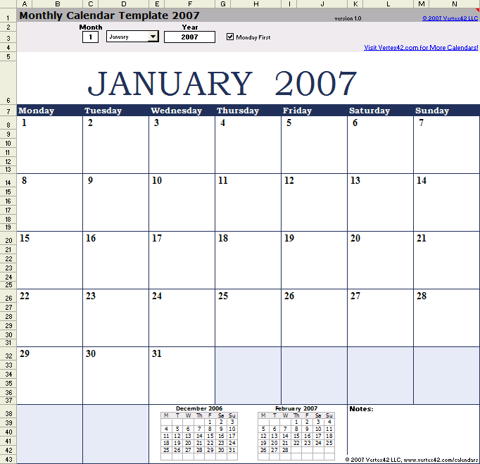
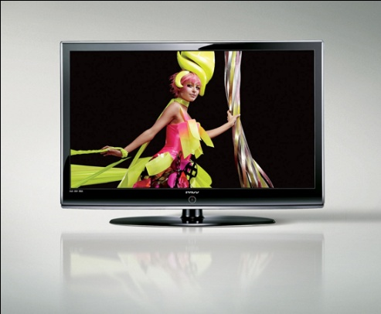
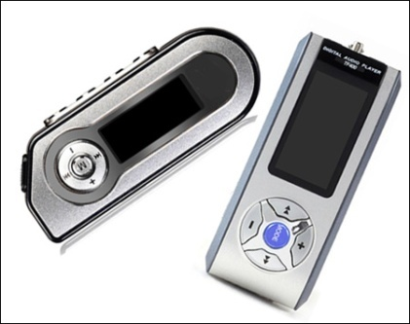

Uses of mobile phones
- Smart phones provide portable use of IT
-Entertainment Uses:
games, music (mp3 player), books (e-book), and digital television broadcast
Social Uses:
phone call, text message, wireless internet (access to e-mail, social networking websites)
Organization Uses:
calendar, finance manager, address book, storage for data

Slide 21
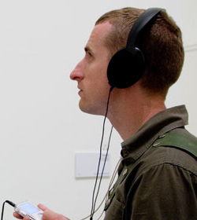
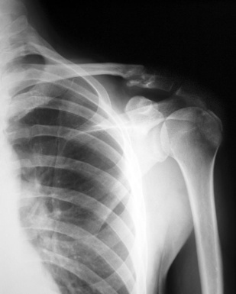
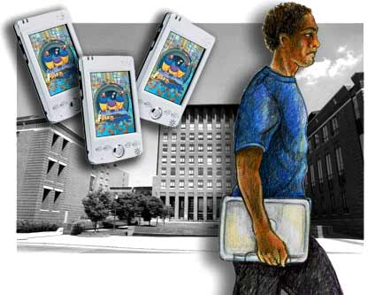
Uses cont.
-Hospital Uses:
used to view image (x-ray, MRI)
-means of communication between nurses and staff
Museum Uses:
audio guide is provided through cell phones
-China:
mobile learning provides access to lectures and test preps.

Slide 22
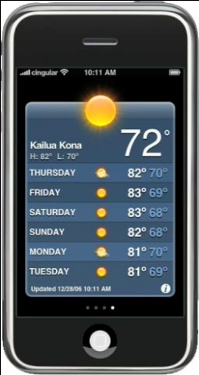
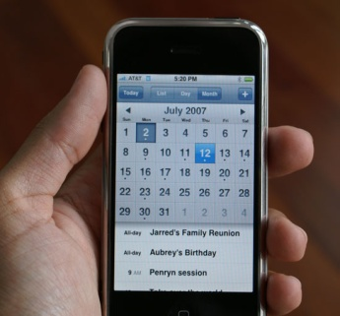
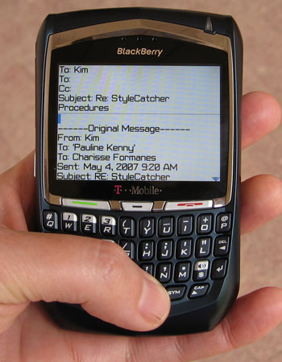
Benefits
  Mobile technology is key to keeping in touch in the modern world.
  Text messaging
  Smart Phones aren't only used for communication but for
    Organizing schedules, taking notes, playing music
    Games, checking the weather, and other applications.

Slide 23

Benefits Cont.
  Cell Phones "revolutionized long distance calling",
    Making it much more inexpensive for long distance communication.
  Cell phone logs have also been helpful in court cases where they can be used as evidence.

Slide 24

Criticisms
Negative health affects
  Increased resting blood pressure, reduces production of melatonin (sleep hormone), linked to cancer
  increased stress level (fatigue, headache, difficulty in concentration, disturbance in sleep)
  male infertility
effect on children
risk in driving
reduced privacy
effects on language

Slide 25
Digital Voice Recorder
Sound recorders for windows
  Both Macintosh and Windows PC platform have the default sound.
  This basic application could:
    Record our own sounds
    Edit & mix *.wav files
    Simple Splicing (merging) and assembly
    Increase volume & speed of *.wav files
    Reverse the sound.
    Add Echo effects
    Some XP Version also provide wav to mp3 conversion

Slide 26
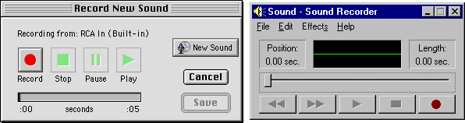
Digital Sound Recorder
For Macintosh
For Windows

Slide 27
Topics covered
Introduction and examples of digital devices
  Camera, mobile phone, digital voice recorders, etc.
Using a digital camera and other technologies i.e. mobile phones to download images and videos

Slide 28
Taking digital photo
There are 4 primary points to consider that impact the quality of a digital photo:
  The quality of the recording device (camera's optics & sensor).
  The size (in pixels) of the digital image.
  The digital format it is stored.
  The technical proficiency and the "eye" of the photographer.

Slide 29
Focusing on the subject
Fixed Focus
  Found on lower-end cameras and phones
  The focus is fixed and can’t be adjusted.
Auto Focus
  Most consumer cameras are equipped with auto focus cameras.
  The auto focus kicks in as you start to press the shutter button.
Manual Focus
  Found on most professional level cameras
  The photographer focuses the camera on the lens.

Slide 30
Zoom
Most digital cameras are capable of some type of zoom.
Many will have one or both types of zoom.
Optical Zoom
  The subject is magnified through the camera's optics or lens
  Produces a higher quality image
  Image quality is maintained in optical zoom
Digital Zoom
  Is an artificial zoom
  Digital zoom crops your image and magnifies the result of the cropping
  Image quality is lost in digital zoom

Slide 31
Taking Photos
To take photos
  You need to move dial to ‘picture taking mode’.
  Most cameras make this easy and assume you’ll take most of your pictures in the easy, automatic mode, and color that part of the dial green.
  In “auto” mode, the camera does a lot of things for you, like adjusting the light and focus.
  Go ahead and turn your camera on, and select the ‘auto picture taking’ mode.
  Snap a couple of pictures around the room here just for fun.

Slide 32
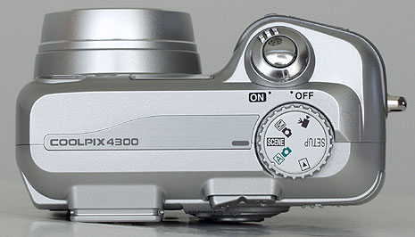
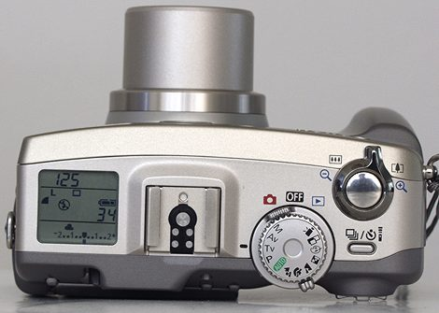
Taking photos

Slide 33
Downloading using Android OS
There are various ways to add media & programs to your smart phones.
Your mobile phone is turned into a true multimedia device.
Visit the Google Play Store
  You can access the store from your phone’s Apps list
  There are many free applications, games, songs, and videos available for download.
  You will need a ‘Google account’ in order to download from the Play Store.

Slide 34
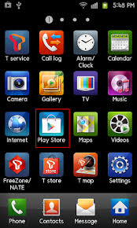
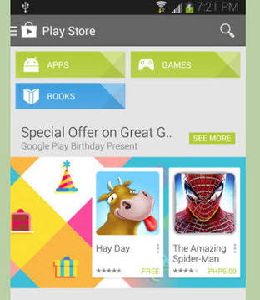
Google Play Store

Slide 35
Downloading apps in Android OS
Download apps from other sources
  In order to install apps from sources other than the Google Play Store, you need to set your phone to allow non-market apps.
  Press the Menu button on your phone and tap Settings.
  Scroll down to Security and tap it to open the Security menu.
  Scroll down and check the “Unknown Sources” box. This will let you install apps directly from the APK file.
An APK file is the file that
  Android uses to install a program. If you want to add a program to your phone, it must be APK format.
Make sure that you download apps from trusted sources.

Slide 36
Downloading apps in Android OS
Download apps from other sources
  There are a variety of communities that offer applications that aren’t available on the Store, often for free.
  These can include beta versions of apps that are in progress, or apps that are purchased outside of the store.
  When you download an APK file, you can open it by using the Downloads app on your phone.
  Tap the APK file and your phone will ask you if you want to install it.

Slide 37
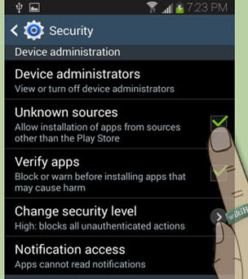
Downloading from other sources

Slide 38
Downloading files in Android OS
Download files from the web
  When browsing the web on your phone, you can download files directly to your phone’s storage.
  To download an image, tap and hold the image in your phone’s browser for a second, and then release.
  A menu will open and you will have the option to save the image to your phone.
Downloaded files are stored in your downloads folder on your phone.

Slide 39
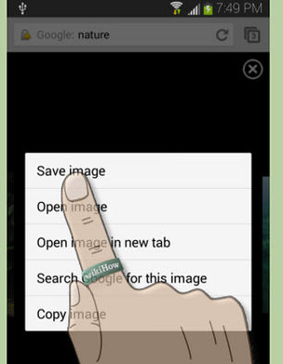
Saving image

Slide 40
Activity- 20 minutes
View and explore a digital camera.
  Take a picture using a digital camera.
  View that image on the LCD of your digi-cam.
Connect your mobile with the internet.
  Run Play store to download an application.
  Download an image or video file using internet from your mobile phone.
Note: You can share the device with other students.

Slide 41
Thanks
End of Lecture 29

Slide 42
Allah Hafiz

