Slide 1
Online Collaboration Applications
ADE100- Computer Literacy
Lecture 28

Slide 2
Knowledge test
What is the purpose of online collaboration?
Name some tools which provide the facility of online collaboration?
What is the purpose of “PREZI” online tool?

Slide 3
Topics covered
Creating, importing and editing a file (using online collaboration tools)
  Documents
  Spreadsheets
  Presentations

Slide 4

Google Drive
Google Drive
  Online storage service that allows you to store your documents, photos, videos, and more online in one place
  You can also access Google Docs, where you can create, share, and collaborate on documents, spreadsheets, presentations, and more from anywhere while online.

Slide 5

Using Google docs
Google Docs
  Creating, editing and sharing documents, spreadsheets and presentations simple and free
  Your docs are stored safely online, so you can access them any time, from anywhere
  Create a doc from scratch, upload an existing doc or browse the template gallery for a format that suits your needs- it’s easy.
  You can even use Google Docs to create an online form to collect data from others.

Slide 6
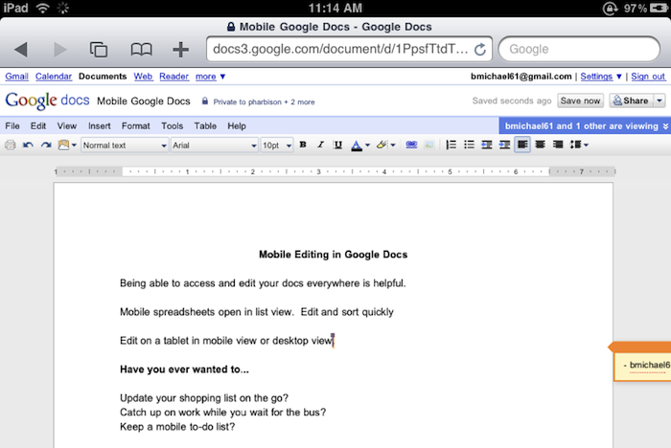
Google docs interface

Slide 7
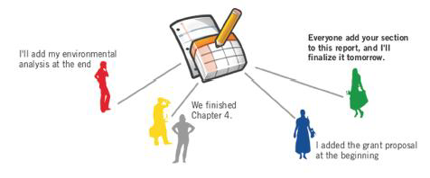
Collaborate with others

Slide 8
Collect data with forms
Select Create>Form to create a form using a variety of question types (multiple choice, checkboxes, etc.).
You can embed your form in an email, and respondents’ answers will be added automatically to a spreadsheet.

Slide 9
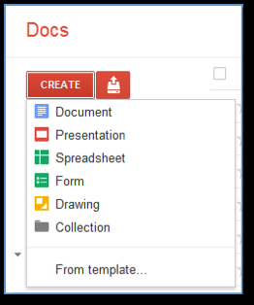
Creating a Form
Google docs menu

Slide 10
Creating a new document
There are different ways of getting started using Google documents:
  you can create a new online document,
  you can upload an existing one, or you can use a template from the templates gallery
To create a new document,
  Go to your Docs list, click the Create drop-down menu and select Document.

Slide 11
Saving the document
When you are working on your document
  Click the Save button in the top right corner of the document
  Enter a name for the document in the window that appears and click OK
  Then you'll see your document in your Docs list.
If you'd like to save and close a document
  Click the Save & close button.

Slide 12
Saving the document
To save a local copy of a document, you can download it to your computer.
To do this, open your document,
  Click the File menu and point your mouse to the Download file as option.
  You'll see these file types: HTML, RTF, Word, Open Office, PDF, and plain text.
  Select a file type and click OK in the browser window that appears.

Slide 13
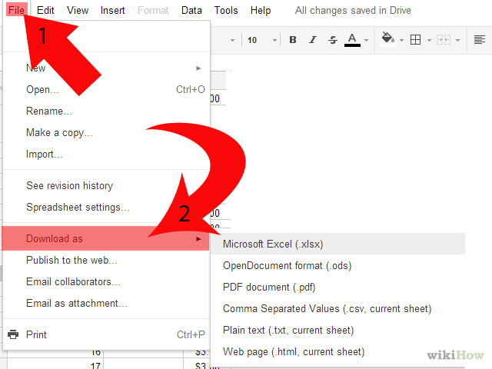
Saving a file

Slide 14
Uploading a document
You can upload existing documents to Google documents at any time.
  Click the Upload button at the top of the sidebar in your Docs list page.
  Click Browse and select the document.
  Click Open.
  Click Upload File.
  The uploaded file appears in your Docs list.
File types are: html, txt, odt, rtf and MS Word
Size limits are:
  Each document can be up to 500K, plus up to 2MB per embedded image.

Slide 15
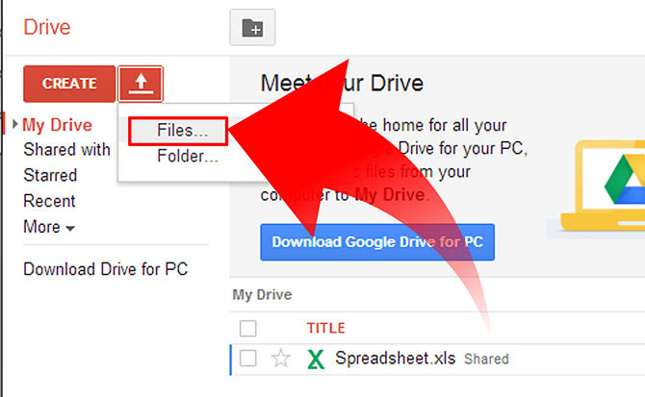
Uploading

Slide 16
Using Templates Gallery
If you want to quickly create a document,
  You can pick one of the templates in our templates gallery.
  Each template has standard text that you can replace with your own, and preset formatting that you can reuse.
You can also access the templates gallery from your document by going to File > Create > From template...

Slide 17
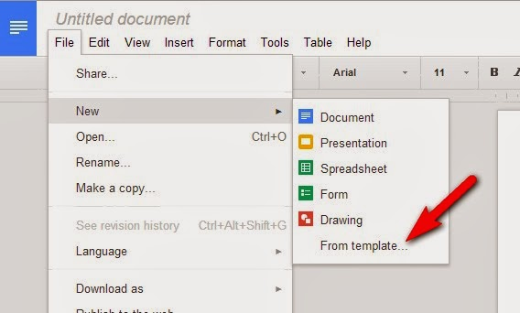
Google templates

Slide 18
Editing the document
You can change the font or the text size in your document from the toolbar or the 'Document styles' window.
To change the spacing of the document, you'll need to open the 'Document styles' window.

Slide 19
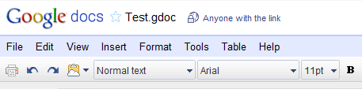
Editing: From the toolbar
To change the font or the text size quickly,
  Select the text you'd like to change
  Click either the font menu, which lists Verdana, or the text-size drop-down menu, set to 10pt by default.
  Choose a new font or text size, and the changes are applied to the selected text.

Slide 20
Editing: From ‘Document styles’ window
Click Format > Document settings... in the menu bar.
A ‘Document styles’ window appears.
  Change the font and text size from the drop-down menus
  Change the spacing in between lines by selecting an option from the Line-spacing drop-down menu
  Preview your changes within the window
  Apply these changes to all your new documents

Slide 21
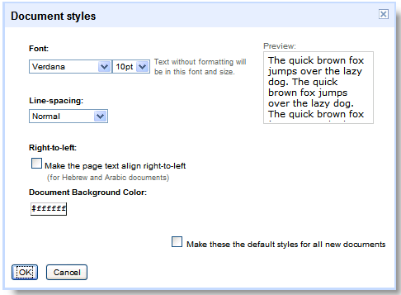
‘Document styles’ window

Slide 22
Inserting images
You can enhance your document by inserting an image. Here's how:
  Click the Insert drop-down menu from the toolbar and select Image.
  Select 'From this computer' or 'From the web‘.
  Depending on what radio button you selected
    Choose an image file from your computer, or enter a URL and preview the image.
  To specify the size of your image and where it appears in the document, click More image options.

Slide 23
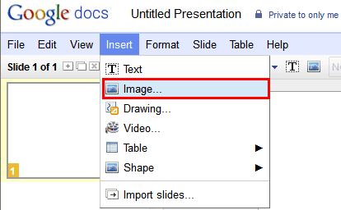
Inserting images

Slide 24
What are comments ?
Comments are a useful way of adding notes to your regular document text and are visible to viewers and collaborators.
These can be invaluable for communicating with collaborators
  About specific parts of the document, as well as making notes about changes you've made or would like to make.
When you publish your document as a webpage, post it to your blog, or print it, the comments will disappear.

Slide 25
Adding comments
To add a comment to your document, follow these instructions:
  Place your cursor where you'd like your comment to appear.
  Click the Insert drop-down menu.
  Select the Comment icon.
  Type your comment in the comment field. Each comment is automatically stamped with your username and the date.
  To print your comments, go to Print settings in the File menu and you'll see a box called Include comments.
  This box will be checked by default.

Slide 26
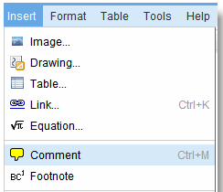
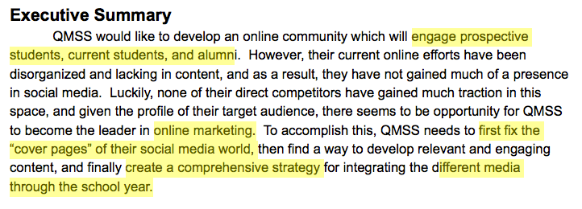
Adding comments
A useful tip:
  If you'd like a shortcut, you can also use the keyboard shortcut, CTRL+M to insert a comment
To delete a comment,
  Simply click on it and choose Delete comment from the menu.

Slide 27
Inserting links
If you want to insert a link to a website or an online document as a reference, follow these steps:
  Place the cursor where you'd like the link to appear in your document.
  Click the Link icon from the toolbar, and a window appears.
  Select 'URL' at the top of the window.
  Enter the URL.
  Click Insert Link. The inserted URL will now be visible in your document.

Slide 28
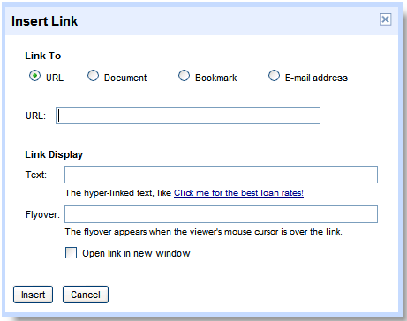
Inserting links

Slide 29
Hiding the actual link’s URL
You can also hide the actual URL but still link to the website from specific text in the document.
  For example, you could choose to link to www.google.com from the words 'search here.'
  If someone clicks 'search here‘, www.google.com opens automatically.
  To insert a link within text, simply type the text into the first text box in the Link Display section.

Slide 30
Sharing your documents
Now you've created your Google document,
  You can share it with your friends, family, or coworkers.
  You can do this from your Docs list or directly from the document.
From the Docs list
  Select the checkbox next to the document you want to share (you can also select multiple documents), and
  Click the Share drop-down menu in the toolbar.
From your document
  Click the Share drop-down menu in the top right corner of the page.

Slide 31
Sharing your documents contd.
Follow these instructions to share documents:
  Select Invite people…
  Select To edit or To view, depending on your preference
  Enter the email addresses or mailing lists that you'd like to add.
  If you'd like to add a message to your invitation, enter some text and click Send.
  To skip sending an invitation, click Add without sending invitation.
  Your collaborators and viewers will still be able to access the document from their Docs lists, but won't receive an email invitation.

Slide 32
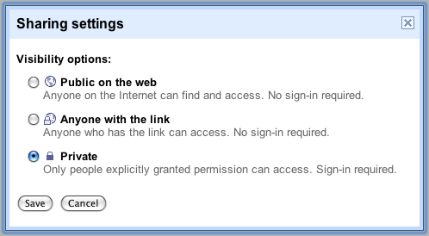
Sharing the documents

Slide 33
Revision history
While you and your collaborators are editing a document,
  You can keep track of changes (and of the person who made them),
  Even revert to an older version by using 'Revision history'
  From your document, click File>See revision history
On the next page,
  You'll see a list of the revisions, the date and time each was last edited, and the changes made.

Slide 34
Revision history contd.
If you change your mind about the most recent edits you or your collaborators made to the document, simply revert to an older version. Here’s how:
  Click any revision from the list you see.
  If you select the wrong one, you can click Older or Newer until you find the version you want.
  Click Revert to this one on the right side of the page
  Your document is reset to the version you selected.
  When your collaborators view this file, they'll see the version you selected.

Slide 35
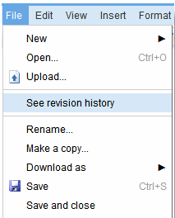
Revision history

Slide 36
Publishing
Once you're done creating and editing your document, you can publish it to a webpage.
  Just click the Share drop-down menu on the top right and choose Publish as webpage.
  Then, click Publish now.
You can send your document's web address
  To your friends, colleagues, and family, and they can enter it in their browser address bar to view your document.

Slide 37
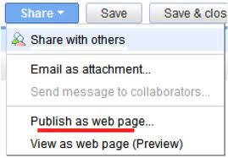
Publish as web page

Slide 38
Printing
If you want a hard copy of your document, you can print it from a PDF or as a webpage.
Here's how you can print as a PDF:
  From within the document, select File > Print
  A PDF appears with the print dialog box ready for printing.
To print as a webpage, follow these steps:
  From within your document, select File > Print as webpage.
  You'll see a page with the print dialog box ready for printing.

Slide 39
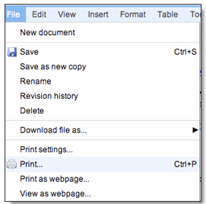
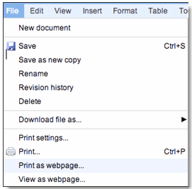
Printing

Slide 40
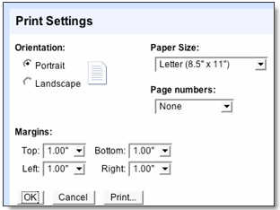
Print settings
If you'd like to change the default paper size or page orientation before printing,
  you can select Print settings from the File menu to access the Print settings window.
  Once you've changed the settings, click Print at the bottom of the window. A PDF with a print dialog box appears.

Slide 41
Summary
Google drive
Google docs
Creating a document
  New, existing, templates
Save a document
Editing a document
Inserting images & links
Sharing a document
Publishing a document
Printing a document

Slide 42
Activity- 20 minutes
View and explore Google docs interface.
Create and save a document using Google docs.
View your saved documents in Google drive.
Publish your document.
View printing options in Google docs.

Slide 43
Thanks
End of Lecture 28

Slide 44
Allah Hafiz

