Slide 1
Online Collaboration Applications
ADE100- Computer Literacy
Lecture 27

Slide 2
Knowledge test
What is the purpose of web 2.0 technologies?
What is text chatting?
Name some applications used for chatting?

Slide 3
Topics covered
Introduction to online collaboration
Working with an online collaboration application
  Applications: Google docs, etc.

Slide 4
What is Collaboration?
Collaboration
  A working practice whereby individuals work together for a common purpose to achieve some business benefit
Key features of collaboration tools are:
  Synchronous collaboration
    Online meetings and instant messaging
  Asynchronous collaboration
    Shared work spaces and annotations(comments)

Slide 5
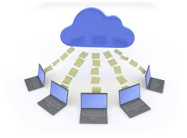
What is Online Collaboration?
Online collaboration
  Offers the ability to interact virtually with anyone to accomplish a task.
Several different ways to collaborate such as
  Online meeting rooms
  Live chat
  On-line bulletin board
    A program that allows users to connect and log into another system to share data and other contents.
  Web meetings and much more.

Slide 6
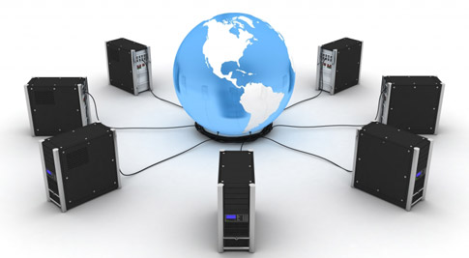
Online collaboration
Online collaboration
  E-learning is not limited by geography
  Online classrooms usually comprise an incredibly diverse group of people from cultures all over the world
  More unique experiences, ideas and attitudes which can be shared
  This also means additional challenges.
  These challenges can all be turned to the advantage of learners when they are met by people willing to work together to succeed.

Slide 7
Benefits of online collaboration
Benefits
  Meet with anyone, anywhere in the world globally.
  Communicate without the hassle or expense of traveling
  Demonstrate products & services to anyone, anytime
  Hold small customer meetings or large conference forums
  Deliver live, time-critical interactive training on any topic to targeted audiences anywhere in the world.
  Local language capabilities.
  Measure your success with detailed reporting and trackability.

Slide 8
Three ways to use online collaboration
Web Meetings
  Collaborate with 1 to 50 people.
  Communicate and connect instantly as you present information
  Share applications without leaving your office
Online Events
  Hold large online events and webinars (a seminar on the web) and reach more people in less time.
  From product market launches, to distributor training sessions and more, connect with your large global audience.

Slide 9

Three ways contd.
Remote Support
  Increase first call resolution with customers in the lab or in remote locations
  Minimize on-site visits with attended or unattended remote support

Slide 10
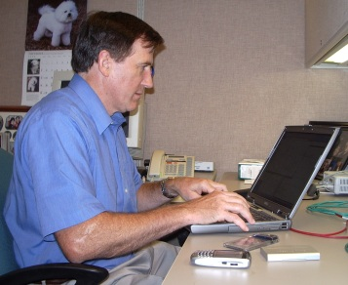

Work together remotely
Meet with anyone more quickly and efficiently to resolve issues.
Troubleshoot issues instantly
Increase productivity
Increase customer satisfaction

Slide 11
Examples of online collaboration
Training Programs
Technical document sharing
Local language presentation
Real-time technical support

Slide 12
Topics covered
Introduction to online collaboration
Working with an online collaboration application
  Application: Google docs

Slide 13
Collaborative applications
Collaborative software
  Also referred to as groupware, workgroup support systems or simply group support systems
  Designed to help people involved in a common task achieve their goals.
  It allows people to work together on the same documents and projects over local and remote networks.
  Also called "social software“, embraces the communications systems as well including
    E-mail, videoconferencing, instant messaging and chat

Slide 14

Google docs
Google Docs
  A free Web-based document-sharing service
  Offered by Google within its Google Drive service
  A storage service but has been replaced by Google Drive
  It allows users to create and edit documents online while collaborating in real time with other users
  Serve as a collaborative tool for editing documents in real time.
  Documents can be shared, opened, and edited by multiple users simultaneously.

Slide 15
Google docs 2
Google Docs can automatically store and synchronize
  Any Microsoft Word document, PowerPoint presentation, or Excel spreadsheet to Google Docs
    In Google Docs or Microsoft Office formats
  The Google Doc copy is automatically updated each time the Microsoft Office document is saved.
  Microsoft Office documents can be edited offline and synchronized later when online.

Slide 16

Google docs 3
Google docs
  Launched 1 GB of storage for free primarily
  In 2012, the free storage increased to 5 GBs
  Support 15 file formats for viewing
  Although you can upload any, including:
    Microsoft Word (.doc and .docx)
    Microsoft Excel (.xls and .xlsx)
    Microsoft PowerPoint (.ppt and .pptx)
    Adobe Portable Document Format (.pdf )

Slide 17
Google docs in education
Google docs
  Enable faculty and students to collaborate more efficiently and effectively on papers, spreadsheets, and presentations
  Facilitate collaboration, provide timely feedback to help student teams improve their work & to monitor student progress

Slide 18
Ways to facilitate collaboration
Team projects
  Several people can collaborate simultaneously
  No need to keep track of several versions of documents
  The revision history features allows one to revert to previous versions of the document, if needed
    This also encourages more accountability since each “collaborator” on the Google Doc can see exactly what they contributed
  The auto-save feature ensures their work will never be lost.

Slide 19
Ways to facilitate collaboration 2
Providing feedback on team projects
  Using the comments feature, you can add feedback in-text or in the margin of the document.
    This way, you can give feedback in your own timeframe and don’t have to worry about coordinating group meetings.
  You can also hold “online office hours” using the chat function if you wish to talk to students about their work.

Slide 20
Ways to facilitate collaboration 3
Full class collaboration
  Share a Google Doc with the whole class to coordinate group projects and presentation signups.
  Or create a venue for interactive brainstorming.
  Encourage students to share their work with the class to allow others to see their ideas and get feedback.

Slide 21
Requirements for Google docs
You should have the following skills to use Google docs effectively.
  Email management skills
  Basic knowledge of word processing

Slide 22

dimdim
Create online classrooms for distance education, tutoring, advising.
Built-in audio and four-way video.
Students and teachers can replicate the traditional classroom experience in cyberspace.
Share Desktop applications.
Students do not have to install anything to their computer.

Slide 23
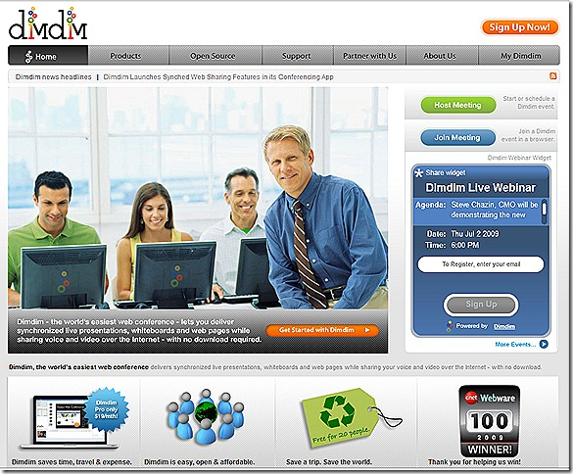
dimdim interface

Slide 24

WiZiQ
Collaborative Web conferencing environment
Enables you to communicate synchronously (in real-time) using video and audio
Or through text chat to share presentations, documents and images on an interactive whiteboard.
Can Record classes.

Slide 25
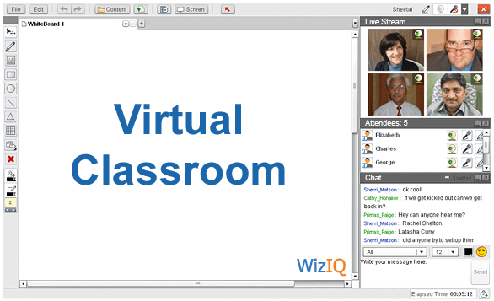
WiZiQ

Slide 26

Dabbleboard
Dabbleboard
  Online collaboration application that’s centered around the whiteboard.
  New type of drawing interface that's actually easy and fun to use.

Slide 27
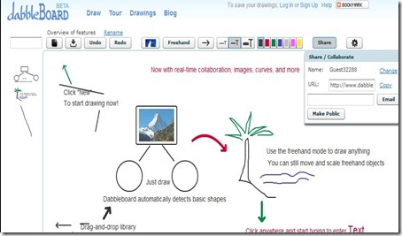
DabbleBoard interface

Slide 28

Twiddla
Web-based meeting playground.
No-hassle whiteboard solution for collaborating online.
Browse websites and draw on them.
Share files, and chat with your students.
Audio options.

Slide 29
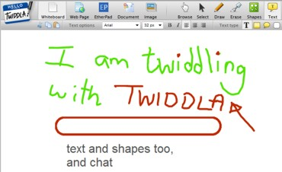
Twiddla interface

Slide 30

Writeboard
Simple, web-based collaborative writing solution
Free and easy to use.
People can see updates, edits, and changes in real-time.
Can save, track revisions, create versions, and roll back to previous versions of Writeboard.

Slide 31
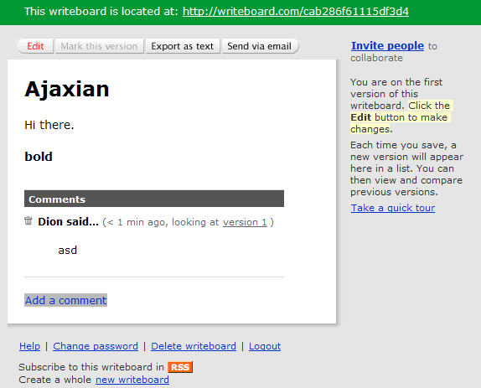
Writeboard interface

Slide 32

bubbl.us
Free, web-based application for collaborative brainstorming.
Create beautiful mind maps that you can share with team members.
You can save, email, and print your mind maps or even embed them directly onto a web page.

Slide 33
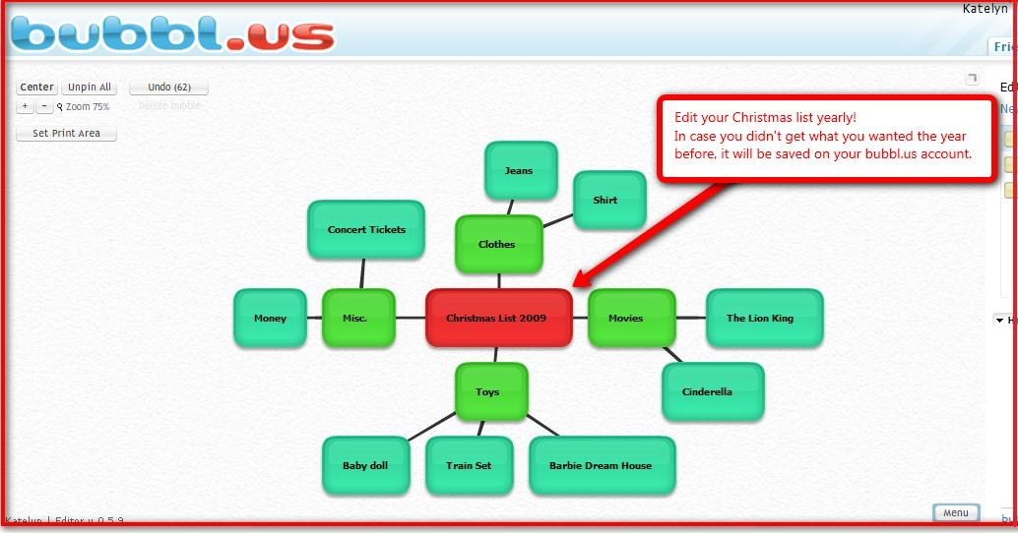
bubbl.us interface

Slide 34

Wimba Pronto Instant Messaging
Instant collaboration system designed for education and Blackboard.
Collaborate and learn in an informal “virtual venue”
Deliver campus services, office hours, library services, or tutoring sessions online.
Blackboard classes loaded automatically.
Student and Instructor have to download the software to their computer.

Slide 35
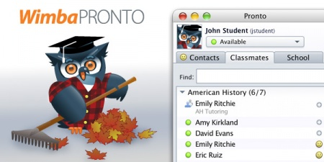
Wimba Pronto interface

Slide 36
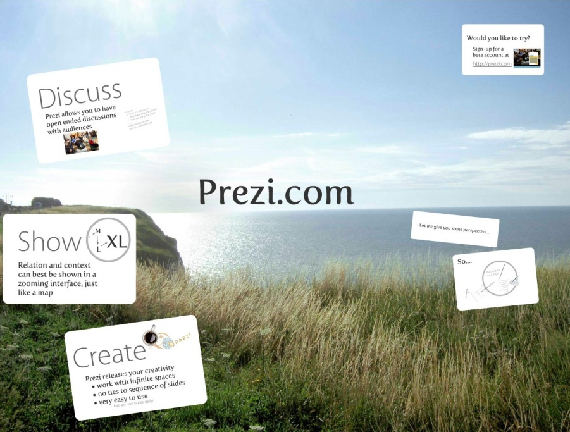
Prezi
Zooming presentation editor
Create presentations live and on the Web
Moving and dynamic

Slide 37
Summary
What is Online Collaboration?
Using Google docs
  Google sheets, slides, sheets, Forms
Other applications
  Dimdim, WiZiQ, dabbleBoard, Twiddla, Writeboard, bubbl.us, Wimba Pronto and Prezi

Slide 38
Activity- 20 minutes
View and explore interfaces of “Google docs, dimdim, WiZiQ, dabbleBoard, Writeboard, Wimba Pronto and Prezi”.

Slide 39
Thanks
End of Lecture 27

Slide 40
Allah Hafiz

