Slide 1
Communication Through Internet
ADE100- Computer Literacy
Lecture 26

Slide 2
Knowledge test
What do you understand by Sign up?
What is the purpose of Sign in?
How folders are attached in the email?
What is the functionality of Compose option in the mail box?

Slide 3
Topics covered
Using web 2.0
Using chat/talk applications
  Skype, Google Talk, etc.

Slide 4
Web 1.0
Web 1.0
  Refers to an early stage of the WWW evolution
  Content creators were few in Web 1.0 with the vast majority of users simply acting as consumers of content
  Personal web pages were common, consisting mainly of static pages hosted on ISP-run servers, or on free hosting services such as Geocities.

Slide 5
Web 2.0
Web 2.0 , a phrase coined by O'Reilly Media in 2004,
  Refers to a perceived second-generation of Web-based services such as
  Social networking sites, wikis, communication tools, and folksonomies
    That emphasize online collaboration and sharing among users.

Slide 6
Web 1.0 & web 2.0
Web 1.0
MP3 (Pre-IPod)
Britannica online
Personal websites
Documentation
Directories (taxonomy)
Stickiness
Web 2.0
IPods
Wikipedia
Blogs
Wikis
Tags (folksonomy)
Syndication (marketing)
Folksonomy: A system of collaboratively creating and managing tags to annotate and categorize digital content

Slide 7










Shared pictures
Shared videos
Shared news/podcasts
Shared knowledge
Shared bookmarks
Shared projects
Shared ‘you’
Shared library
Shared virtual life

Slide 8
The Challenge
Schools and teachers must update their learning methods to include
  the use of ICT, web 2.0 technologies, social media and mobile computing.

Slide 9
The reaction
How do schools & teachers react to this challenge?
Schools
  Ask for more money to buy computers.
  Register a Facebook page.
  Tell teachers that they have to learn ICT and use it in class.
  Make rules for the use of ICT in class.
Teachers
  Ask for time off to update their ICT-competence.
  Register a Facebook page and a Twitter account

Slide 10
How teachers meet the challenge?
Find a web 2.0 application
Learn to use the application
Figure out how to use app in class
Teach the students to use the app
Do a project with the class

Slide 11
The problem
It’s a one-off.
  Teacher go back to traditional teaching as soon as the project is done.
It’s time consuming.
  It steals a lot of time from the teachers primary tasks.
Students don’t get it.
  Students feel the application is just one more thing the teacher tells them they have to learn.

Slide 12
The problem
Teachers are unable to stay updated.
  There are thousands of web 2.0 applications and services.
  New are added every day and old ones are constantly updated.
  The application will become obsolete or changed before it can be reused

Slide 13
Digital Literacy
Today’s technology driven society also requires digital literacy, which means that an individual can
  Read and write digitally in order to access the Internet
  Find, manage and edit digital information
  join in communications
  Engage with an online information and communications network

Slide 14
Enter “Classroom 2.0”
Benefits of teaching and learning with Web 2.0 technologies:
  Fosters collaborative learning
  Facilitates real-time learning and feedback, breaking down a culture where learning is seen to occur only in the classroom.
  Encourages self-directed, relevant, authentic learning in teachers and students.
  Enhances student engagement and ownership of learning.

Slide 15
Enter “Classroom 2.0”
Breaks down physical barriers around the classroom,
  Allowing students to share, collaborate and network with other learners across their year level, in subject areas, in their community or globally.
Provides a context for students to develop digital literacy skills:
  Read and write digitally; find, manage and edit digital information; engage with a digital information system.
Provides a platform for learning responsible digital culture
  Cyber safety, privacy issues, copyright, responsible digital citizenship, empowerment in a digital age.

Slide 16
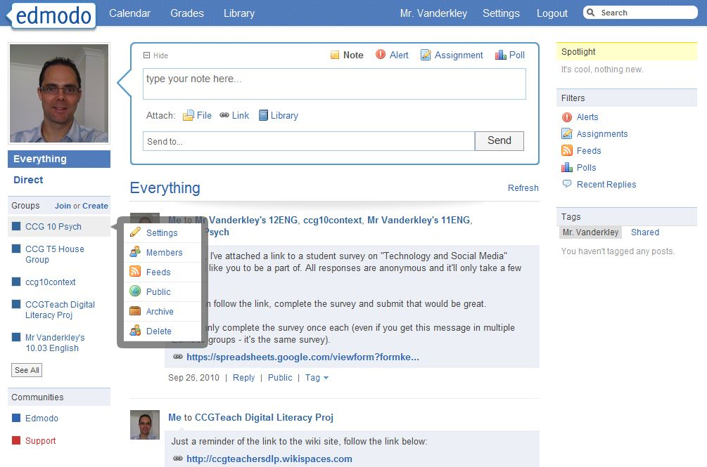
Web 2.0 tools
Notes:
Basically it’s about...(text)
Such as a class portal, a blog, a wiki, a social bookmarking tool, etc.

Slide 17
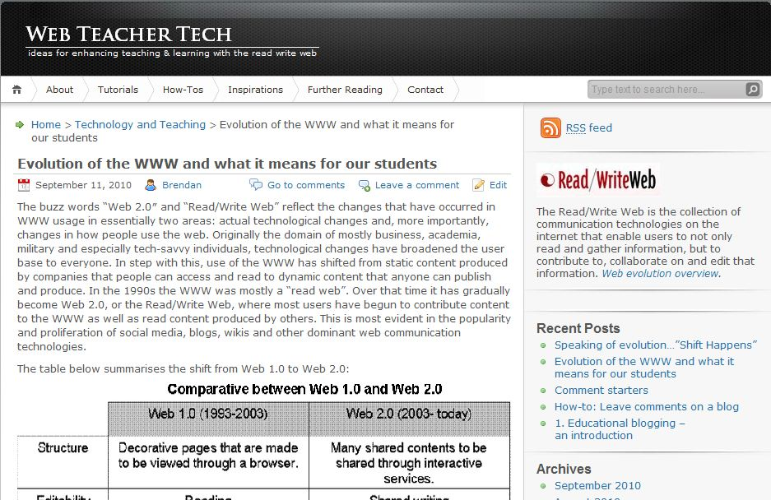
Web Teacher Tech

Slide 18
Topics covered
Using web 2.0
Using chat/talk applications
  Skype, Google Talk, etc.

Slide 19
What is Chat?
Chat
  A general term for real-time communication that occurs over the Internet.
  Originally, the term chat described the act of users exchanging typed messages

Slide 20
Types of Chat
Text Chat
  Communication between chat users takes place via typed text.
  The user types their message into the chat program, sends it, and it instantly appears on the screen(s) of the other user(s).
Audio or voice chat
  Communication between chat users takes place via audio, much like a phone conversation, but is conducted on the internet.
  However, for learners need to have a microphone and speakers and/or hear phones.
Example: Skype

Slide 21
Types of chat
Public chat
  Users do not know each other, although regular users of a specific chat room will get to know each other over time, and users may decide to use an alias instead of their real name.
  Example: Yahoo! Chat
Private chat
  This requires the installation of a client program, which connect individual users over internet.
  Private text chat is also known as instant messaging.
  Examples: Yahoo! Messenger, MSN, Google Talk, etc.

Slide 22

Using Skype
Download the latest version of Skype for your PC.
Go to http://www.skype.com/en/download-skype to get started.
If you look in the upper hand right corner of the page that pops up you should see a light blue "Join Skype" button with blue writing. Click on that.

Slide 23
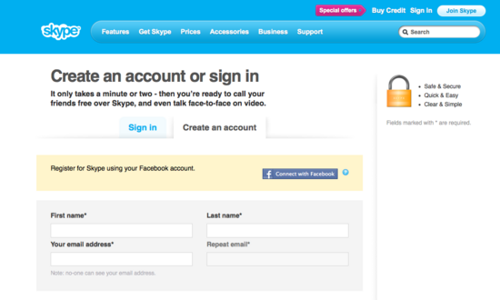
Setting Up Personal Information
Enter your personal information.
    Don't worry, all of the information is confidential unless it clearly states that it will be displayed or given to the public, or if you give your explicit permission to do so.

Slide 24
Create Skype Username and Password
Have a care when you create your user name.
You will not be able to change or delete this in the future.
Enter in your password.
  Your password must be at least 6 standard characters, and also must include at least 1 number.
  Skype's password checker is very strict.

Slide 25
Setting Up Passwords
When choosing a password it is a good idea to
  Keep changing it until it says "Password: Good" in green below the password box.
A “Medium” password works fine, but a "Good" password is best.
If your password is too weak, you will not be allowed to continue.

Slide 26
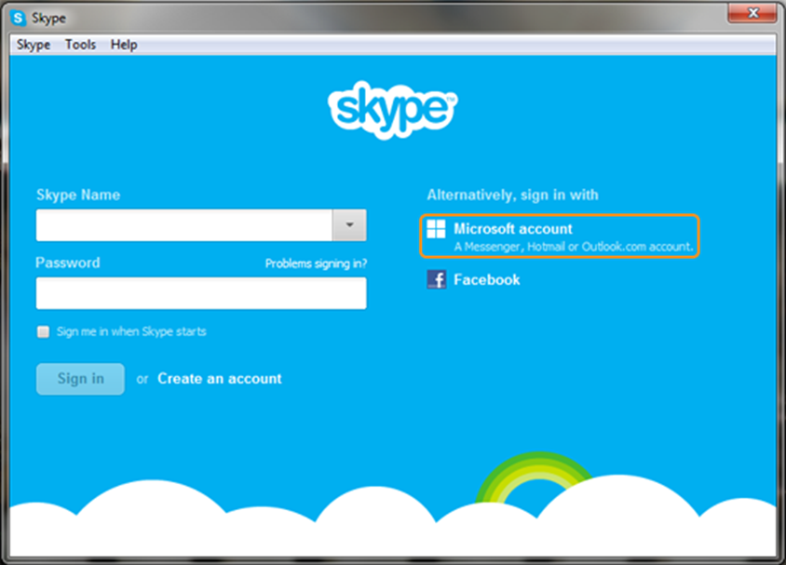
Sign in to your Skype account
After you have established your Skype account,
  You will see the following window.
To begin using Skype, you need to sign in first.
You can sign in with your:
  Skype Name – if you already have a Skype account

Slide 27
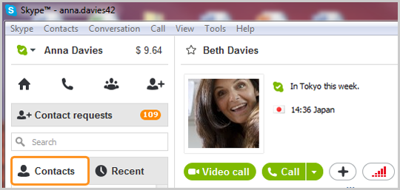
To Make a Video Call
Sign in to Skype, then click the CONTACTS tab.
Find the person you want to call and make sure that they are online.
Click the contact. You will see the details on the right side of the window.

Slide 28
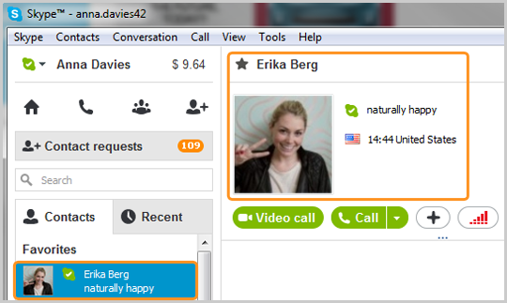
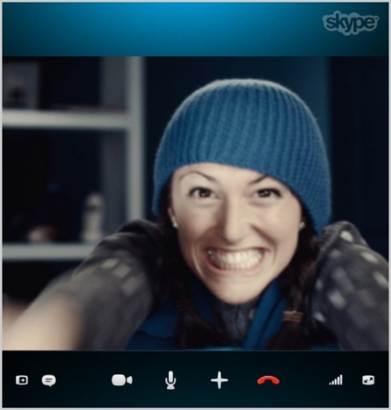
To Make a Video Call
Click the Video call button.
The screen changes color, a call bar appears near the bottom of the screen and you’ll hear ringing until the other person answers.
If you can’t see or hear each other, click the quality button in the call bar and check your settings.

Slide 29
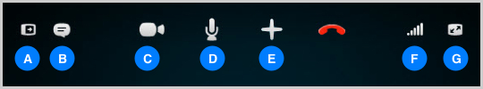
Call Screen Settings
Hide or reveal your Contacts, Facebook or Recent lists.
Instant Message the person you are talking to.
Turn your webcam on/off so the person can/can’t see you.
Mute your microphone so the other person can’t hear you.
Share your desktop, share a file, or add people to the conversation.
Check your call quality information and adjust your volume.
View or exit full screen mode.

Slide 30

Sharing Your Screen in Skype
Screen sharing lets you share your computer screen with anyone on Skype.
You can display presentations, show photos and videos without having to send them
Before you share your screen, make sure that you have:
  The latest version of Skype
  A strong internet connection

Slide 31
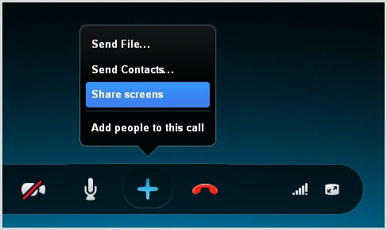
Sharing Your Screen in Skype
After the call has started, click the + button in the call bar and select Share Screens.

Slide 32
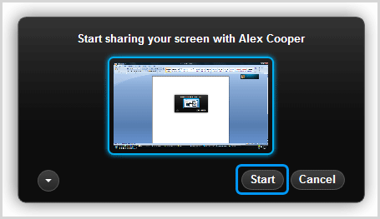
Sharing Your Screen in Skype
In the dialog box that appears, Click Start to share your entire screen.

Slide 33
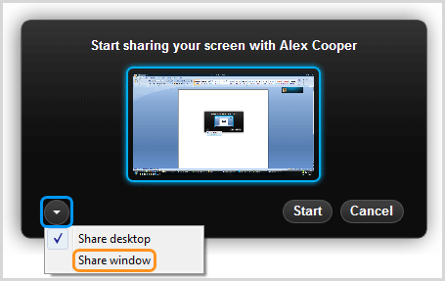
Sharing Your Screen in Skype
To share a specific window, rather than your entire screen,
Click the down arrow button and select Share Window.

Slide 34
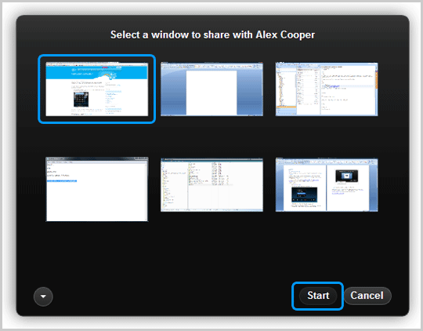
Sharing Your Screen in Skype
Then select the window you want to share and click Start.

Slide 35
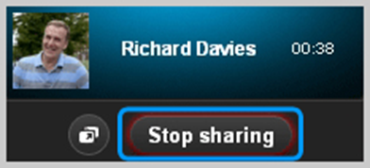
Sharing Your Screen in Skype
You can change screen sharing options at any time by clicking the Change Sharing Options icon in the floating call window.
When you want to stop sharing your screen, in the floating call window click Stop Sharing.
Only one person can share their screen at a time.
The person you are sharing your screen with can send you video, files , or photos.

Slide 36
To End a Skype Call
Just click on the red phone icon and end the call.
Close your Skype window.

Slide 37
Activity- 20 minutes
Sign in to your facebook account. View and explore the interface of facebook.
Create a user account using any chatting software like Google Talk, Skype, etc.
Sign in to your Skype account.
View and explore the interface of Skype.

Slide 38
Thanks
End of Lecture 26

Slide 39
Allah Hafiz

