Slide 1
Communication Through Internet
ADE100- Computer Literacy
Lecture 25

Slide 2
Knowledge test
What is the use of Print Screen in quick draw approach?
Why do we need to save a webpage?
What type of content you can find on the multimedia resources?

Slide 3
Topics covered
Creating and using email to communicate and collaborate
  Email management (creating, sorting, forwarding, searching, flagging and deleting)
Attaching document (files and folders)

Slide 4
E-Mail
Electronic mail (E-Mail)
  Only internet service widely used on the web
  Exchange messages through a computer network
  Mostly used to send/receive text messages but you may exchange audio/video messages
Advantages
  Less expensive than telephone
  Faster than postal mail service
  Easy to access anywhere
  Attach documents, images and program files

Slide 5
Mail server
Mail server
  When you send an email message, the message will store on the server until the recipient will access it.
POP server
  Mail servers that use Post Office Protocol (POP)

Slide 6
Creating a free email account
Several websites allow you to create a free email (Electronic Mail) account
For example,
  www.gmail.com
  www.yahoo.com
  www.hotmail.com
  www.msn.com
The computer must be connected to the internet for using email service.

Slide 7
Hotmail
Hotmail
  Totally free email service run by Microsoft
  Used to send and receive email
  User friendly interface
  Sign up first to create an email id
  When you create an account then you can send or receive emails anywhere anytime
  Hotmail service is run by Hotmail webpage

Slide 8
Email address
info@gmail.com
First part (info) is your email id
Then @ (at sign) differentiates email id and domain
Gmail is your host computer
Com is commercial domain name

Slide 9
Creating an email account
Go to http://www.hotmail.com
Click on the words “Sign up” to register on the site
A registration form will display. Fill in the form.
Registration form consists of two parts which require two kinds of information.
Profile information
  First name, last name, language, country, city, postal code, time zone, gender, birthday, occupation

Slide 10
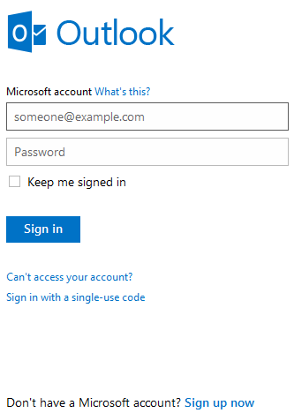
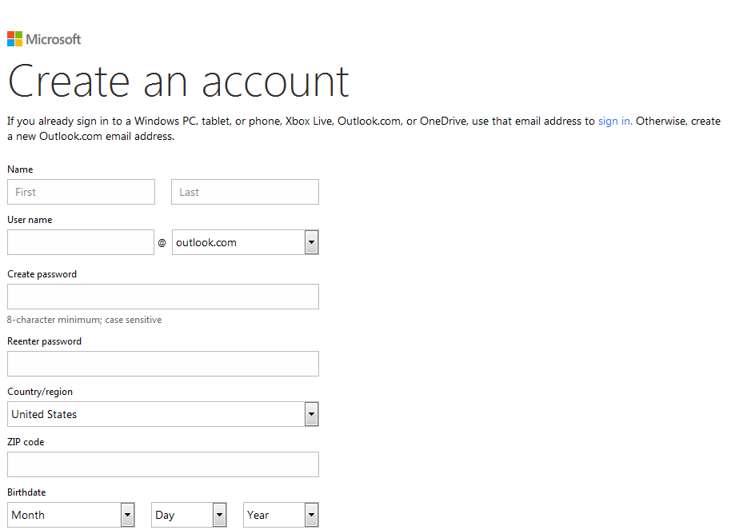
Sign up & registration form

Slide 11
Creating an email account 2
Account information
  Email address: username@hotmail.com
  Password
  Retype password
  Secret question: High school name?
  Secret answer
  Registration check: enter some character you can see on the screen in irregular manner
Now click submit button at the bottom of form

Slide 12
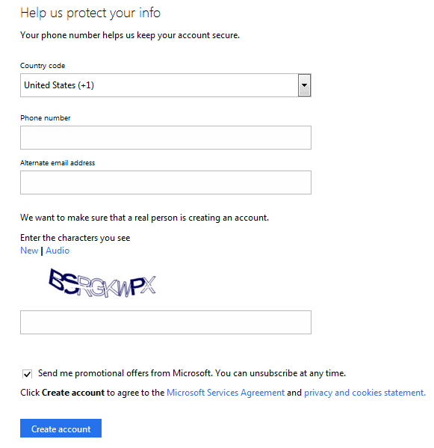
Registration form 2

Slide 13
Creating an email account 3
A webpage will appear to congratulate you for your new account.
Click Continue button on this webpage
You are taken to a screen with hotmail terms to use.
You may read and then click “Accept” button rather than “I decline” button
The next screen will ask you if you wish to subscribe to various online publications.
Subscribe if you wish and press continue button
Now your hotmail account will appear

Slide 14
Using an email program
Standard email programs are free and easy to use
Microsoft Outlook Express is commonly installed on Windows-based computers.
Mostly web-based email service is provided on the websites like gmail, yahoomail, hotmail, etc.

Slide 15
Sign in to your email account
Enter URL of your host website like www.hotmail.com
Click sign in or Log in because you already sign up
A webpage will display with username and password fields
Enter your user name like info@gmail.com
Then enter your password
“Keep me signed in” option will save your password for next time. Select the checkbox
Click Sign in button

Slide 16
Sign in form

Slide 17
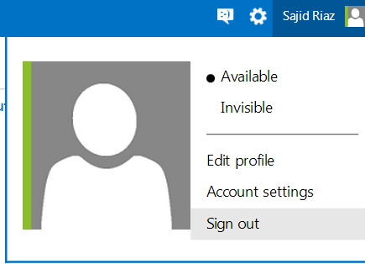
Sign out from your mail box
After sign in
  You can check your emails
  You can also compose a message
  You can search a message, etc.
When you finish your activities then sign out

Slide 18
Sending an email
Click on the Compose in the hotmail menu bars
A new page will open where you can type an email message. The contents of this page are:
To:
  Type the recipient email address
Cc: (Carbon copy)
  Use if you want to send the exact copy to another person. Just type email address.
Bcc: (Blind carbon copy)
  Similar to Cc but the email address given here is not displayed to other recipients

Slide 19
Composing an email
Subject:
  Shows the purpose of your message
Attachments:
  Attach one or more files/folders
Message box:
  Type your message here. You can format the text using toolbar.
Send:
  Click Send button when your message is completed

Slide 20
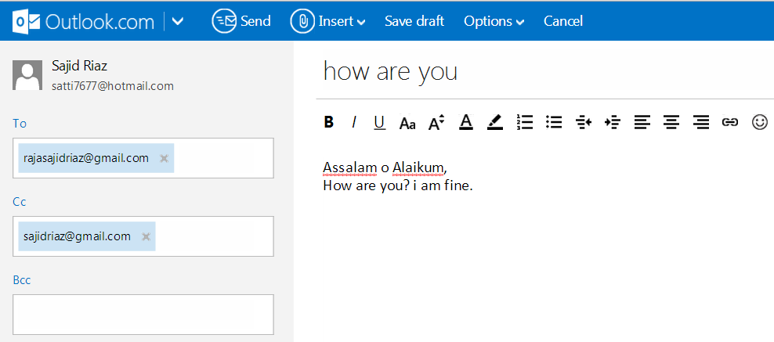
Composing an email
subject

Slide 21
Receiving and reading an email
When someone sends a message, it appears in the inbox folder.
Click the inbox option
A list of email messages will display on the right side with the subject line text
The old and read messages will display in normal text
The new and unread messages will display in bold format
Click any message to display and read it.

Slide 22
Receiving and reading an email
Once you receive a message then you can do the following actions:
Reply:
  Send a response back to the sender
Reply All:
  Send the reply to all the senders
Forward:
  send message to someone else or sender
Delete:
  Deletes the message and send to Trash folder

Slide 23
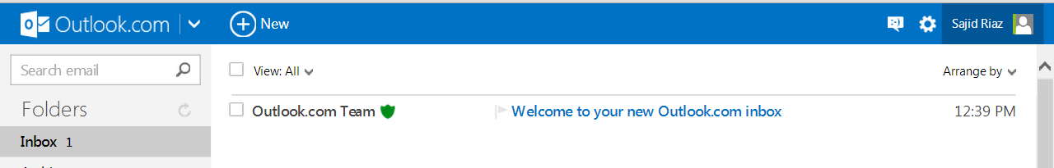
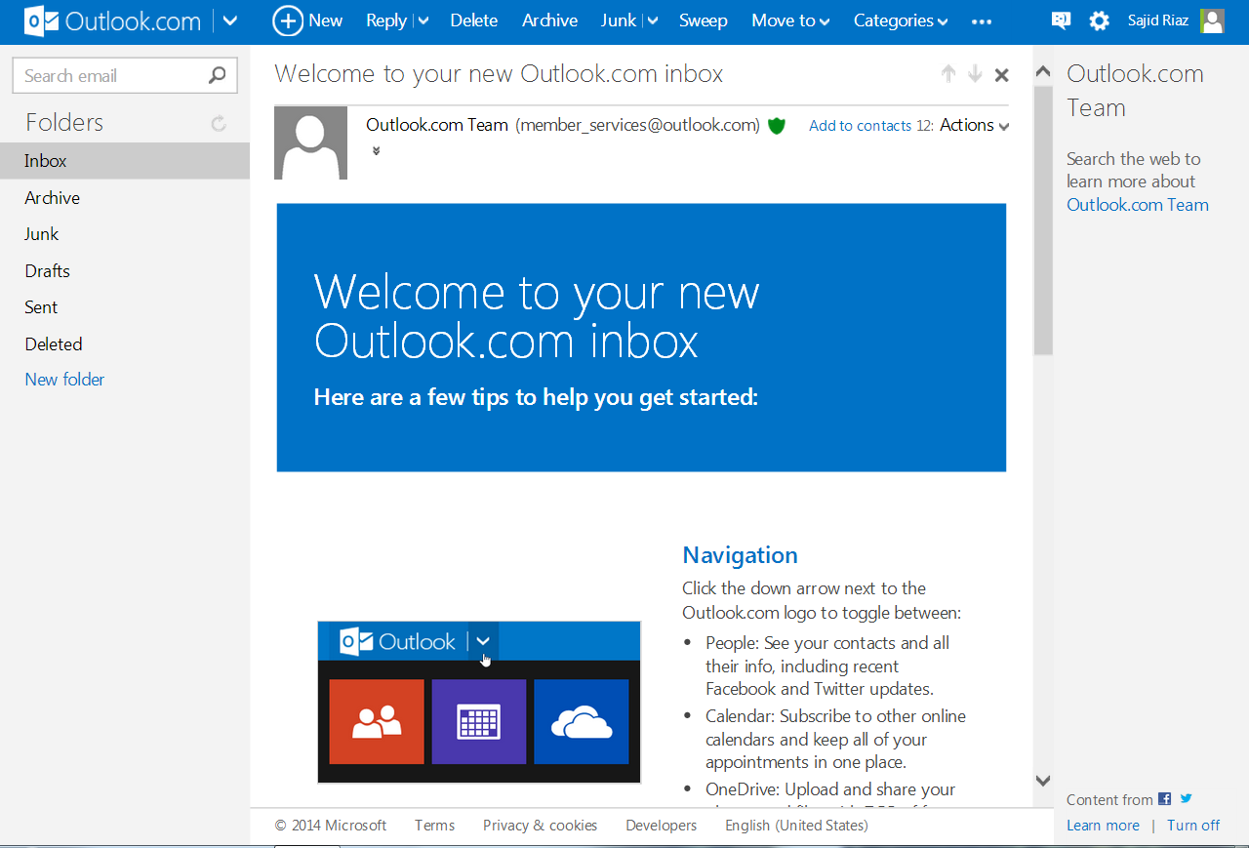
Reading an email

Slide 24
Email Attachments
You can send one or more files/folders in your email as an attachment
  Files can be attached easily but folders are attached in the zip format
  Using a compression software first compress the folder and then attach it
  If the size of a file is heavy then you first compress it and then attach it
  Compression overcomes the bandwidth limitations

Slide 25
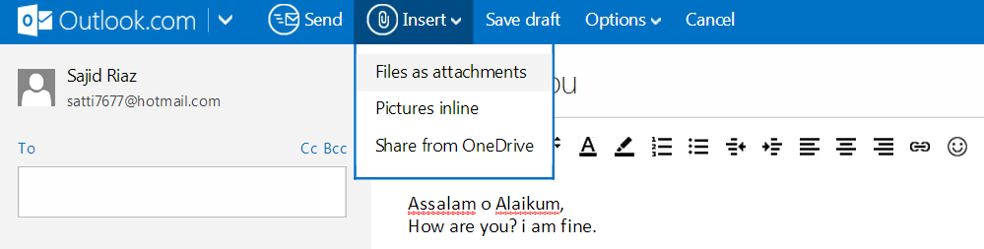
Attachments

Slide 26
Attaching files
Sign in to your account
Compose a message
Click attachment icon in the modern email program OR
Click Browse button in front of attachment option
Search and select the file and then click Open button from the dialog box
The file will be display and attach soon after some processing
Similarly attach more files

Slide 27
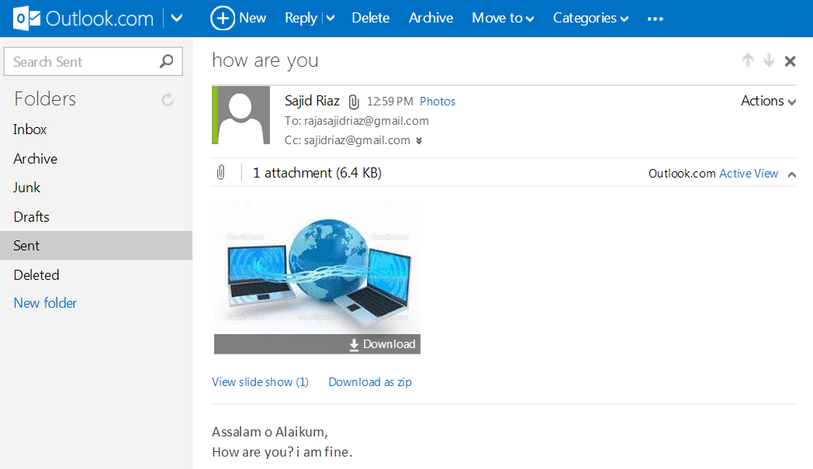
File attached

Slide 28
Attaching folders
Sign in to your account
Compose a message
First compress the folder if you want to attach several files
Compressed folder will act like a single attachment
Click attachment icon in the modern email program OR
Click Browse button in front of attachment option
Select the compressed folder and double click it
The folder will attach soon after some processing
Similarly attach more folders

Slide 29
Opening email attachments
When you receive an email with attachment, the attachment sign appears
The attached file icons with filenames will be displayed at the end of your email message
If you click on the file then it will be opened in your browser using a plug-in
Download the attachment files on your system using the download option below the attached document

Slide 30
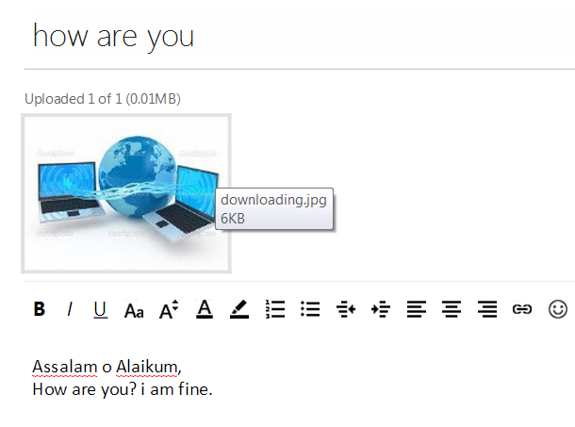
Opening attachments

Slide 31
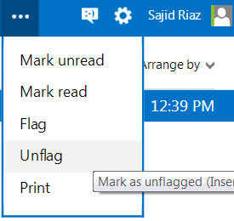
Flagging emails
Flagging
  Does not do anything to email
  Simply a visual reminder for you
  Perhaps you want to flag an email for some latter action like read it again.
Unflagging
  Once you performed the desired action
  Remove the flag

Slide 32
Searching emails
It is difficult to browse through hundreds of old emails just to find a particular email message.
Using Search box
  Find search box in your mail box
  Enter the word you are looking for in the box and click the magnifying glass icon or press Enter key
  For example, if you are looking for an email relevant to vcomsats
  Just type this word then all emails related to this word will be displayed

Slide 33
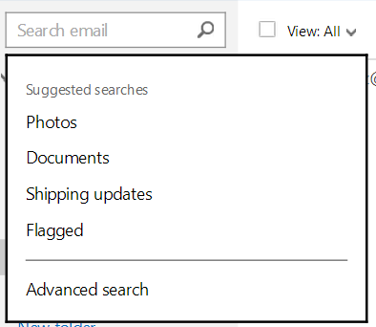
Searching email

Slide 34
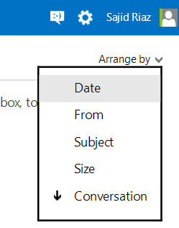
Sorting emails
Open the inbox in outlook.com
Click the arrow of “Arrange by”
Select the option from the menu to sort the emails

Slide 35
Activity- (30 minutes)
Create a new email account using hotmail, Gmail, yahoo or msn.
Sign in to your email account.
View and explore mail box options.
Send an email to your friend with some attachment.
View your email in the sent folder.
Read an email from your mail box and open the attachment.
Delete an email from your email account.
Reply to an email message.

Slide 36
Further reading
Introduction to computers, 7/e by Peter Norton
  Lesson 8B: Email and other internet services
Use Wikipedia for more information

Slide 37
Thanks
End of Lecture 25

Slide 38
Allah Hafiz

