Slide 1
Searching & Saving Web Resources
ADE100- Computer Literacy
Lecture 24

Slide 2
Knowledge test
What do you mean by downloading?
What is the purpose of uploading?
What is the function of plug-in?

Slide 3
Topics covered
Saving information from web pages
Interfacing with online multimedia resources
  Example: videos on www.youtube.com about learning computer

Slide 4
Saving a webpage
There are many reasons why you would want to save the text and other content of a Web page.
  For example, you may want to access the information without a network connection.
  You may also want to record the page's content let the information become unavailable for whatever reason.
  Pages go offline all the time, some never to return like broken link or bookmark.

Slide 5
Quick Draw approach
The fastest way to capture what's currently in the browser window is to press Print Screen in Windows to take a snapshot of the entire screen
Then open any image processor such as Paint
Press CTRL+V to paste the window or desktop capture into a new file
Save the file as a JPEG, PNG, BMP, or other image format

Slide 6
Drawback of Quick Draw
The screen capture is fast, but
  You probably want to copy more of the page than can fit in one browser window OR
  You may want just some of the page's text or images
  You won't be able to copy text from or otherwise interact with the duplicated content: it's one big image.

Slide 7
The Text Only approach
If you only want the text without images and interactive elements
  The fastest way is to press CTRL+A to select the entire page,
  Press CTRL+C to copy it
open any word processor or text editor, and
  Click Edit > Paste Special > Unformatted text
  The resulting text file includes all the text on the page, some of which you probably don't want, such as the page's site navigation.

Slide 8
The Text Only Approach
The text-pasting is more precise
  if you use the mouse to select only the text you want to copy rather than the entire page.
  Then press CTRL+C,
  Open your text editor/word processor, and press CTRL+V to paste the semi-formatted text
  In many word processors, links in the resulting text will be Ctrl-clickable
  Alternatively, you can click Edit > Paste Special > Unformatted text to paste plainly.

Slide 9
Print as PDF approach
Google Chrome's built-in support for "printing" a page to a PDF file gives the browser an edge over Firefox and Internet explorer.
  Simply click the wrench in the top-right corner
  Choose Print > PDF > Save as PDF
  In Windows the print-preview window lets you adjust the page layout from portrait to landscape
  Select only certain pages, and access other options by clicking Advanced.

Slide 10
The Browser Plug-in approach
After you sign up for a free account with the Read It Later service,
  You can create a single list all the pages you've saved for offline viewing, regardless of which browser or PC you use.
The Read It Later add-on for Firefox puts a button in the upper-right corner of the browser that provides quick access to your list of saved pages.
You can filter, search or sort your list and access your account options.
Right-click anywhere on the page
Choose Read This Page Later to add the current page to your offline-browsing list

Slide 11
Browser Plug-in approach
To add pages to your Read It Later list from Chrome and IE
  Drag the service's bookmark to the IE's Favorites toolbar and Chrome's bookmarks bar.
  If the bookmarks bar isn't visible in Chrome,
    Click the wrench icon in the top-right corner
    Select Preferences
    Check "Always show the bookmarks bar" under Basics

Slide 12
Google web history
Google Web History
  Helps people to manage their browser bookmarks and favorites,
  Used to retrace your steps on the Web
  Keep record of everything I've searched for and every site I have visited in reverse-chronological order
Many people prefer not to have their Web activities tracked so precisely.
  To prevent your history from being recorded, just sign out of your Google account.

Slide 13
Saving a webpage as a file
Open Internet Explorer
Go to the webpage you want to save
Click the Page button, and then click Save As
Navigate to the folder where you want to save the webpage.
By default, webpages are saved in Documents folder
Type a new name in the File name box if you want to change the name

Slide 14
Saving a webpage as a file
In the Save as type box, do one of the following:
  To save all the files associated with the page, including graphics, frames, and style sheets in their original format, select Webpage, complete.
  To save all information as a single file, select Web Archive, single file (*.mht).
  To save just the current HTML page, without graphics, sounds, or other files, select Webpage, HTML only.
  To save just the text from the current webpage, select Text File.
Click Save.

Slide 15
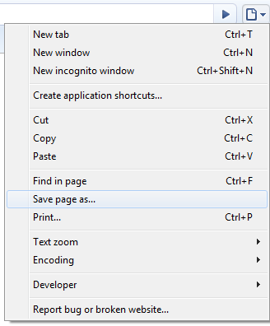
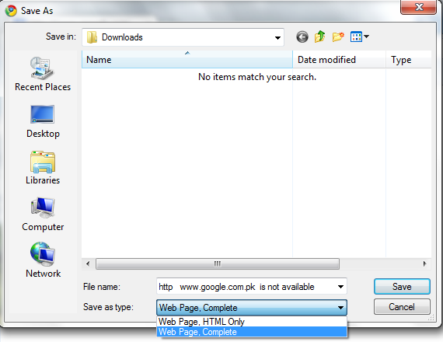
Saving webpage as a file

Slide 16
Interfacing with online multimedia
WGBH Teacher Domain
  Teachers’ Domain is a free digital media service for educational use from public broadcasting and its partners.
  You’ll find thousands of media resources, support materials, and tools for classroom lessons, individualized learning programs, and teacher professional learning

Slide 17
PBS Learning Media
PBS Teachers
  Awesome place for all kinds of educational multimedia
  Here you’ll find classroom materials suitable for a wide range of subjects and grade levels
  They provide thousands of lesson plans, teaching activities, on-demand video assets, and interactive games and simulations
  These resources are correlated to state and national educational standards

Slide 18
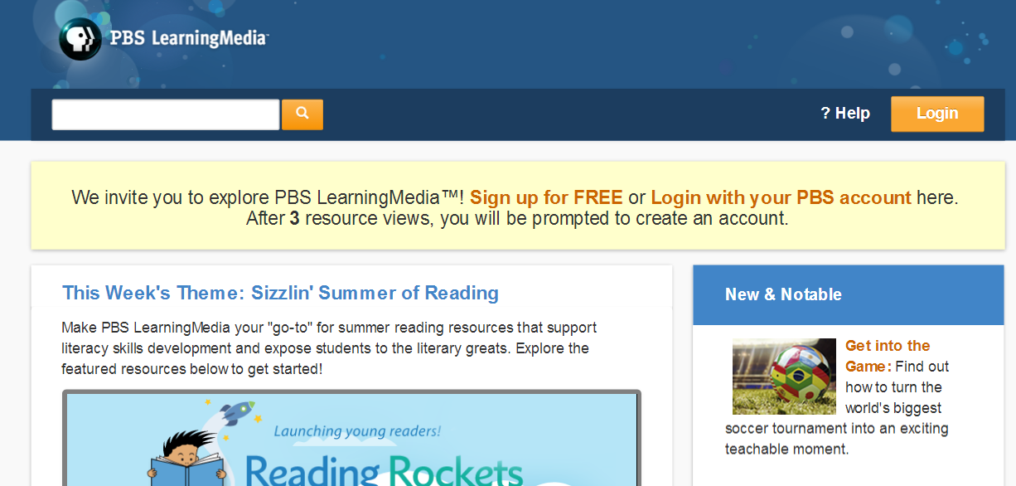
PBS Learning

Slide 19
Khan Academy Learning Media
The Khan Academy
  Students and teachers are encouraged to “Watch… Practice… Learn almost anything for free”
  Has a library of over 2,700 videos, covering everything from arithmetic to physics, finance, and history and 276 practice exercises
  They make it clear that they are on a mission to help you learn
    what you want, when you want, at your own pace

Slide 20
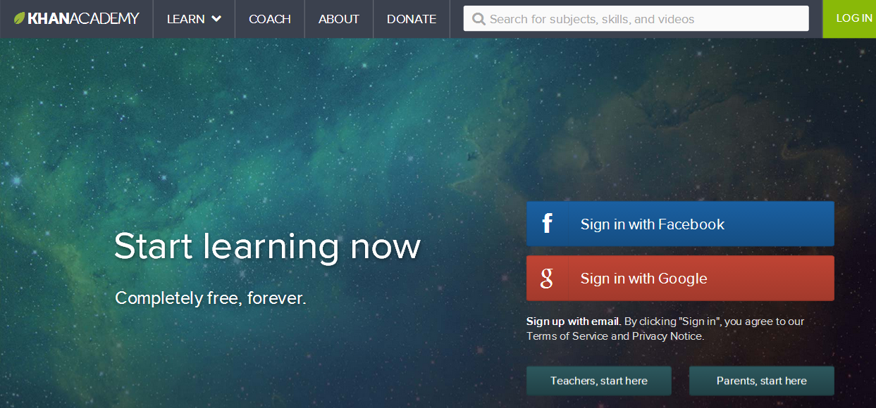
Khan Academy Learning Center

Slide 21
YouTube Learning Media
YouTube Education
  Let’s not forget YouTube and its amazing searchable collection
  These videos can be used for
    Teaching a concept
    Providing an entry event
    Providing the catalyst for a discussion

Slide 22
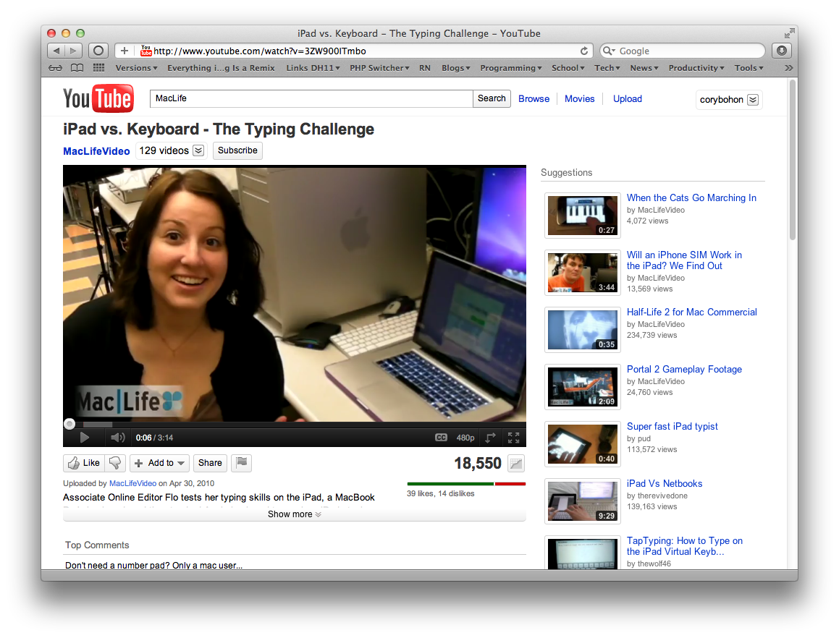
YouTube Education

Slide 23
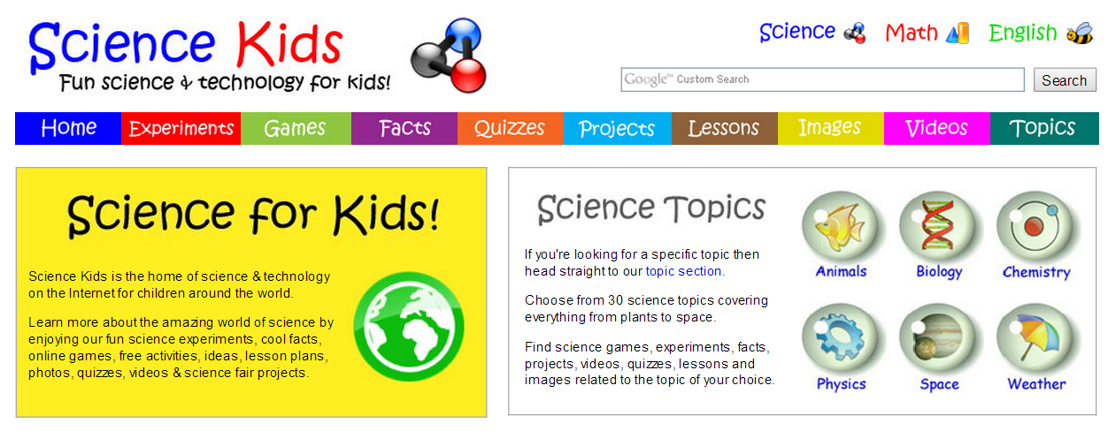
Science for Kids
Science for Kids
  Cool place for videos and activities
  You will find a gold mine of resources that can be put into a unit to help your students master content in a project.

Slide 24

How stuff works science
How stuff works science
  Excellent collection of videos that cover interesting and engaging topics across the science curriculum.

Slide 25
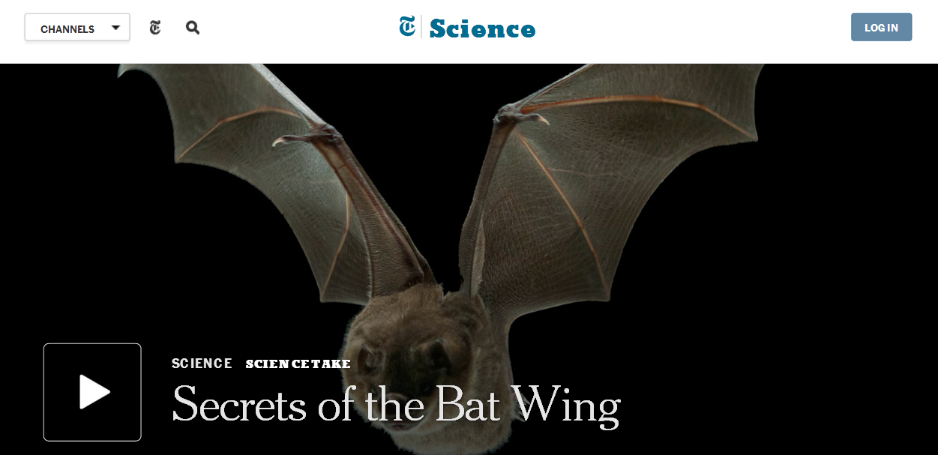
Science
Science
  A selection of engaging videos from the creators at the New York Times.

Slide 26
Watch/know/learn
WatchKnowLearn
  Non-profit online community
  Over 30,000 videos and is growing every day through contributions from teachers across the globe
The co-founder of Wikipedia has launched a
  Web site designed to offer free access to thousands of education-related videos for students ages 3-18

Slide 27
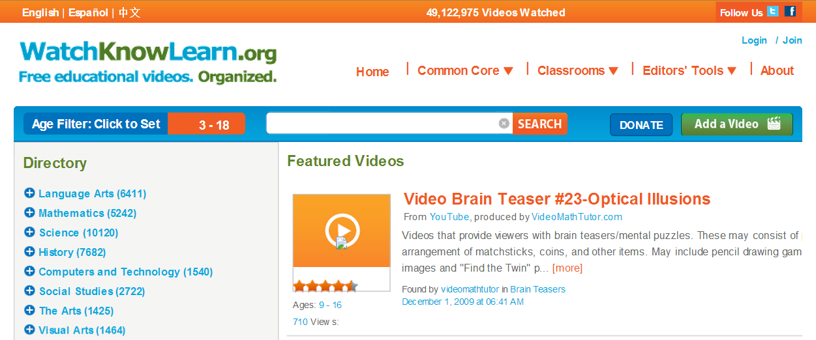
WatchKnowLearn media center

Slide 28
Discovery Education
This outstanding pay service also has a section that is free
Discovery Education
  Offers a broad range of free classroom resources
  Foster deeper engagement and
  Provide opportunities for students to take charge of their own learning with high quality, engaging
  Relevant tools designed for today’s busy teachers

Slide 29
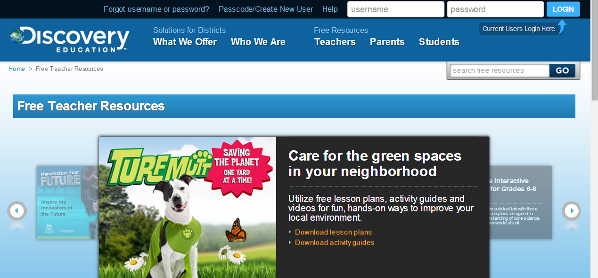
Discovery Education

Slide 30
National Geographic
Find some amazing videos, pictures, segments, and stories that could be used to spark interest
Whether it can be a discussion starter
  An informational lesson
  A question raiser
  You will find some awesome content at this site.

Slide 31

National Geographic

Slide 32
Activity-(20 minutes)
Save a webpage as a file from the web browser.
Print a webpage using the web browser.
Copy text from a site and then save it in a text file.
Save a webpage as a bookmark for later use.
Capture the entire screen and then save it as a picture file. (Hint: Print Screen)

Slide 33
Activity- (20 minutes)
Open one or more multimedia sites like PBS learning media, National geographic or Science for Kids and watch an online multimedia file.
View and explore the interface of multimedia resources.

Slide 34
Thanks
End of Lecture 24

Slide 35
Allah Hafiz

