Slide 1
Searching & Saving Web Resources
ADE100- Computer Literacy
Lecture 23

Slide 2
Knowledge test
List some applications of PowerPoint.
What are the characteristics of good presentations?
What are the characteristics of bad presentations?

Slide 3

Topics covered
Searching multimedia resources
Uploading, downloading documents and other files
  Pictures, audios, videos etc.

Slide 4
Searching information on the web
Net surfing
  Scanning pages and clicking on links randomly
Using a URL
  Quickest way to find information on the Internet
  But you must know where it is located
Use search tools and services
  Assist you in locating the information you need among the vast amount of information available on the Net

Slide 5

Characteristics of multimedia
Large in file size
May be dynamic in nature
  Audio or video instead of static text or image
No simple methods for indexing or describing the contents of the files
Varies kinds of file formats
  JPEG, GIF, TIFF in images
  MOV, MPEG in video
  MP3 format in Audio

Slide 6
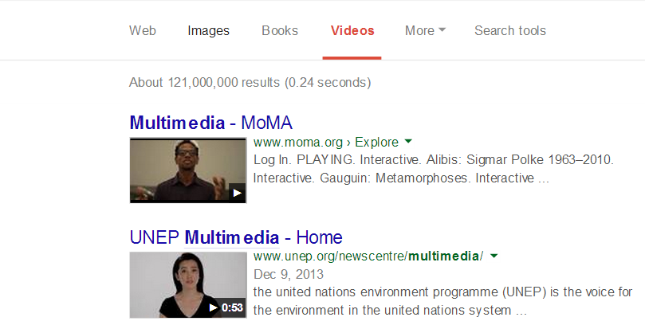
Searching multimedia resources
Various kinds of buttons on the search engine
Web
  Displays relevant all types of files i.e. text, images, sound, videos, etc.
Images
  Displays only relevant images
Videos
  Displays only relevant video files

Slide 7
Searching information on the web
Analyze your topic
Choose the search tool you need
Learn how to use the search tools
Formulate your search strategy
Search with a question in mind

Slide 8
Analyze your topic
Analyze your topic
  What are you searching? for what purpose?
  What type of information do you want?
  The purpose is to determine what terms to use in your search
  What search tool features you need to search successfully

Slide 9
Select the search tool
Choose the search tool you need
  Search tools find documents matching your info. need
  Every search tool is different. They vary in features and size/comprehensiveness.
  The most important features in selecting a search tool are those which allow you to refine or focus your search when you need to

Slide 10
Learn search tools
Learn how to use the search tools
  Being familiar with most of the major search tools and their capabilities allows you to zero in on your search
  Learn how to use Boolean logic, phrase searching, truncation, field searching, etc.
  Spend time reading the Help files to know its features and capabilities

Slide 11
Formulate a search strategy
Formulate your search strategy
  Allows you to search for information systematically
  It also saves you a lot of time and money if you are paying for Internet access by the minute
  Your search strategy should be based on your information need

Slide 12
Search with a question in mind
Search with a question in mind
  How am I going to use this?
  Do I have enough or too much information?
  Scan the content of the material to find out if it has anything of value
  Evaluate the website for accuracy and authority

Slide 13
Simple Search Strategy
Pick your site
learn to use the search tools
choose your words carefully
Vary your spelling
know how to widen your search
Know how to use the refining techniques
Use multiple search engines
Use meta-search engines
Use specialized search engines
Reuse your search

Slide 14
Searching Pitfalls and solutions
Pitfalls
Endless links that lead to getting lost
Data traffic takes infinity to download
Too many; too few; many irrelevant sites
Information overload
Solutions
Stop/ try another search
Try it another time /site; change ISP
Refine or vary your search
Search with a more specific question in mind

Slide 15
Search string or query
Search string
  The text you write in the search box is called Query or search string.
For PowerPoint files
  Write the text related to the topic and then add extension of PowerPoint program like PPT or PPTX
  Ex. Computer systems ppt, or “Computer System” ppt, or “computer system”+ppt

Slide 16
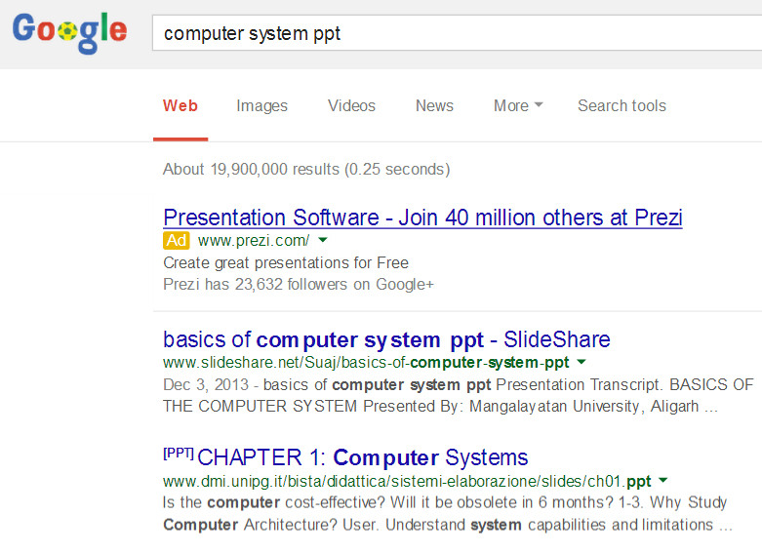
Search Query

Slide 17
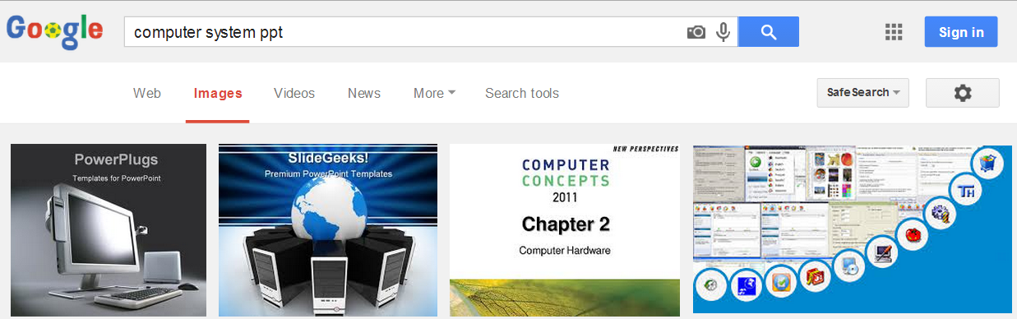
Searching pictures
Enter the name of topic in the search box of search engine
Select Images tab rather than Web

Slide 18
Searching audio/video files
Enter the search string in the search box
Add the type of file if you know
For example, the following strings can be used:
  Tips for PowerPoint video
  “Tips for PowerPoint” +mp3 free download
You may enter the string and then click videos option in the search engine
If you know the exact name and extension then enter directly

Slide 19
Searching videos

Slide 20

Plug-ins
Plug-ins
  Allow end users to view and interact with new types of documents and images
  Helper applications (or players) display or run files downloaded from the Internet
For example:
  Adobe Flash Player

Slide 21

Plug-ins for multimedia
Plug-ins are used to display multimedia files:
  Text
  Images
  Sound
  Animation, video, and presentation

Slide 22
Text
Text and document plug-ins
  Overcome the display limitations of HTML and Web browsers
Adobe Acrobat provides
  Special fonts and graphic images embedded as data into the file

Slide 23
Images
Most browsers read
  Only bitmapped JPEG, GIF, and PNG image files
Plug-ins that enable
  The viewing of vector formats (such as Flash) are useful
Vector graphics are device-independent.
  An image is displayed at the correct size and with colors supported by the computer.

Slide 24
Sound
Digitized sound files
  MP3, WAV, AIF, or AU formats may be sent
  And played on a user’s computer from Internet

Slide 25
Sound
Speech files can be encoded into
  A token language that is a shorthand description of the speech components.
Sound elements may also be embedded into
  Projects made with various authoring tools
Some sounds can be multicast to
  Allow multiple users to listen to the same data streams without duplication.

Slide 26
Animation, Video and Presentation
The most data-intense multimedia elements are
  Video streams containing images and synchronized sound
Video streams are commonly packaged as
  Apple’s QuickTime, Microsoft’s Video for Windows (AVI), and as MPEG files
The compromise between bandwidth and quality is
  Ever present when designing, developing, and delivering animations or motion video for the Web

Slide 27

Downloading
Downloading means
  Transferring files from internet to your computer
You can download different kind of files like
  Pictures, audio, videos, program files
  PowerPoint documents
  Word documents, Excel documents
  Templates, Programs, EBooks, etc.
Sometime you need to sign in for downloading e.g. slideshare
Programs: Internet download manager (IDM)

Slide 28
Downloading audio/video files
Open the search engine like Google
Search the video or audio file
MP3 format works well with PowerPoint
Open the desired webpage that is selected from the Google results
Right click on the audio or video file and select “save link/target as” or click download button if found on the webpage
Save dialog box appears with a default filename which you may change and click Save button

Slide 29
Downloading Pictures
Enter a search string in the search engine
Click Images button in the search engine
Locate your image and then right click on the image
Select “Save Picture As” from the popup menu
Save Picture dialog box appears with a default filename which you can change
Search the folder or save it in Downloads folder
Click Save button

Slide 30
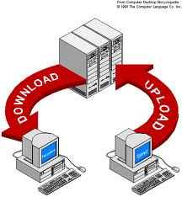
Uploading files
Uploading means
  Transferring files from your computer to the internet
You can share various kinds of files like
  PowerPoint slide notes
  Word, PowerPoint, Excel documents
  Adobe Pdf files
  Program files
  EBooks
  Templates, etc.

Slide 31
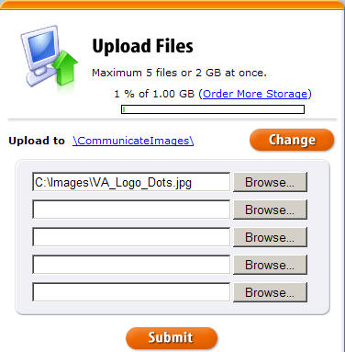
Uploading documents
There are various websites which allow you to share your documents like slide share, facebook, twitter
First you sign up or register
Then you need to sign in with an email address
Then you can add a file on the site

Slide 32

Uploading audio/video
Several websites allow you to add sound or movies
  For example, daily motions, tunepk, youtube, facebook
First you sign up or register on that site
Then you need to sign in with an email address
Then follow few steps to upload a sound or movie file

Slide 33
Activity-20 minutes
Search a PowerPoint Presentation on the topic of “Computer Literacy”.
  Modify the terms for better results
Download the presentation on your computer.
View the downloaded file and open it in the relevant program.
Copy your downloaded file from Downloads folder to another folder.

Slide 34
Thanks
End of Lecture 23

Slide 35
Allah Hafiz

