Slide 1
Multimedia- Microsoft Power Point
ADE100- Computer Literacy
Lecture 22

Slide 2
Knowledge test
What is the purpose of animations?
Why slide transition is used?
What is the purpose of action buttons?
How you can play a presentation from the beginning/current slide?

Slide 3
Topics covered
Using multimedia to create presentations
  School profile
  Lesson presentation/Demonstration
  Action plans
  Assignment presentation, etc.
Guidelines for creating effective presentations

Slide 4
School profile
School profile
  A document produced by schools to present annual report to parents
  Add data provided by the department for children, schools and families
  The data includes standard information such as
    Number of students
    school type
    Summary of school performance

Slide 5
Lesson presentation/Demonstration
Lesson Presentation
  Prepare your class lecture on any topic
  Kind of hints as you write on paper
  Now write such hints using PowerPoint and deliver your lecture effectively
Demonstration
  We prepare Demos for job presentation in the class
  Make slides of your topic
  Insert charts, pictures according to your requirements

Slide 6
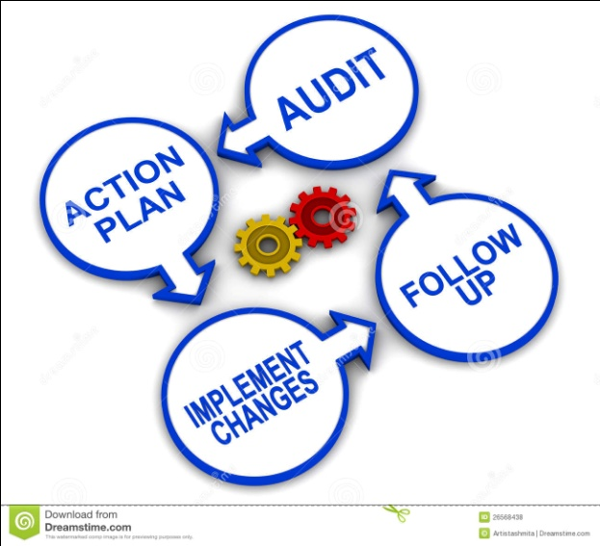
Action plans
Action plans
  Detailed plan outlining actions need to reach one or more goals
  Used as a tool in social planning
  Organizational strategy to identify necessary steps towards a goal

Slide 7

Assignment presentation
Assignment presentation
  Develop a presentation for long text
  For example, for a chapter, for a book, thesis, projects, etc.
  Just highlight main points, don’t give details
The contents of assignment presentation can be:
  Title page, introduction,
  body, conclusion
  Reference list

Slide 8
Guidelines for creating an effective presentation
Remember that PowerPoint helps to ‘visualize ideas’, communicate key points, and make information ‘memorable’.
Do not use presentations to dump data.
The presentation should be to the point, focusing on actual purpose.
The presentation should have a professional look, representing the purpose and institution’s identity.

Slide 9
Guidelines contd…
The presentation should not be text-heavy.
Include only required text, and maximize graphics in the presentation.
Support your presentation with graphs and charts.
Do not describe these charts with detailed text
  Rather talk about the information presented in the charts while presenting

Slide 10
Guidelines contd…
Colors and fonts should appear to be uniform throughout the presentation to avoid inconvenience.
Use readable and common fonts
  make sure the font size is large enough to be readable by all attendees of the presentation.
  Do not sacrifice readability for style.
Avoid too much bulleting and indentation.
Animation, sound, and other effects in the presentation should not be disturbing.

Slide 11
Guidelines contd…
Remember that you want the viewers to focus on what you’re presenting, not how it is presented (overuse of fonts, styles, etc.)
Practice properly before delivering a presentation in any seminar
Be mindful of the time, listeners’ positive responses, and their ease;
  Don’t make people bored with longer-duration presentations.
Remember these four points for an effective presentation:
  significance, simplicity, structure, and rehearsal

Slide 12
Bad presentations
Dumping text
Very small text that is not readable
Poor slide design
Overuse of PowerPoint features
The slide slave
  Remember that people come to see a speech, not a slide show
Turn OFF lights; tells the audience to pay attention to slides not to the speaker

Slide 13
A Survey of audience disliking- Bad way to present
The speaker read the slides to us =62.0%
Text so small I couldn't read it =46.9%
Slides hard to see because of color choice = 42.6%
Full sentences instead of bullet points =39.1%
Moving/flying text or graphics =24.8%
Overly complex diagrams or charts =22.2%

Slide 14
Survey results of audience responses- Good way to present

Slide 15
Tips for making an effective presentation
WATCH A VIDEO CLIP

Slide 16
Activity
Prepare a presentation on any topic of your interest for your class Demonstration.
Suppose you want to present it for your job Demo.
  Remember that your job Demo must be attractive because you have to get job on the basis of this presentation.
  Make slides for a Demo of 20 minutes
  Remember all the guidelines and tips

Slide 17
Group discussion- 20 minutes
Make a group of two or three students.
What problems you faced in past
  When you were not using PowerPoint in your classroom activities
Discuss that how PowerPoint will help you in your professional life:
  Role of PowerPoint in your professional growth
  What problems can be solved using PowerPoint
Are you willing to use PowerPoint in your professional life? If not then why?

Slide 18
How to become lifelong learners
Don’t use paper for your lecture outlines
Use PowerPoint tool for your lecture preparation
Keep using it ever
Try to use new versions of PowerPoint
You can also type Urdu/Arabic in Microsoft Office

Slide 19
Microsoft Office
We have learnt
  Microsoft Word
  Microsoft PowerPoint
  Microsoft Excel
Many other office products
Try to learn & use more office products according to your requirements
Use these tools in your daily life activities like
  Home budget, Job database
  Build CV, write application
  Make your class presentations

Slide 20
Microsoft Office environment
More or less similar in all tools
Therefore easy to learn and use with a little effort
Word, PowerPoint and Excel are basic and used everywhere
These tools are sufficient for office work
We have covered only basic contents; you can learn more by using it more

Slide 21
More Office tools
Microsoft Visio
  To build diagrams like flow charts, organizational charts
Microsoft Outlook
  To manage multiple email accounts simultaneously
Microsoft OneNote
  To maintain personal information like diary notes
Microsoft Publisher
  To create professional design like advertisements, book covers, visiting cards, certificates, etc.

Slide 22
Final comment
Play
Play
Play

Slide 23
Thanks
End of Lecture 22

Slide 24
Allah Hafiz

