Slide 1
Multimedia- Microsoft PowerPoint
ADE100- Computer Literacy
Lecture 21

Slide 2
Knowledge test
In which tab of PowerPoint templates are found?
What is the purpose of slide layout?
Why pictures are compressed in slides?
What is the purpose of hyperlinks in Microsoft PowerPoint?

Slide 3
Topics covered
Adding animations and special effects
  Applying slide transition
  Adding & customizing animations
  Adding action buttons
  Turning off animations
Setting up and playing presentations
  Printing presentations
  Setting time

Slide 4
Slide Animations
Slide Animations
  Allows text transition- appearance/disappearance of individual text on the slides during presentation
  The individual characters, words, statements or symbols appear on the slide in a beautiful way
  Moving and flying text and objects
  By default, “No Animation” style is set

Slide 5
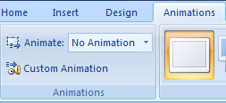
Adding animations
Several animations for slide objects are available
Choose Animate from Animations tab
Select an animation effect from the combo box and apply it
Select Apply To All if you want to apply on the whole document

Slide 6
Customizing Animations
Custom animations
  Choose Animations>>Custom Animation
  When clicked then Custom Animation pane opens
  Click Add Effect button arrow to select a category and subcategory of animations to apply
  Click Slide Show button to see the preview
  You can move animations up or down to change the sequence of animations

Slide 7
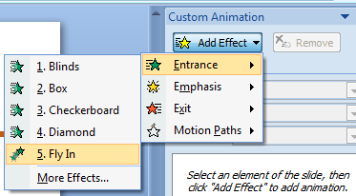
Custom Animations

Slide 8
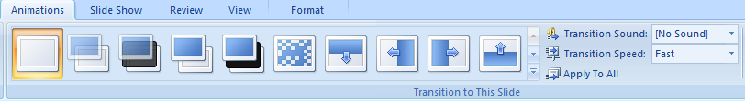
Slide Transition
Slide transition
  A visual effect given to a slide as it appears or disappears on the screen
  Various slide transitions are available that can be placed on different slides
  By default, no transition is set

Slide 9
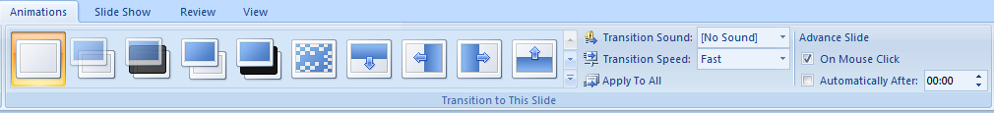
Applying slide transition
Transition to This Slide
  Go to “Transition to This Slide” from Animations tab
  Search and select a style from given styles in the ribbon
  Move cursor over the style to see the effect on the slide
  Choose any one and click once to apply on the current slide

Slide 10
Applying slide transition
Changing Transition Sound
  Select Animations>>Transition Sound
  By default, “No Sound” is selected
  Click the arrow in the Transition Sound box and select a sound to play when slide transition occurs
Changing Transition Speed
  Animations>>Transition Speed
  By default, Fast is selected
  You can change it by clicking arrow of Transition Speed box to slow or medium

Slide 11
Setting time
Advance Slide
  Choose the method that how slides will advance
  By default, “On Mouse Click”
Changing Advance Slide
  Check the checkbox before “Automatically After”
  Insert the time duration in seconds after which the slide will move to the next slide
Apply To All
  When you set all transition options
  In the end, click “Apply To All” button to apply the settings on the whole document slides

Slide 12
Adding Action buttons
Action buttons
  Allow you to create hyperlinks from slide to slide, to a specific file/program or a webpage
  Activates when you run slide show view
Inserting an Action button
  Choose Shapes from Insert tab
  Select the arrow below the icon and choose an action button you want to insert
  Click once the button icon and then draw it on the slide
  Action Settings window will appear
  To assign a hyperlink to the button, click “Hyperlink to” and click the down arrow to direct the link and Click OK

Slide 13
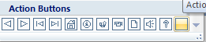
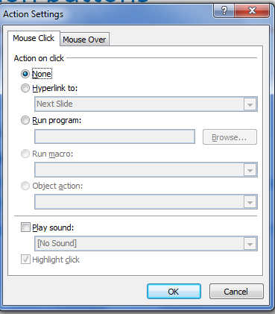
Inserting action button
Action button

Slide 14
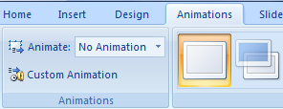
Turning off animations
Select Animate from Animations tab
Choose “No Animation” from the box in front of Animate option
Choose the default transition style i.e. “No Transition” style from the transition style icons

Slide 15
Topics covered
Adding animations and special effects
  Applying slide transition
  Adding & customizing animations
  Adding action buttons
  Turning off animations
Setting up and playing presentations
  Printing presentations
  Setting time

Slide 16
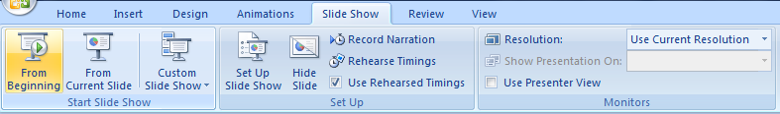
Playing the presentation
Click the Slide Show tab
From beginning
  Click to run slides from the first slide or press F5
From current slide
  Click to start slide show from current slide or press Shift+F5
Custom slide show
  Displays only slides you select
  You can have different shows for 30 minutes or 60 minutes from the same presentation

Slide 17
Custom slide show
Creating a custom slide show
  Choose Slide Show>>Custom Slide Show
  Click the arrow along “Custom Slide Show” icon
  Select “Custom Shows” from the menu to create a new custom show
  “Custom Shows” dialog box appears
  If you have already created a slide show then it appears otherwise create a new show
  Click New button in the dialog box

Slide 18
Custom slide show contd.
Creating a Custom Slide Show
  Define Custom Show dialog box appears, select the slides from “Slides in Presentation” box and click “Add” button to shift them to “Slides in Custom Show” box
  Enter a “Slide Show name” in the box and then click OK

Slide 19
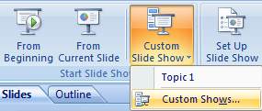
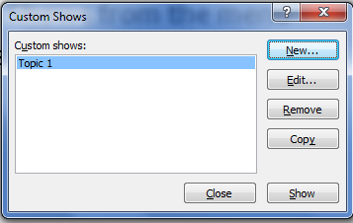
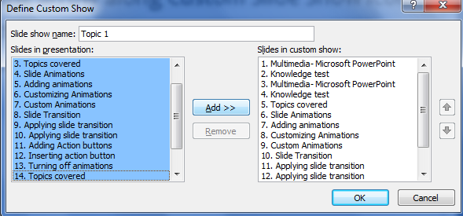
Custom slide show

Slide 20
Setting up presentation
Set Up Slide Show
  Advanced options for slide show
Hide slide
  Hides the current slide from the presentation
  It will not show in slide show view
Record Narration
  Record a narration track using microphone attached to your computer
  It will play with the slide show

Slide 21
Setting up presentation
Rehearse Timings
  Launches a full screen show for your rehearsal
  Time spent on each slide will be recorded
  You can save these timing to run the show automatically in future
Use Rehearsed Timings
  Select the check box to use rehearse timings you created to run slides automatically

Slide 22
Printing The Presentation
Three ways i.e. Print, Quick print and Print preview
Print
  Choose File>>Print>>Print
  Select “Print” from “File or Office button”
  Print dialog box appears
  Select the print options and click OK
Quick Print
  Choose File>>Print>>Quick Print
  Select this option to send a direct print to the default printer using default settings without making changes

Slide 23
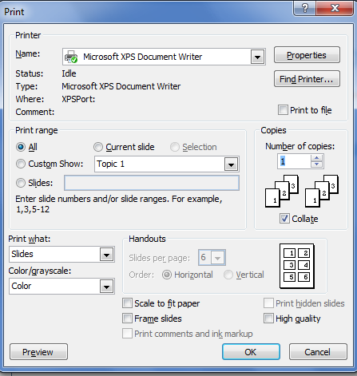
Print dialog box

Slide 24
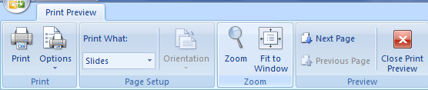
Print Preview
Print
  Click to open print dialog box for setting printing options
Options
  Change the printing order of slides on the pages
  Change color scheme of slides like color/grayscale or pure black & white
  Scale to fit paper
  Apply header and footer

Slide 25
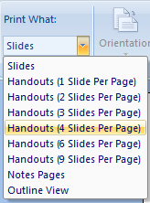
Print Preview
Print what
Slides
  Prints the whole slide on one page
Handouts
  Print the slides in the group of 1,2,4,6,9 on each page
Notes pages
  Print just speaker notes
Outline view
  Print just outline of your presentation

Slide 26
Print Preview
Orientation
  Choose Landscape or portrait page orientation
Zoom
  Used to increase/decrease the size of your page on the screen
Fit to Window
  Zoom the presentation so that the slide fills the entire window

Slide 27
Print Preview
Next page
  Used to preview the next page
Previous page
  Used to preview the previous page
Close print preview
  Click the icon to close the Print Preview mode

Slide 28
Activity-30 minutes
Prepare a presentation on any topic of your interesting subject for your class.
  Add animations and transitions
  Add action buttons
  Play the presentation
View & explore Animations tab options.
Turn OFF animations and transitions
View & explore Slide Show tab options.
View & explore various Print options in PowerPoint.

Slide 29
Thanks
End of Lecture 21

Slide 30
Allah Hafiz

