Slide 1
Multimedia & Microsoft PowerPoint
ADE100- Computer Literacy
Lecture 20

Slide 2
Knowledge test
What do you mean by multimedia?
Why PowerPoint is called a multimedia program?
What is the purpose of “Slide Sorter” view?
What is the default view of PowerPoint?
What is the purpose of “Slide Show” view?

Slide 3
Topics covered
Making slides look good
  Applying templates, changing color schemes, slide layout, background
Adding pictures and artistic effects
  Inserting & compressing pictures, applying borders to pictures and other objects, adding 3-D effects
Adding sounds, movies and links

Slide 4
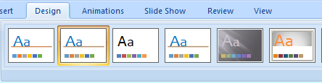
Applying design templates
Choose Design>>Themes
Several built-in Themes are available in PowerPoint
Search and select a Theme to apply
Single click the selected Theme to apply it on all slides

Slide 5
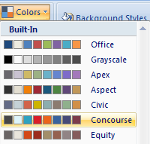
Changing color scheme
Choose Design>>Colors
Click the arrow in front of Colors icon
A color palette with several color schemes will display
Choose a color scheme and just click once to apply it on all slides

Slide 6
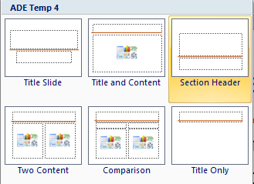
Changing slide Layout
Insert a new slide from Home>>New Slide
Choose a slide layout from Home>>Layout
Both actions can be performed simultaneously using arrow of New Slide Icon

Slide 7

Changing Background color
If you want to use built-in colors
  Choose Design>>Background Styles
  Click arrow in front of background styles icon
  Thumbnails of dark and light colors will display
  Search and select a color for your slides
  Single click the color theme to apply on all slides
If you want to create your own background color
  Choose Design>>Background Styles>>Format Background

Slide 8
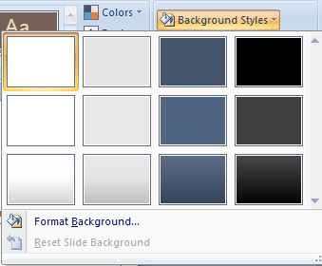
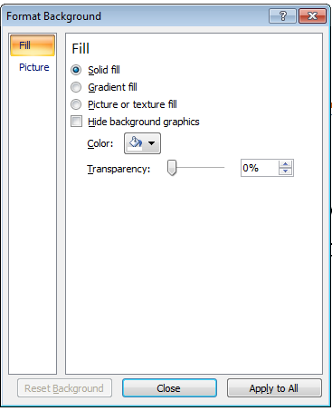
Changing Background color

Slide 9
Topics covered
Making slides look good
  Applying templates, changing color schemes, slide layout, background
Adding pictures and artistic effects
  Inserting & compressing pictures, applying borders to pictures and other objects, adding 3-D effects
Adding sounds, movies and links

Slide 10

Adding Pictures
Select the slide from “Slide Pane” where you want to add picture
  Choose Insert>>Pictures or if new slide then from content box click the icon of insert a picture from file
  Insert picture dialog box appears
  Search and select a picture from your PC
  Double click the picture file OR
  Click the file and click Open button

Slide 11
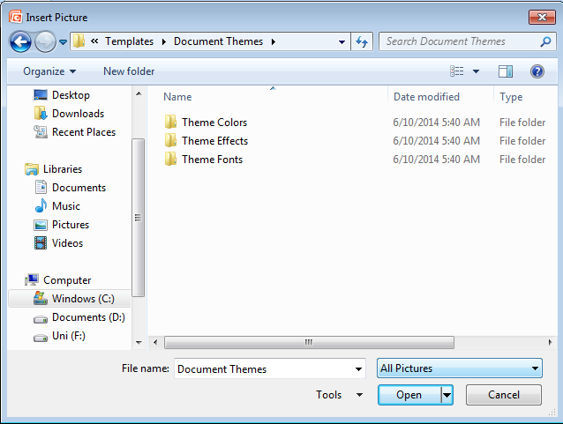
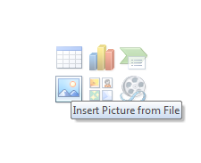
Adding pictures contd.

Slide 12
Inserting ClipArt
Choose Insert>>ClipArt
A clipart dialog box appear in the right pane
Enter the title of clipart type you want to find in “Search for” text box
If your search criteria match then images will be displayed below in white blank area
Single click the clipart image to insert in your slide
You can also search for online clipart images using “Clip art on office online” link

Slide 13
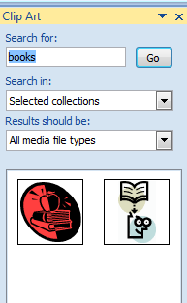
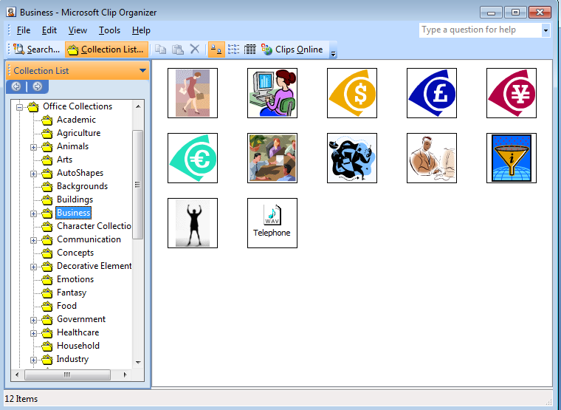

Inserting ClipArt

Slide 14
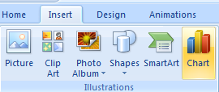
Inserting Charts
Choose Insert>>Chart
A chart will display in the slide
An excel datasheet will also display to enter or modify chart data

Slide 15
Inserting tables
Choose Insert>>Tables
Similar options like Microsoft word
Move your mouse pointer to select rows and columns to be added
Insert table
  A dialog box appears to enter no. of rows/columns
Draw table
  Click to draw the table on the desired slide

Slide 16
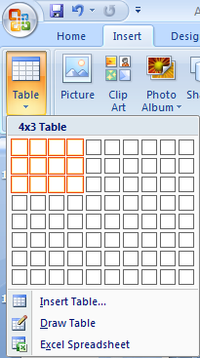
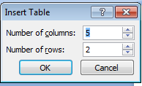
Inserting a table

Slide 17

Compressing Pictures
You can resize pictures to best fit in the slide area
Normally pictures are too small or too large
You can adjust the size of picture that can be easily visible for the audience
You can do it with mouse or Format>>Compress Pictures

Slide 18

Working with images
Choose Insert>>Shapes
Select a shape and draw it on your slide
Grouping
  Images can be grouped to become one image
  Allows to move together or apply formatting at once on all combined shapes
Method
  Select all the grouped images by holding down SHIFT key and clicking once on each image
  Select Group from Format tab

Slide 19
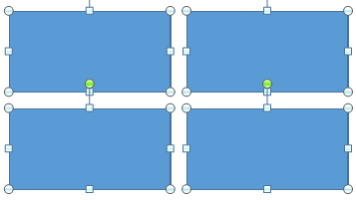

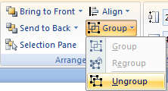
Grouping
Before grouping or Ungroup
After grouping

Slide 20
Working with images
Ordering images
  We can bring an image backward or forward
Send to Back
  Used to move the image behind an image
Bring to Front
  Used to move the elements at the top of an image

Slide 21
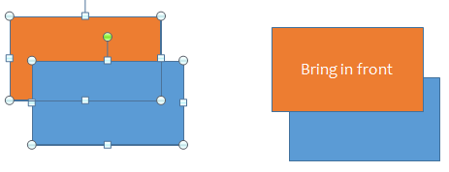
Ordering images
Before ordering
After ordering

Slide 22
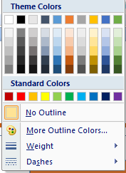

Applying Picture borders
You can apply different border styles to pictures
When you insert or select a picture, Format tab appears
Click Format>>Picture Border

Slide 23
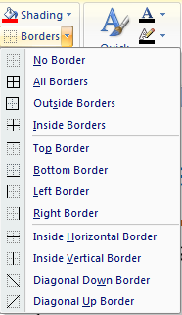
Applying borders to other objects
Borders can be applied to other graphical objects as well
For example, table, charts, photos, etc.
Table borders
  Design tab appears when you select a table
  Select Design>>Borders

Slide 24
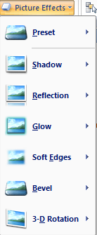
Adding 3-D effects
Choose Format>>Picture Effects
Format tab appears when you insert or select a picture
Click arrow of “Picture Effects” button
A menu with submenus will appear
Select an effect from the submenu of any main menu option like
  Preset, Shadow, Glow, 3D rotation, etc.
  In this picture, Bevel effect is selected.

Slide 25
Topics covered
Making slides look good
  Applying templates, changing color schemes, slide layout, background
Adding pictures and artistic effects
  Inserting & compressing pictures, applying borders to pictures and other objects, adding 3-D effects
Adding sounds, movies and links

Slide 26
Adding sounds
Select any slide where you want to insert an audio file
Choose Insert>>Sound
Click the Insert tab and select Sound button
Click the arrow below sound button and Select “Sound from File” from the menu
Search and select a file from the “Insert Sound” dialog box
Click Open button

Slide 27
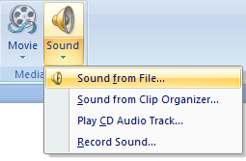
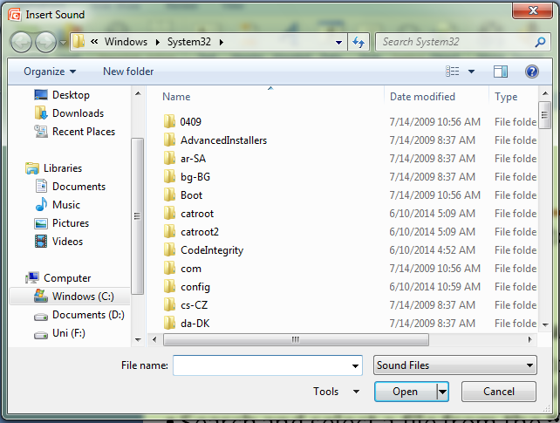
Insert sound

Slide 28
Adding movies
Select any slide where you want to insert a video clip
Choose Insert>>Movies
Click the arrow below Movie button and select “Movie from File” from the menu
“Insert Movie” dialog box will open, search and select a movie file from your PC
click Open button

Slide 29
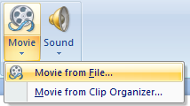
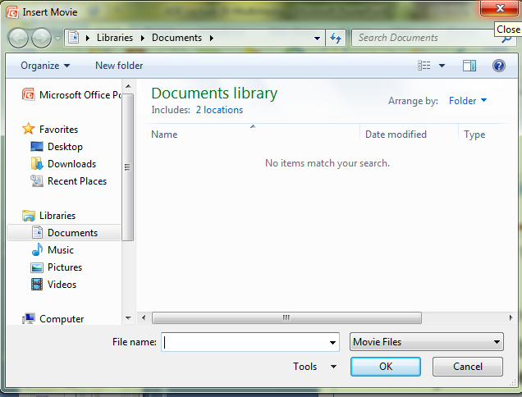
Insert movie

Slide 30

Adding links
In PowerPoint, Hyperlinks
  Used to link a slide with other slides, webpage, show or file
  Can be text or a graphical object
  Become active only during slide show
  The mouse pointer changes to a hand when it is pointed to a hyperlink
Inserting a hyperlink
  Select the text or object
  Select Insert>>Hyperlink or
  Press CTRL+K

Slide 31
Insert Hyperlink dialog box
In Link to pane on the left select the desired option:
  Select “Existing File or Webpage” to link to a file in the system or a webpage in the internet
  Select “Place in This Document” to link to a slide from the same presentation
  Select “Create New Document” to create a new presentation which will open against this link
  Select “Email Address” to open the email editor with the given email id and subject
  Specify the detail of the location to which the hyperlink should point and click OK

Slide 32
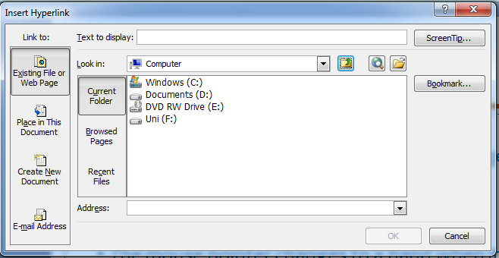
Insert hyperlink dialog box

Slide 33
Activity-20 minutes
Create a PowerPoint presentation about the Computer System.
  Apply a design template
  Use different slide layouts
  Insert a picture in each slide and type in the explanation
  Wherever required insert an audio file from internet or your computer

Slide 34
Activity-20 minutes
Change color scheme of your presentation.
Change background color of slides.
Insert a picture and modify it by resizing, applying borders and 3D effects.
Insert a chart.
Insert few shapes and then group and ungroup them.
Create a hyperlink to a file.
Insert a sound or movie.

Slide 35
Thanks
End of Lecture 20

Slide 36
Allah Hafiz

