Slide 1
MS Excel- Spreadsheet
ADE100- Computer Literacy
Lecture 18

Slide 2
Knowledge test
What is the concept of formula?
What is function in spreadsheet?
What happens if you don’t use equal sign before formula or function?
List few types of charts.

Slide 3
Topics covered
Print properties
Using spreadsheets to create classroom management documents
  Seating chart
  Electronic attendance register
  Result sheet
  Student academic performance graph
  Bio data

Slide 4
Printing in Excel
Print preview
  Provides a view about how the page will look like after printing
  Allows to make changes before printing
Method
  Choose File>>Print>>Print Preview

Slide 5
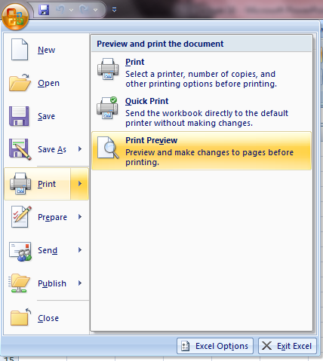
Print preview

Slide 6
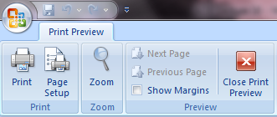
Print preview toolbar
Print
  Print dialog box will open
Zoom
  Increase or decrease the page view in percentage
Show margins
  Click to view page margins

Slide 7
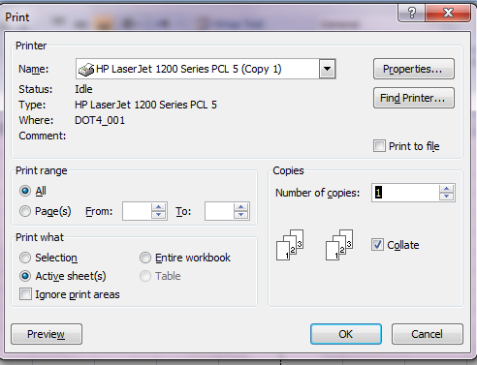
Print dialog box

Slide 8
Print preview toolbar
Next page
  Click to view the next page of document
Previous page
  Click to view the previous page of document
Close print preview
  Click to close print preview window

Slide 9
Print preview
Page setup
  Used to set page orientation
  Scale the print to fit one or more pages
  Adjust margins
  Create page headers and footers
  Print or hide gridlines and screen colors

Slide 10
Page orientation, size and scaling
Page orientation
  You can change page orientation between portrait (tall & thin) and landscape (short and wide)
  Landscape is better for large no. of columns
  Portrait is better for less columns but more rows
Paper size
  Paper size should match the paper in the printer or the worksheet will not print correctly
  For example, Letter, A4, Legal, etc.
Scaling
  Used to shrink the print to any required size, a number greater than 100 is used to enlarge the page

Slide 11
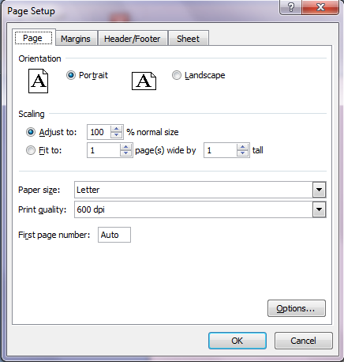
Page Setup

Slide 12
Page margins
From page setup dialog box, select the margins tab
Enter the new margin dimensions in the boxes
From the Center on page panel, click the alignment tick boxes required i.e. horizontally or vertically

Slide 13
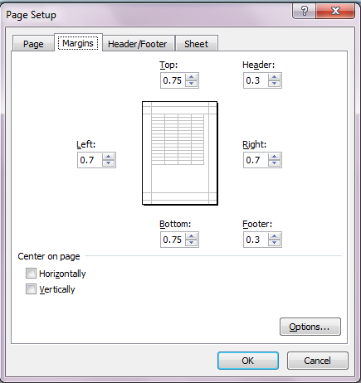
Page Margins

Slide 14
Header and Footer of worksheet
Data can be added at the top (header) or at the bottom (footer)of page in the margin area
You can add any text or picture like logo in the header/footer
You can also add entries which update automatically like date and time, file name or page number

Slide 15
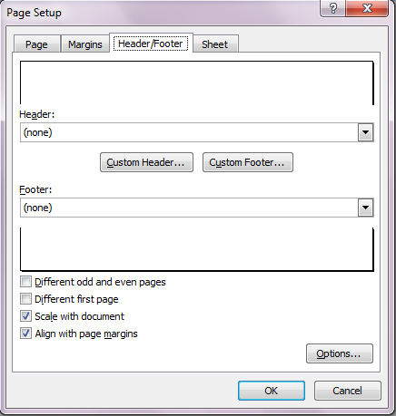
Header and Footer

Slide 16
Sheet tab settings
Gridlines on the screen will not print unless selected from page setup
Colors used on the screen are printed as shades of gray on a black and white printer
Dark colors such as blue and red print out dark gray
Pale colors such as yellow and pink print as light gray

Slide 17
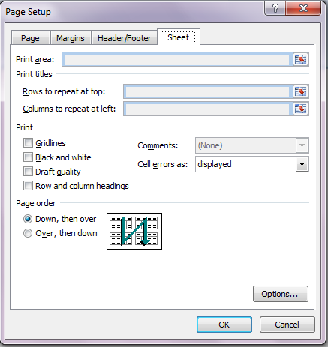
Sheet tab

Slide 18
Topics covered
Print properties
Using spreadsheets to create classroom management documents
  Seating chart
  Electronic attendance register
  Result sheet
  Student academic performance graph
  Bio data

Slide 19
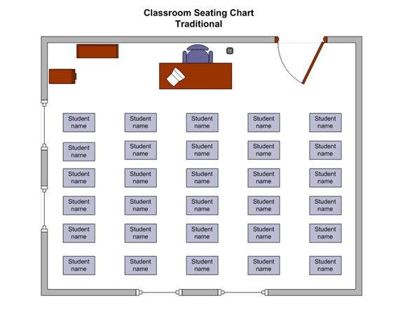
Seating chart

Slide 20
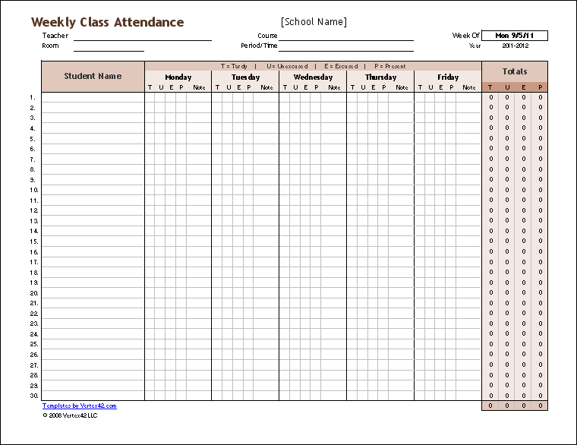
Electronic attendance register

Slide 21
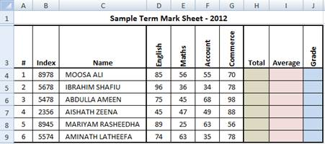
Result sheet

Slide 22
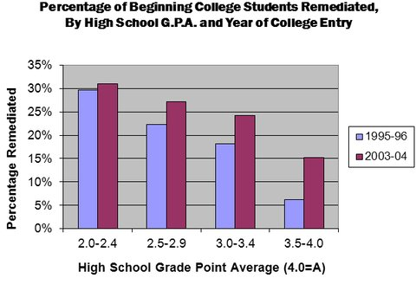
Student academic performance graph

Slide 23
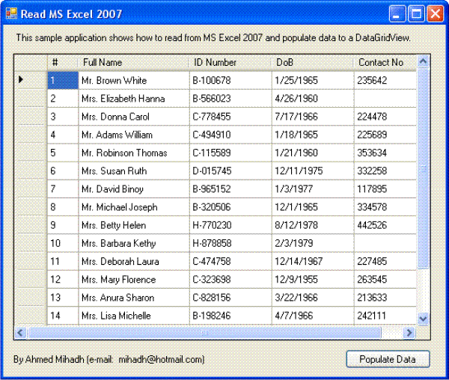
Bio data

Slide 24
Activity 1: Aggregate attendance
Record total student attendance month-wise against total number of working days for a particular month.
Calculate percentage of the aggregate attendance for different months.
Present the data in a bar graph that shows aggregate student strength at a glance for different months of the academic year.

Slide 25
Activity 2
View and explore printing options in excel.
View and explore print preview options.
Take a print out of the document you designed in the previous activity.

Slide 26
Group discussion- (20 minutes)
Make a group of two or three students.
Share your experiences about using Microsoft Excel and compare it with your paper work.
  How Microsoft excel will facilitate you in your classroom activities.
  What is your opinion whether spreadsheet program is helpful for you or not?
Share your ideas with other groups and ask about their opinions.

Slide 27
Tips
Now use excel in your classroom activities.
Use excel templates
Try to avoid traditional paper work.
Vast topic but we covered just common & more relevant features of excel
Implement in daily life activities like your home budget, party planner
Play, Play, Play,…….

Slide 28
Further reading
Computer Applications in Business by Tasleem Mustafa
  Chapter 18: Printing in Excel

Slide 29
Thanks
End of Lecture 18

Slide 30
Allah Hafiz

