Slide 1
Calculations & Graphics using Spreadsheet
ADE100- Computer Literacy
Lecture 17

Slide 2
Knowledge test
What is cell alignment?
What is the purpose of Fill handle?
Why comments are inserted in the excel sheet?
Why hyperlinks are used?

Slide 3
Topics covered
Doing mathematics
  Formulas, addition, subtraction
  Average, logic formula, etc.
Making charts
  formatting i.e. background,
  Legend, color of bars, creating pictograph

Slide 4
Formulas
Formula
  Expression that produces some values
  Use values, cell references and built-in functions
  Must begin with an equal sign (=)
  When the formula is entered in the cell the calculation executes immediately
  Cells display result and formula bar shows formula

Slide 5
Entering formulas
Entering a formula
  Click on the empty cell that will display the result of the formula
  Type the equal sign (=)
  Type your formula without any spaces like a1+a2+a3 and press Enter key
  If you change any value of a cell referenced in a formula, the formula will automatically recalculate and display the new value.

Slide 6
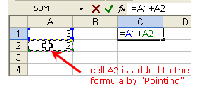
Addition
Addition
  Move the cursor to cell A1 and type a value of 10
  Press Enter
  Type a value like 20 in cell A2
  Enter formula in cell A3; =A1+A2 and press Enter
  The result of calculation will display in the cell and formula in the formula bar

Slide 7
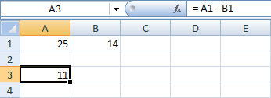
Subtraction
Subtraction
  All the steps are similar but change the formula like =A1-A2

Slide 8
Arithmetic operators in excel
Operator | Operation | Example
+ | Addition | =a1+a2
- | Subtraction | =a1-a2
* | Multiplication | =a1*a2
/ | Division | =a1/a2
% | Percent | =50%
^ | Exponent | =5^3 (cube)

Slide 9
Precedence of operators
Precedence
  The order in which operators are evaluated in the expression
  Expression is combination of operands and operators like 3+4, x+y
  The operators with high precedence are evaluated first
High to low precedence
  Parentheses ()
  Negation –
  Percentage %
  Exponentiation ^
  Multiplication and division *, /
  Addition and subtraction +,-
precedence

Slide 10
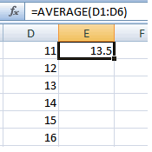
Average
Average
  Calculates arithmetic mean
  Write some values in the cells like from A1 to A5
  Select the cell A6 and enter formula of average
  Wrong formula =A1+A2+A3+A4+A5/5
  Correct formula =(A1+A2+A3+A4+A5)/5
  Function; =average(A1:A5)

Slide 11
Cell References
Excel offers three types of cell references for use when a formula is copied
  Absolute $A$1
  Relative A1
  Mixed $A1 or A$1
$ indicates that the row number or column letter will not be modified during a copy
Notes:
Excel offers three types of cell references for use when a formula is copied. An absolute cell reference (for example, $A$1) indicates that the address will be fixed and will not be altered during a copy operation. A relative reference (for example, A1) indicates that the address will be adjusted relative to its new location. A mixed reference (for example, $A1 or A$1) has one part that is absolute and the other relative.
The F4 key can be used to toggle through the four types of cell references.

Slide 12
Mixed Cell References
In mixed reference $A1, the column is fixed, but the row may be altered during a copy
In mixed reference A$1, the row is fixed, but the column may be altered during a copy
Notes:
A mixed cell reference contains a fixed column and relative row or a fixed row and a relative column.

Slide 13
Functions
An Excel function is a predefined formula that performs a calculation
Category | Description
Compatibility | Contains functions compatible with Excel 2007 and earlier.
Cube | Returns values based on data in a cube, such as validating membership or returning a member’s ranking.
Database | Analyzes records stored in a database format in Excel and returns key values, such as the number of records or averages value in a field.
Date & Time | Provides methods for manipulating date and time values.
Notes:
An Excel function is a predefined formula available in many categories. Function categories and their descriptions are listed in Table 2.1. Some categories include Compatibility, Cube, Database, and Date & Time.

Slide 14
Function Basics
Category | Description
Engineering | Calculates values commonly used by engineers, such as conversions.
Financial | Performs financial calculations, such as payments, rates and present/future values.
Information | Provides information about the contents of a cell, typically displaying TRUE if the cell contains a particular data type, such as a value.
Logical | Performs logical tests and returns the value of the tests. Includes logical operators such as AND, OR, and NOT.
Lookup & Reference | Looks up values, creates links to cells, or provides references to cells in a worksheet.
Math & Trig | Performs standard math and trigonometry calculations.
Statistical | Performs statistical calculations, such as averages or standard deviation.
Text | Manipulates text strings, by combining words or converting cases.
Notes:
Additional function categories shown in Table 2.1 include Engineering, Financial, Information, Logical, Lookup, Math & Trig, Statistical and Text.

Slide 15
Function Terminology
Syntax is the set of rules that govern correct formation of a function
An argument is an input, such as a cell or range
A function begins with the equal sign (=) followed by the function name and arguments in parentheses
  Example: =SUM(A1:A3)
Notes:
The function =SUM(A1:A3) exhibits correct syntax and is well-formed. The function begins with an equal sign (=), then lists the function name (SUM). The argument or input to this function is a range of cells (A1:A3). This function returns the mathematical sum of values in the range A1 to A3.

Slide 16
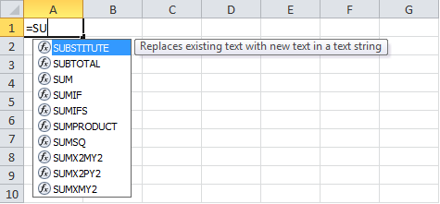
Inserting a Function
When a function is typed, Formula AutoComplete displays a list of functions matching the partial entry
Notes:
Excel offers several techniques with which to enter a function. As you type, the Formula AutoComplete option lists all of the names that match the partial entry. In Figure 2.8, a list of functions beginning with letters =SU appears.

Slide 17

Inserting a Function
A function ScreenTip is a small pop-up description that displays the function arguments
Notes:
A function ScreenTip will appear with each function argument boldfaced. In Figure 2.9, the argument number of the SUM function is boldfaced indicating that a number, cell address, or range is expected.

Slide 18
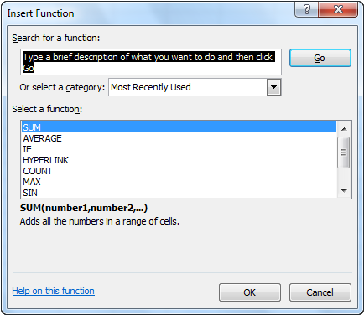
Insert Function Dialog Box
Use the Insert Function dialog box to search for a function or select one from a list
Notes:
The Insert Function dialog box can be used to search for a function for which you do not know the name or to select one from a category list. Figure 2.10 illustrates use of the Insert Function dialog box.

Slide 19
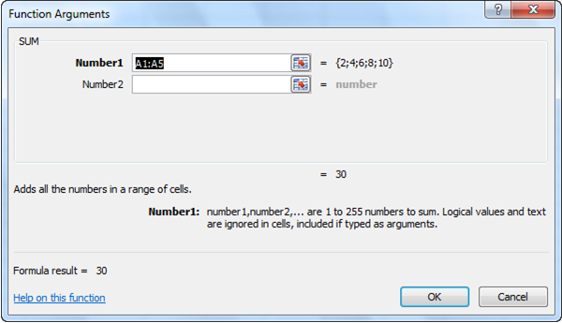
Function Arguments Dialog Box
The Function Arguments dialog box offers help on each argument
Notes:
Once a function is selected, the Function Arguments dialog box opens with information on each argument syntax. Figure 2.11 illustrates the Function Arguments dialog box.

Slide 20
Totaling Values with SUM
The SUM function returns the mathematical sum of some number of cells or ranges; for example:
  =SUM(A1:A3)
  =SUM(A1,B3,C5)
  =SUM(A1:B3,C5:E8)
Notes:
The SUM function returns the mathematical sum of some number of cells or ranges. Multiple cells or ranges are separated by a comma (,). Examples include:
=SUM(A1:A3), which returns the sum of values in the range A1 to A3
=SUM(A1,B3,C5), which returns the sum of values in the three cells A1, B3, and C5
=SUM(A1:B3,C5:E8), which returns the sum of values in the range A1 to B3 and C5 to E8
Do not use a formula as an argument in this case. For example, =SUM(A1+A2) computes the addition of A1 and A2, and then returns the sum of that one value. It is a misuse of the SUM function.

Slide 21
Basic Statistical Functions
Common statistical functions include:
  AVERAGE arithmetic mean
  MEDIAN midpoint value
  MIN minimum value
  MAX maximum value
  COUNT number of values in range
  COUNTA number of nonempty cells
  COUNTBLANK number of empty cells
Notes:
Common statistical functions include the following:
AVERAGE returns the average or arithmetic mean of a range.
MEDIAN returns the midpoint value, halfway between the lowest and highest value in a range.
MIN returns the smallest or minimum value in a range.
MAX returns the largest or maximum value in a range.
COUNT returns the number of numeric values in a range.
COUNTA returns the number of nonempty cells in a range.
COUNTBLANK returns the number of empty cells in a range.

Slide 22
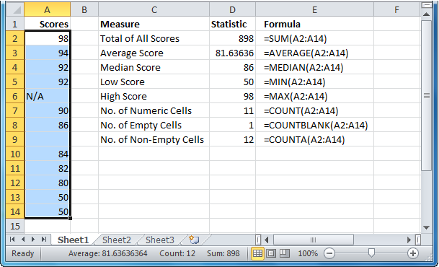
Basic Statistical Functions
Notes:
See Figure 2.12 for a display of the basic statistical functions.

Slide 23
Logic function
IF function
  Used to make decisions
  For example, display “Pass” if marks are more than 40 or “Fail” otherwise
Procedure
  Insert marks of students in cell A1
  Type formula; =IF(A1>40, “Pass”, “Fail”) in B1
  Press Enter
  if the value is greater than 40 then Pass will display otherwise Fail will display

Slide 24
Formula vs. function
Formula
Function
User defined
Does not require parameters
Predefined in excel
Need parameters

Slide 25
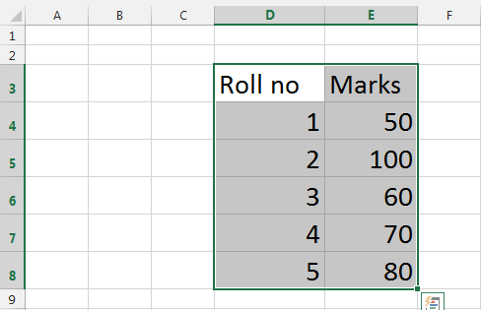
Creating charts in excel
Creating charts
  Enter the data in the sheet and highlight all the cells to be included in the chart including headers
  Choose Insert>>Charts
  Select the Chart Type and click OK
  Your chart will be displayed on the sheet

Slide 26
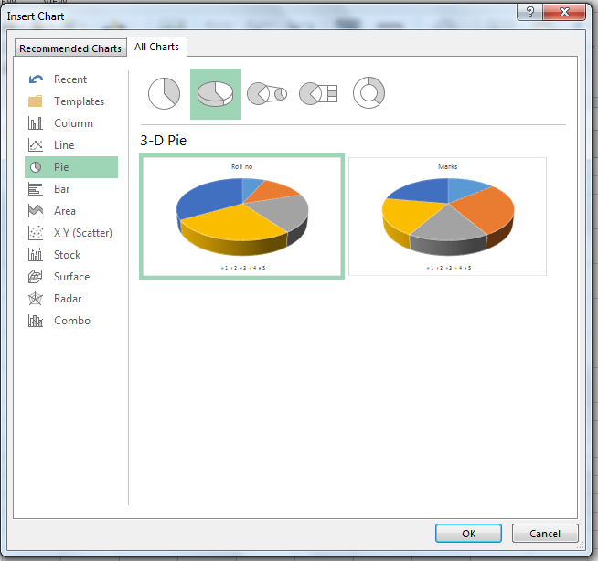
Insert chart dialog box

Slide 27
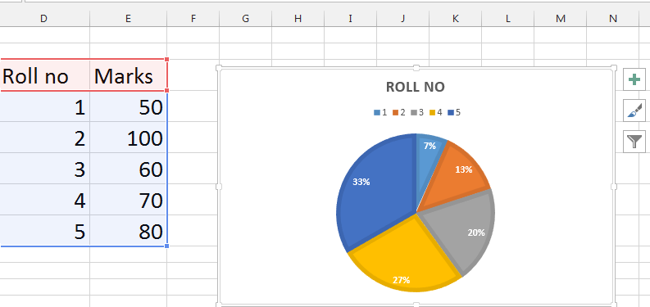
Inserting charts
Chart is inserted in your sheet

Slide 28
Formatting charts
Moving your chart
  Select your chart
  Click and hold the chart
  Drag the chart to the appropriate location
  Release the mouse button
Resizing your chart
  Select your chart
  Click and hold on one of the handles
  Drag the handle in or out to adjust the size of chart
  Release the mouse button

Slide 29
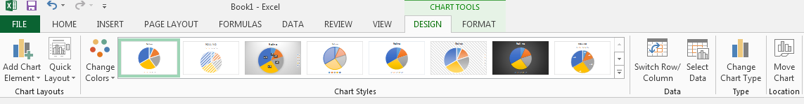
Chart Design tab

Slide 30
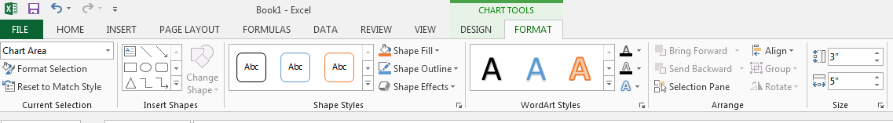
Chart Format tab

Slide 31
Activity 1
Create examination result sheet for your own class.
You may include the following headings:
  Exam title, school name
  Roll no, student name, class, section
  Signature line
  Subject list like urdu, English,Pak. Std, etc.
  Use formula in total and percentage column

Slide 32
Activity 2
Add some values and apply a formula of addition, subtraction and average.
Insert a chart based on the data entered in the previous step and then modify chart settings
  Chart type, chart color, etc.

Slide 33
Further reading
Computer Applications in Business by Tasleem Mustafa
  Chapter 17: Formulas and Functions
  Chapter 19: Creating charts in excel

Slide 34
Thanks
End of Lecture 17

Slide 35
Allah Hafiz

