Slide 1
Spreadsheet
ADE100- Computer Literacy
Lecture 16

Slide 2
Knowledge test
What is spreadsheet?
Differentiate between Save and Save As.
Why formula bar is used?
What is a cell address?

Slide 3
Topics covered
Adding and working with information
  Formatting cells
  Adding comments
  Inserting hyperlinks
Changing the look of information with spreadsheet
  Cell alignment
  Changing font face and size
  Adding background color to cells and rows
  Inserting pictures

Slide 4
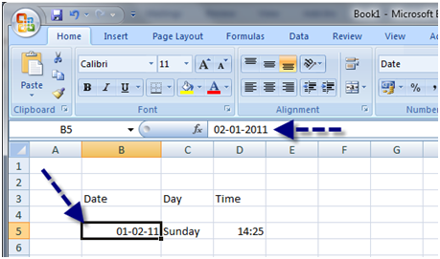
Entering data in the cells
Entering data in a cell
  Select the cell where you want to insert data
  Type the data
  Press Enter from keyboard

Slide 5
Types of data
Text
  Also called Labels because it is often used to identify the information in columns or rows
  Include any letters, numbers and symbols on the keyboard
  Up to 32,000 characters may be entered in a cell
Values
  Numeric entries; used in calculations
  Numbers can be displayed in different formats like with or without currency symbol
  Numbers that contain too many digits for the width of column are displayed as hash symbols (####)
  This problem can be solved by resizing the width of column

Slide 6
Types of data
Dates
  The values that can be used in calculations to calculate time interval like your age.
  May be displayed in different formats
  For example, dd-mm-yy, mm-dd-yyyy
Formula
  The instructions that perform calculations
  May be very simple or complex
  The result may be a number, date or a message
  Begins with equal (=) sign
  For example, =A1+A2, =a1/a3, =Sum(a1,a2) and =sum(a1:a100)

Slide 7
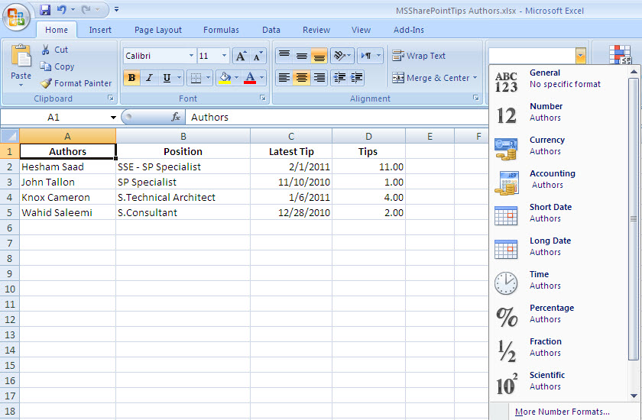
Types of data

Slide 8
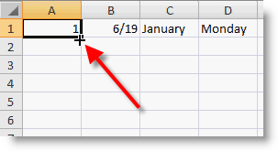
Fill Handle
Fill handle
  A time saving tool that automatically fills a series of words like days, number patterns and formulas
  AutoFill feature makes data entry fast and efficient
Filling in a common series
  Select the initial cell for the series
  Place the mouse over the fill handle, your mouse pointer appears like a black plus sign (called crosshairs)
  Drag the handle over the cells that are to be filled
  Release the mouse button. Excel fills the cells.

Slide 9
Examples of Fill handle series
Initial selection | Extended series
Mon | Tue, Wed, Thu…..
Monday | Tuesday, Wednesday,…..
Jan | Feb, Mar, Apr, ….
1,2 | 3,4,5,6,7,8,……..
1997,1998 | 1999,2000,2001,….
1,3 | 5,7,9,11,…..
2,4 | 6,8,10,12,……

Slide 10
Editing data
Editing data
  Editing is very easy in excel
  Edit your entries using formula bar or cell itself
  First you must active the desired cell
You may use any of these methods for editing
  Double click on the cell containing the data you want to edit
  Click once on the formula bar
  Press F2

Slide 11
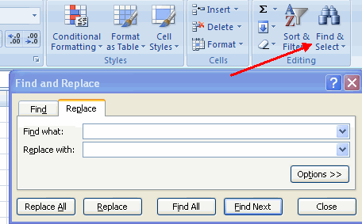
Find and Replace data
A search can locate specific information on the worksheet
Finding data
  Click Home>>Find OR
  Press CTRL+F
  The Find dialog box will appear
  Type the data in “Find What” textbox
  Click Find Next, excel will go to the next occurrence

Slide 12
Find and Replace data
Find and Replace data
  Open Find dialog box from Home>>Find
  Click Replace button in the dialog box
  Enter data in Find What and Replace With textbox
  click Replace All button to replace all occurrences
  When finished then press Close button

Slide 13
Formatting cells
Changing Font
  Select the cell for formatting
  Home>>Font
  Click the arrow on the Font box
  From the menu select the Font to apply
Changing Font size
  On the Formatting toolbar, click the arrow on Font size box
  From the menu list, select the size to apply or type the number if not listed and press Enter

Slide 14
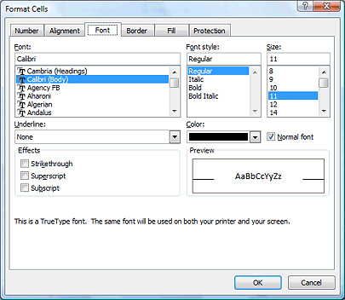
Changing Font

Slide 15
Changing Font style
Font style
  Refers to font effects but not the font itself
  Bold, italic, underline styles are used
Method
  Select the cell
  Choose Home>>Font
  From the Formatting toolbar click the enhancement buttons i.e. B, I, U OR
  press CTRL+B, CTRL+I, CTRL+U

Slide 16
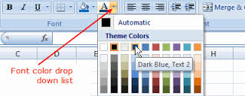
Changing Font color
Changing Font color
  Select the cell to format
  On the formatting toolbar, click Font Color to apply the color displayed on the button OR
  On the formatting toolbar click the arrow on the Font Color button and select a color from the menu

Slide 17
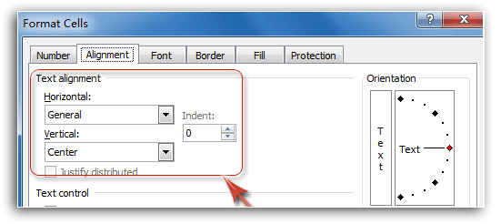
Cell Alignment
Text is aligned automatically on the left of column and values on the right.
This can be changed if required.
Text Alignment
  Select the data with the mouse
  Click the align left/center/right/justify icon

Slide 18
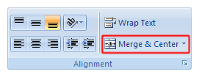
Merge and center
Merge and centers
  Selects data across multiple cells
  Merge and center functions are combined on this icon
Method
  Select the series of cells in columns
  Click on the “merge and center” icon
  Press Enter from keyboard

Slide 19
Rotating text
Rotating text
  Allows to change the direction of text at different angles diagonally or vertically
  Great way to adjust text in narrow columns
Method
  Select the desired cell or range of cells
  Choose Home>>Format>>Format cells
  Click Alignment tab. Under Orientation , Red Diamond will be at position zero degrees
  Now click and drag Red Diamond to the desired degree level like 90, 45, etc.

Slide 20
Wrapping text in a cell
Wrap text
  The text automatically move to the next line when touches the margin boundary without pressing Enter key
Method
  Select the cells for wrapping text
  Choose Home>>Format>>Format cells
  Select the Alignment tab from Format Cell dialog box
  Under Text control, select Wrap text and click OK

Slide 21
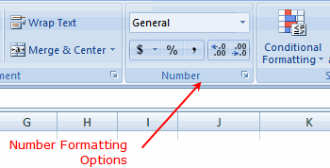
Number format
Numbers formatting
  Numeric data is displayed in different styles
  For example, general, number, currency, date, time, percentage, etc.
Applying currency style
  select the cells
  Click Home>>Format>>Format cells
  Select Number tab from the dialog box
  Click on the Currency from category list
  Select a currency symbol from Symbol box and click OK

Slide 22
Borders
Applying cell borders and shading
  Select the cell or range of cells
  Clicking Borders icon on the formatting toolbar will apply the most recently selected border style
  To apply a different border style, click the arrow on the Borders button and then choose style from the palette
  For more choices, choose Border tab from Format Cells dialog box
  Add shading by clicking Fill Color button on the toolbar in Home tab

Slide 23
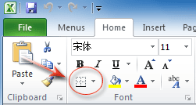
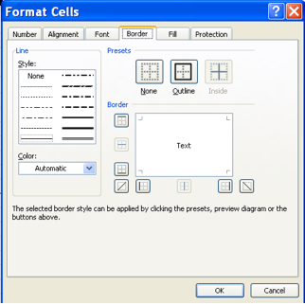
Borders

Slide 24
Inserting a hyperlink
Hyperlink
  A connection between an element in a hypertext document, such as a different element in the document, another document, a file
  The user activates the link by clicking on the linked element
  Usually underlined or in a color different from the rest of the document to indicate that the element is linked
Method
  Choose Insert>>Hyperlink
  Insert Hyperlink dialog box will appear
  Select a file you want to link with this text
  Email and URLs are inserted in the form of hyperlinks

Slide 25
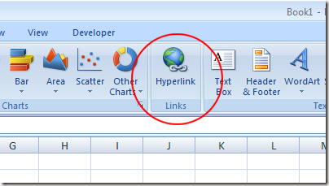
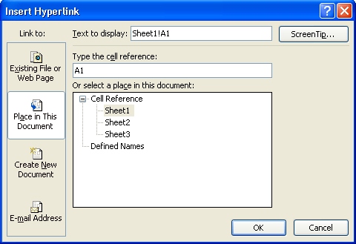
Hyperlinks

Slide 26
Adding comments
Comments
  Similar to sticky notes on which you can write reminders and attach to a paper
  May explain the limitations on the input values
Applying comments
  Select a cell
  Right click on the cell
  Select insert comment from the menu
  A comment box will appear near the cell, write some text inside the comment box
  To close & store the comment, click on any other cell

Slide 27
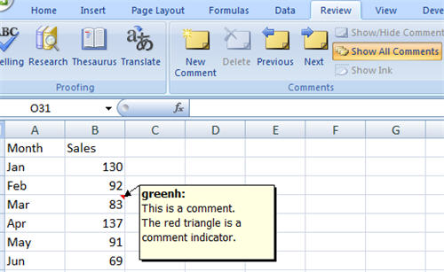
Insert comments

Slide 28
Inserting a picture
Method
  Select the initial cell where you want to insert a picture
  Choose Insert>>pictures
  Insert Picture dialog box will appear
  Search and select the desired file and click Insert button

Slide 29
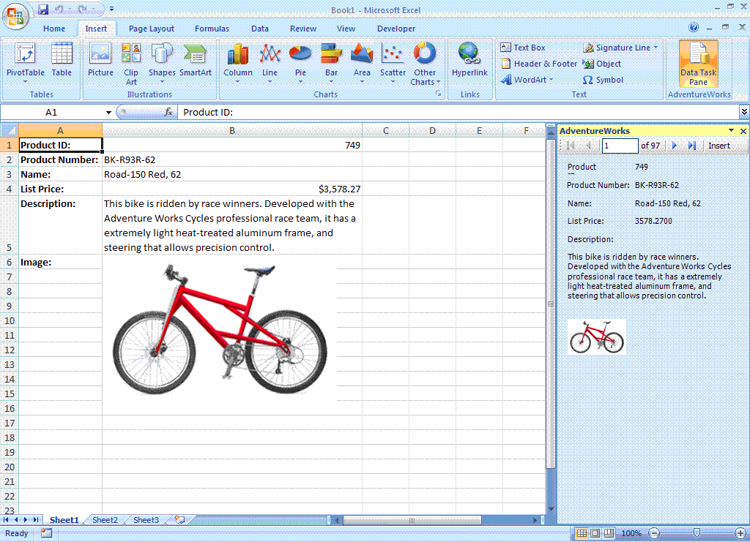
Insert pictures

Slide 30
Activity 1
Create a contacts directory of your personal and professional contacts.
Give a title of “Contacts Directory” on the top.
Insert at least five records in the sheet.
The directory will include column headings:
  Serial number
  Name, Address
  Phone number, Cell number
  Email address

Slide 31
Activity 2
Enter data using Fill Handle feature.
Apply formatting on your cells or sheet.
  Change number formats, borders,
  Change background color, foreground color, font, font size, font style
  Change cell alignment, wrap text, rotate text, merge and center
Insert a picture from you computer in the sheet.
Insert a hyperlink to open a file.
Insert a comment on the cell.

Slide 32
Further reading
Computer Applications in Business by Tasleem Mustafa
  Chapter 14: Data entry tips and tricks
  Chapter 15: Formatting in excel

Slide 33
Thanks
End of Lecture 16

Slide 34
Allah Hafiz

