Slide 1
Using Productivity Application- Spreadsheet
ADE100- Computer Literacy
Lecture 15

Slide 2
Knowledge test
Why columns are used in word?
What is autocorrect feature of word?
What is the use of templates in word?

Slide 3
Topics covered
General introduction to spreadsheets interface
Creating, saving and opening spreadsheet
Using worksheets

Slide 4
Spreadsheet
Spreadsheet program
  Used for calculations
  Provides worksheets to enter data
Worksheet
  Collection of rows and columns
  Calculate using formulas and built-in functions
  Display data in charts and figures
Workbook
  Collection of worksheets

Slide 5
Advantages of spreadsheet
Spreadsheet
  Increases the ease and speed of calculations
  Easy to modify and recalculate data automatically
  Display numeric data as charts or graphs

Slide 6
Microsoft Excel
Microsoft Excel
  Used for calculations in tabular form
  The main window is called worksheet.
  The intersection of a row and column is called Cell.
    Cell contains data, text, numbers, date, formula, functions
  Rows are labelled by numbers (1,2,3……)
  Columns are labelled by alphabets (A,B,C,AA,AB…)
  Cell address
    Cells are labelled with both row number and column letter e.g. A1, B5, C30

Slide 7
MS Excel Interface
Worksheet
  256 columns and 65,536 rows in a worksheet
Workbook
  By default, 3 worksheets in a workbook
  First sheet; sheet1 then second; sheet2, etc.
  You save a workbook with worksheets
Active cell
  The current cell where you will enter data

Slide 8
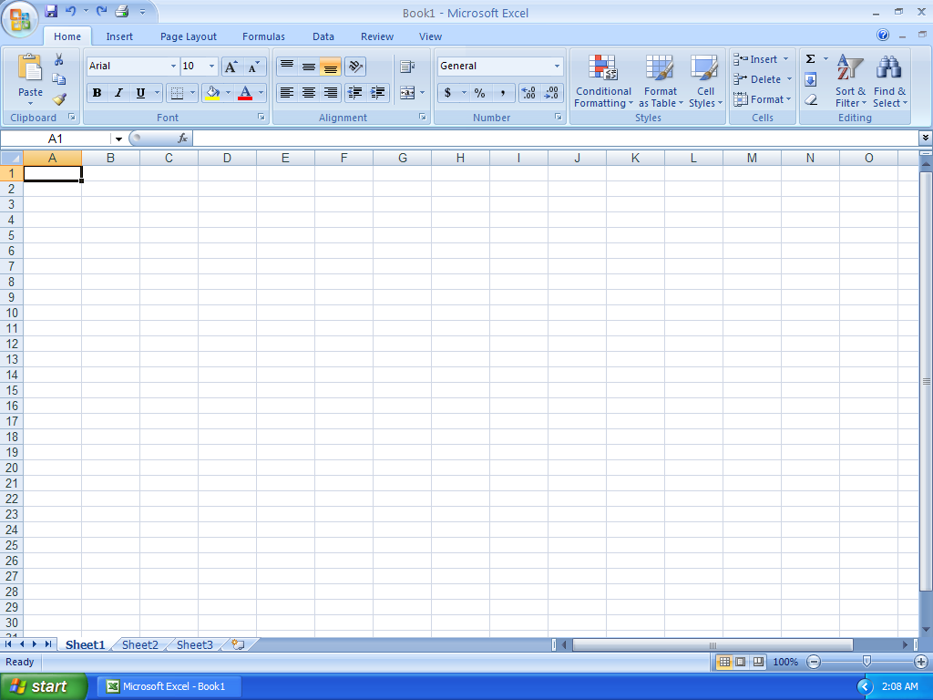
MS Excel Window

Slide 9
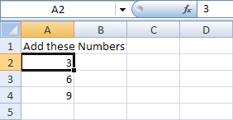
Active cell

Slide 10
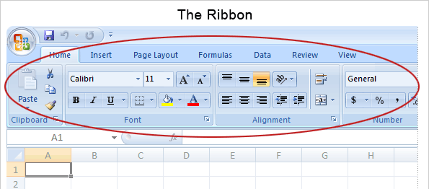
Ribbon

Slide 11
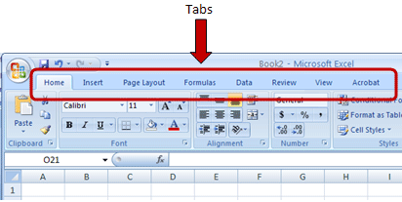
Menu bar

Slide 12
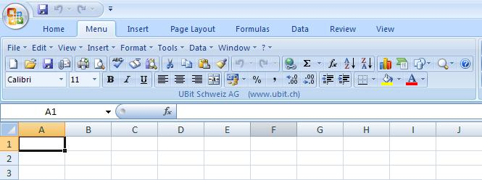
Toolbars

Slide 13
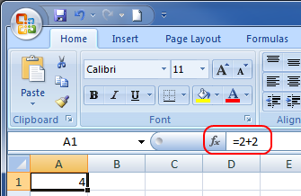
Formula bar
Formula bar
  Displays the location of active cell and the value or formula used in the active cell

Slide 14
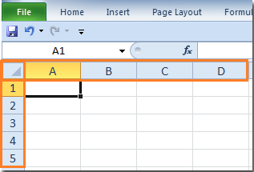
Row/column headings

Slide 15
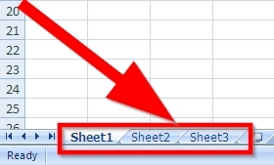
Sheet tabs

Slide 16
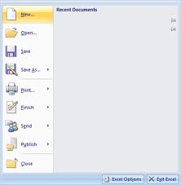
Creating a file
To create a new spreadsheet
  Open File menu and choose New or press CTRL+N
  A new excel workbook will be open with “three default sheets”

Slide 17
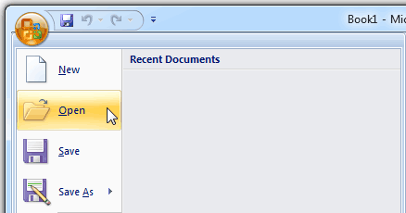
Opening a file
To open an existing spreadsheet
  Open File menu and choose Open or press CTRL+O
  Open dialog box appears, select the desired file and then click Open button

Slide 18
Saving a file
To save a file
  Select File menu and choose Save or press CTRL+s
  Save dialog box appears, the default name like book1, book2 will appear
  You can change this name according to your requirements like Result sheet
Save As function
  Once you saved a file then you can create its different versions with different names
  File>>Save As

Slide 19
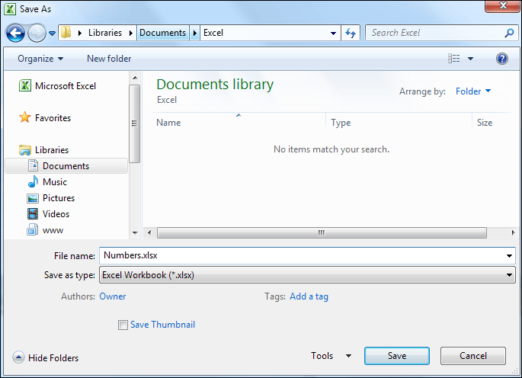
Saving a file

Slide 20
Using worksheets
You can restructure a workbook by
  Adding, copying, moving or deleting worksheets
To make a sheet easier to identify
  Rename the worksheet and change the color of sheet tab

Slide 21
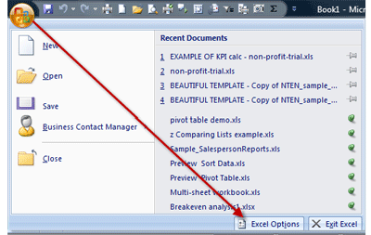
Changing the no. of default sheets
You may increase or decrease no. of worksheets in a workbook.
Procedure:
  File>>options
  Click on General Tab
  Change the number of sheets in new workbook and choose OK

Slide 22
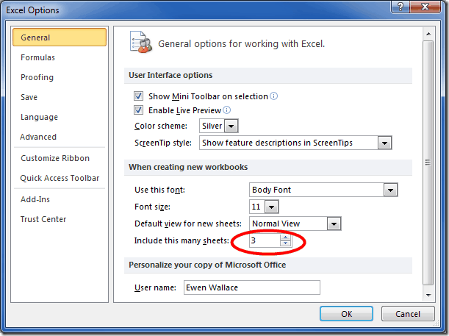
Changing default sheets

Slide 23
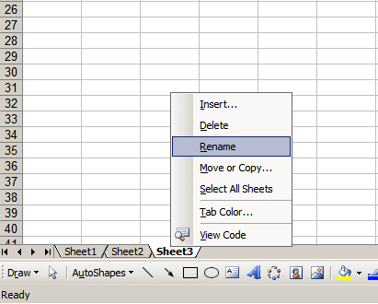
Renaming worksheets
Procedure:
  Double-click on the sheet tab OR
  Right click on the sheet tab and Choose Rename from the menu
  Type the new name
  Press Enter

Slide 24
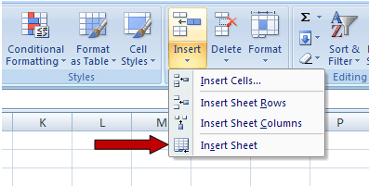
Inserting sheets
Right click on the sheet tab and choose insert OR
Insert>>Worksheet
Insert dialog box appears, select Worksheet and click OK

Slide 25
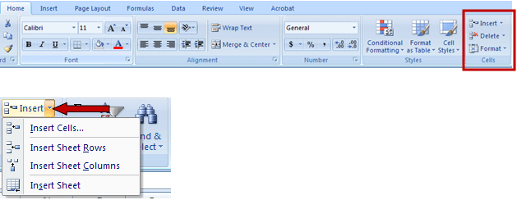
Inserting row or column
Select the row or column where you want to insert new row or column
Right click the selection and from shortcut menu select Insert OR
Press CTRL++
OR Home>>Insert

Slide 26
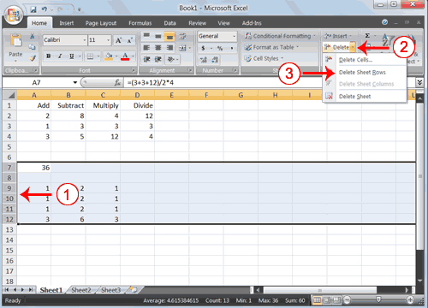
Deleting a row/column
Select the columns or rows to delete
Right click on the selection and select Delete or
Press CTRL+-
OR Home>>Delete

Slide 27
Moving and copying sheets
Moving sheets
  Select the sheet tab to be moved
  Hold the mouse button down, drag the sheet to new location
Copying
  Select the sheet tab to be copied
  Right click on the sheet tab and choose Move or Copy
  Move or Copy dialog box appears, select the checkbox of create a copy

Slide 28
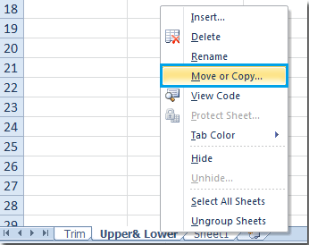
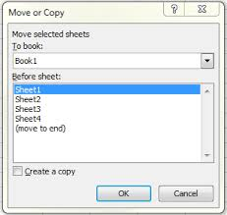
Move or copy sheets

Slide 29
Activity-(20 minutes)
View and explore components of MS Excel window.
Create and save a new excel file with your name.
Open a spreadsheet file.
Perform these operations on worksheets.
  Insert a new worksheet
  Delete a worksheet
  Copy and move a worksheet
  Insert/delete a row or column

Slide 30
Further reading
Introduction to computers, 7/e by Peter Norton
  Chapter 10A: Productivity Software
    Topic: Spreadsheet programs
Computer applications in Business by Tasleem Mustafa
  Chapter 13: Understanding MS Excel

Slide 31
Summary
General introduction to spreadsheets interface
  Menu bar, toolbar, active cell, status bar, etc.
Creating, saving and opening spreadsheet
  Creating a file
  Saving a file
  Opening a file
Using worksheets
  Adding, copying, moving or deleting worksheets
  Renaming a worksheet

Slide 32
Tips
Microsoft excel
  Try to play with the computer like games
  Play, play, play……..
  Develop documents like result sheet, award list, time table, etc.

Slide 33
Thanks
End of Lecture 15

Slide 34
Allah Hafiz

