Slide 1
Word Processing
ADE100- Computer Literacy
Lecture 14

Slide 2
Knowledge test
What is print preview?
What is the concept of tables?
What do you mean by picture crop option?
Which menu is used for adding pictures in the document?

Slide 3
Topics covered
Advanced features (continued)
Using word processing to create classroom instruction documents:
  Diagrams
  Lesson plan
  Worksheets
  Flash cards
  Brochures
  Newsletters
  Motivation tool (certificate)

Slide 4
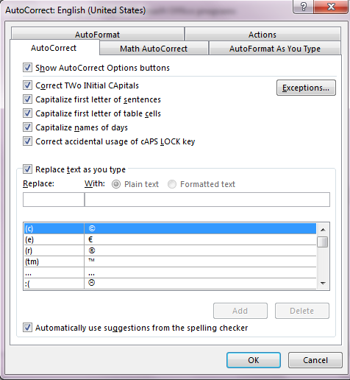
AutoCorrect
AutoCorrect feature
  Automatically detects and corrects misspelled words, grammatical errors and incorrect capitalization

Slide 5
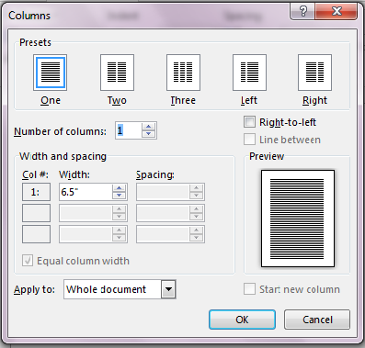
Columns
The text can be arranged into multiple columns.
No. of columns depend on page size
E.g. newspaper, magazines, etc.
Page layout>>columns

Slide 6
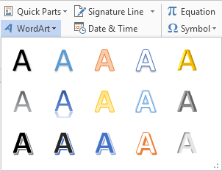
WordArt Graphics
Word Art
  A small program in MS word that runs in the word environment
  Used to turn ordinary text into graphics objects
  The text can be converted into variety of shapes by rotating, adding shades, colors, borders, shadows, etc.
  Insert>>WordArt

Slide 7
Mail Merge
Mail merge
  The records of a database are merged into text of document
  Very shortcut method used to create form letters, mailing labels, envelops, etc.
For example,
  Sending result cards to all the students of a school
  Mail merge can be used for this purpose

Slide 8
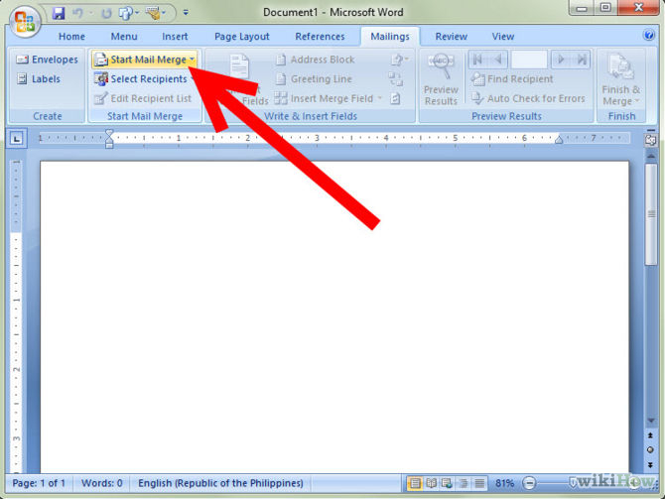
Mail merge

Slide 9
Using word templates
Word templates
  When working with Word it is annoying to create forms that you use often from the beginning
  If possible, you want to use a file that someone has partially completed and change it slightly for your own use.
  A template is a file that is just one step away from completion. In other words, it is the basis of a form.
  Readymade or predefined designs
  Available online as well at different websites
  Most popular is office.microsoft.com
  Some templates are provided in the program

Slide 10
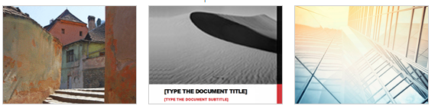

Word templates

Slide 11
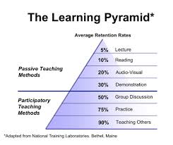
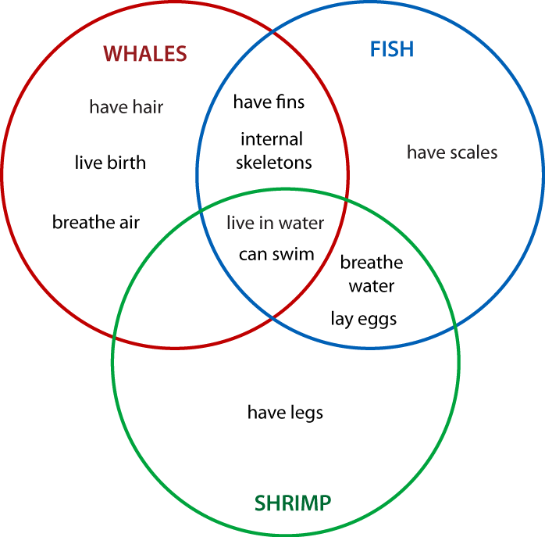
Diagrams

Slide 12
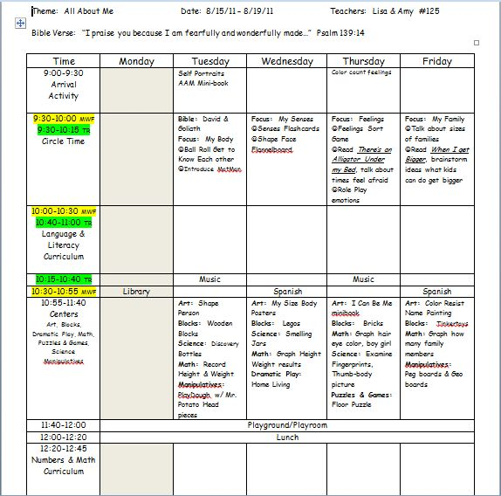
Lesson plan

Slide 13
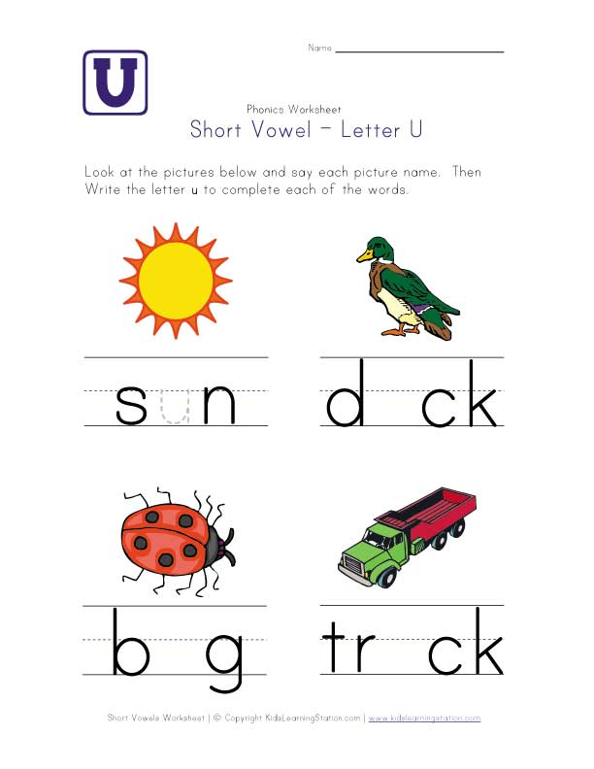
Worksheets

Slide 14
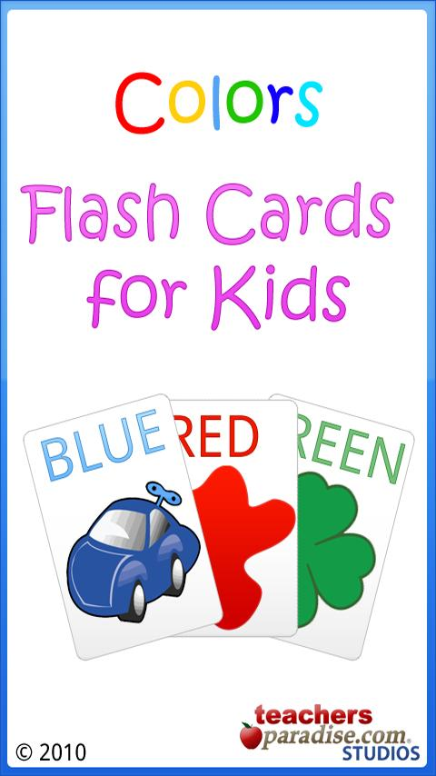
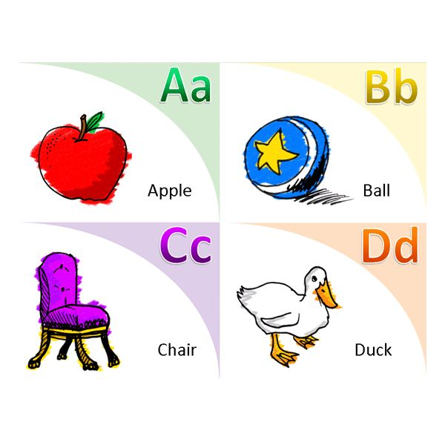
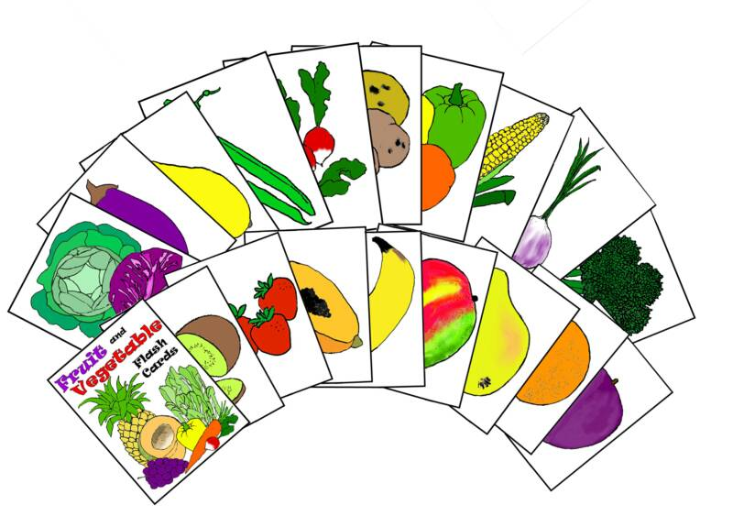
Flash cards

Slide 15
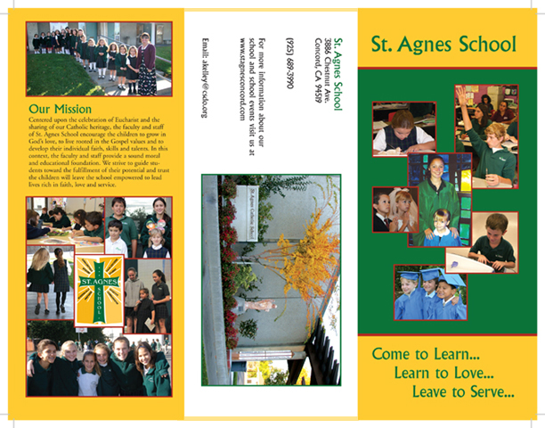
Brochures

Slide 16
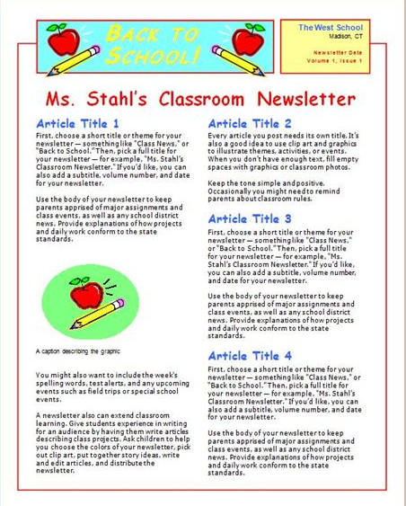
Newsletter
Newsletter
  Report or open letter giving informal or confidential news of interest to a special group
  Monthly newsletter

Slide 17
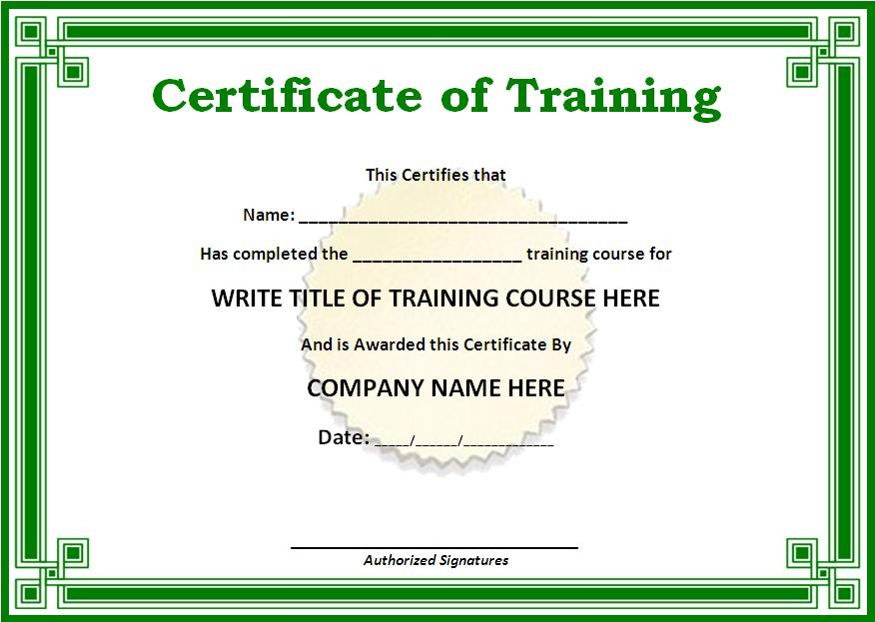
Motivation tool- certificate

Slide 18
Activity
Prepare a quiz or question paper of a subject of your interest using basic features of Microsoft word.
  Document title (bolded and background shaded)
  Page header and footer, Page number in the footer
  Text alignment, Bullets and numbering
  Indenting (using tab or ruler)
  Reasonable paragraph and line spacing (1.25 suggested)
  Some items can be italicized (names etc.)
  Font style: Times New Roman
  Font size: 12 for subject and body, 14 for the document title, and 10 for header and footer text and numbering

Slide 19
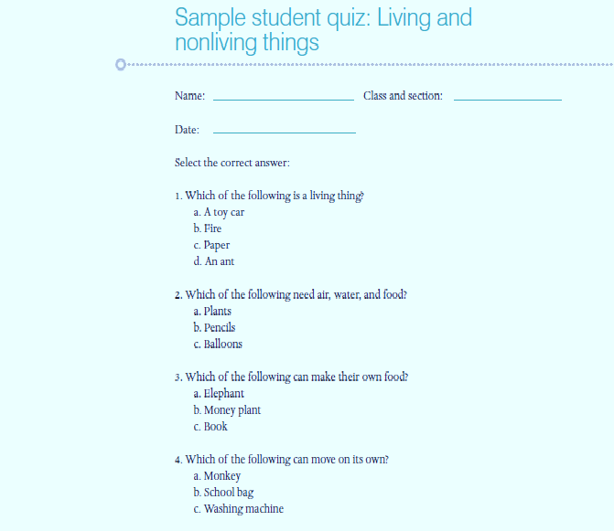
Sample Question Paper

Slide 20
Activity
Create your CV or Resume for the post of Teacher. Your CV should include:
  Personal information
  Qualifications
  Experience history
  Extracurricular activities
  Hobbies
Create a covering letter for your job application.
  First paragraph, tell how have been informed about this job
  Second paragraph, tell brief detail of your qualifications
  Third paragraph, tell about your job experience with duration

Slide 21
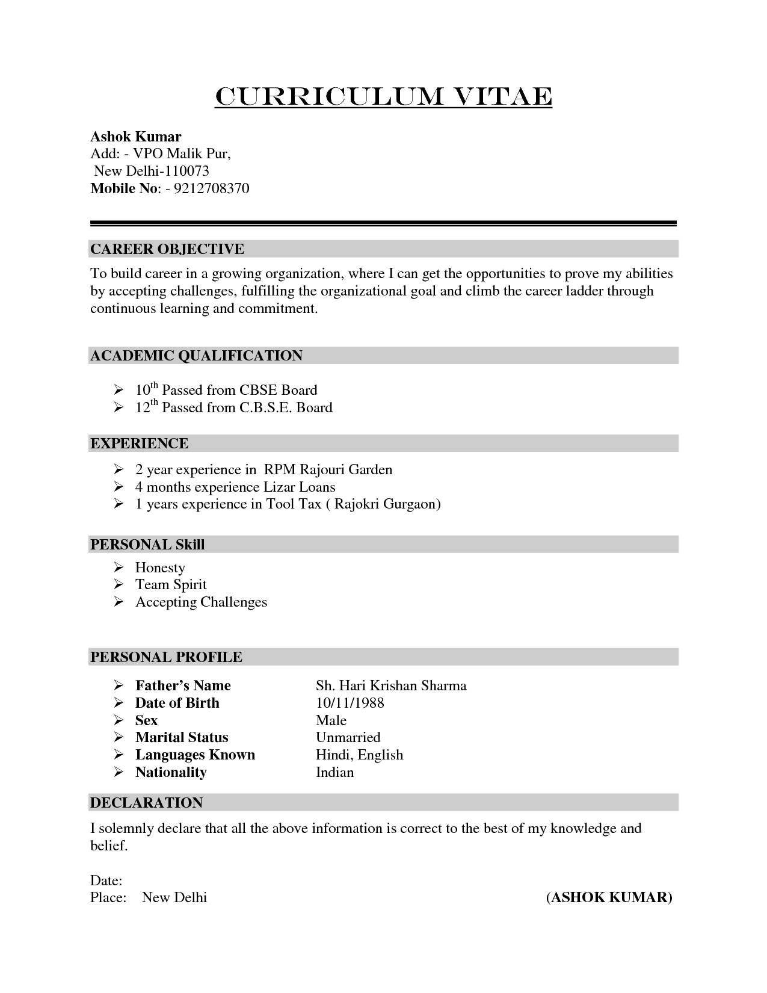
CV Format

Slide 22
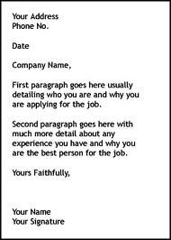
Cover Letter

Slide 23
Thanks
End of Lecture 13

Slide 24
Allah Hafiz

