Slide 1
Word Processing
ADE100- Computer Literacy
Lecture 13

Slide 2
Knowledge test
What is the purpose of page range?
What is direct printing?
What is the purpose of collate in printing?
What is the importance of print preview?

Slide 3
Topics covered
Adding pictures to pages (from clipart & file)
Working with tables, charts and graphs
Working with diagrams (using ‘draw’ feature)

Slide 4
Inserting image from ClipArt
A ClipArt
  Gallery of pictures, sounds, and video clips that can be inserted in the document
  MS word has a library of Clip Art images
To insert a ClipArt
  Choose Insert>>pictures, a submenu appears
  Choose clip art from submenu, the Insert Clip Art dialog box appears
  Search the image and select it
  Click once on the image you want to insert

Slide 5
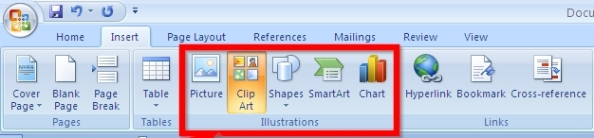
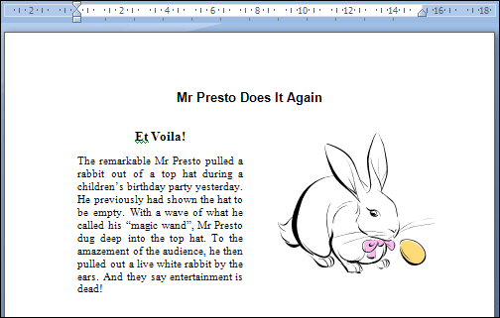
Inserting ClipArt

Slide 6
Inserting image from File
An image or picture stored on the hard disk can be added in the word document.
Procedure:
  Choose Insert>>Pictures
  Insert picture dialog box appears
  Search and select an image file from the disk
  Double click the file or select and click insert button

Slide 7
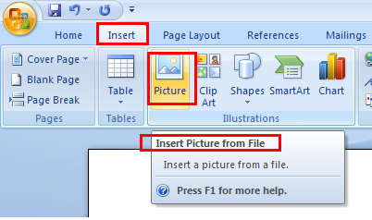
Inserting a picture

Slide 8
Tables
Table
  A tool used to organize data in rows and columns
  Consist of series of rows and columns
  Intersection of a row and column is called a cell
  Data is written inside the cell
  Formatting can be applied on the table using borders and shading colors.

Slide 9
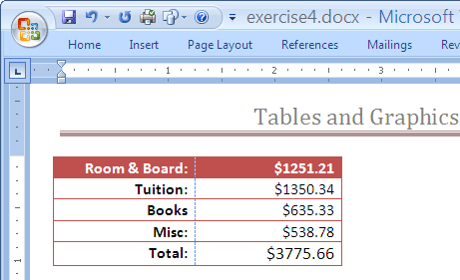
Creating tables
Tables can be inserted anywhere in the document.
Different ways to insert tables:
  From Insert Table
  From Draw table

Slide 10
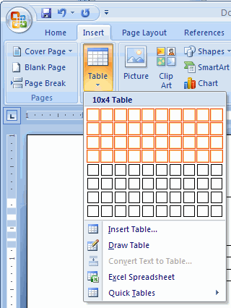
Creating from Insert Table
Place the insertion point at the position where you want to insert a table
Insert>>Table>>Insert Table
Insert table dialog box appears, specify no. of rows and columns
Click OK

Slide 11
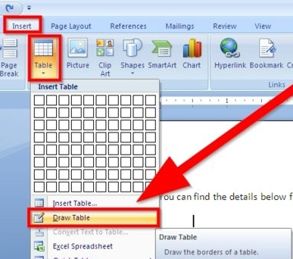
Creating from Draw Table
Insert>>Table>>Draw Table
The cursor pointer will change like pencil
Now you can draw the table rows and columns

Slide 12
Inserting & deleting rows/columns
Place your cursor in the row or column, below or above where you want to enter new row or column.
Inserting a row/column
  Select Layout tab and choose insert below or insert above icon
Deleting a row/column
  Select Layout tab and choose Delete icon
  Click it, a dropdown menu will open
  Select delete rows or delete columns
  Selected columns or rows will be deleted

Slide 13
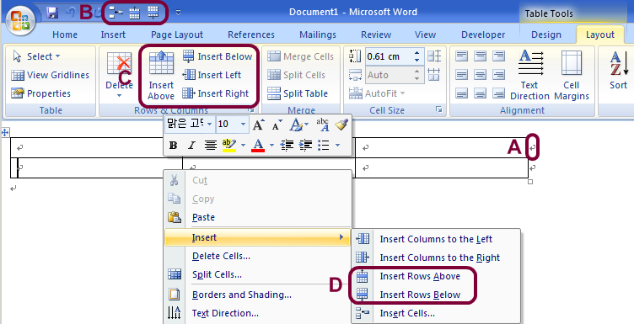
Inserting a row/column

Slide 14
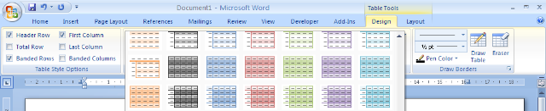
Table Design
Using table Design tab
  Several design templates for tables are available
  Choose anyone style to apply on your table
  Apply borders and shading using toolbar options like shading, pen color, etc.

Slide 15
Charts & graphs
Charts
  Present data in a visual format in the form of symbols like bars.
  Many types of charts like pie chart, bar chart, etc.
Graphs
  It is just one type of chart.
  Data is represented in the form of lines

Slide 16
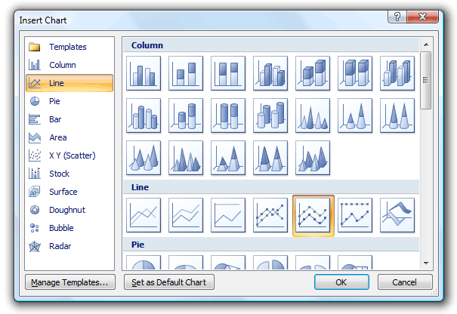
Charts and graphs

Slide 17
Elements of a chart
Plot area
  The area in which values are plotted. It contains data points and gridlines
Chart area
  The object in which the chart, legend, title and your custom objects reside.
Series
  Collection of related data values
X-Axis
  The horizontal axis

Slide 18
Charts & graphs
Y-Axis
  The vertical axis
Legend
  A box often located to the right of the chart
  Indicates the name of each series along the color scheme used by the series
  Use a legend if two or more series
Chart toolbar
  Allows to select any object in the chart
  You can change the chart type or may reverse some features of charts

Slide 19
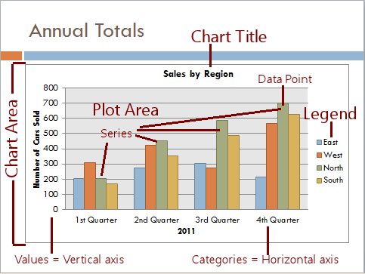
Elements of a chart

Slide 20
Important chart types
Pie charts
  Used to compare parts of a whole
  Help to divide the groups into the components that make it up
Line graphs
  Used to indicate the relationship of one variable with another
  Created using straight or curved lines
Bar charts
  Used to emphasize the contrast between quantities
  Two types are used: vertical and horizontal bars

Slide 21
Chart types

Slide 22
Diagrams- using draw feature
Drawing objects
  Objects that are created using built-in tools like lines, curves and other shapes.
Draw textbox
  Choose Insert>>Textbox>>Draw Textbox
Draw shapes
  Choose Insert>>Shapes
  Select a shape and then draw it on the document

Slide 23
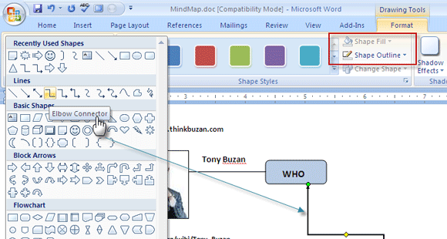
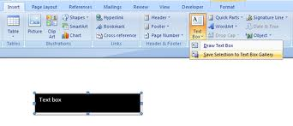
Draw feature

Slide 24
Summary
Adding pictures to pages
  from clipart
  From file
Working with tables
  Creating table from menu & draw
  Inserting/deleting rows and columns
  Table design
Charts and graphs
  Elements of charts
  Important types of charts
Working with diagrams
  Drawing shapes and textboxes

Slide 25
Activity- (20 minutes)
Insert a table in the word document. Apply some table design.
  Enter data in the rows and columns of table.
  View and explore table properties.
  Apply some formatting on the table.
  Insert a row and column.
  Delete a row and column.
  Merge and split some cells in the table.
Insert a textbox and shapes using draw feature.

Slide 26
Further reading
Computer Applications in Business by Tasleem Mustafa
  Chapter 12: Using tables in documents
PM Series- Introduction to Information Technology by Riaz shahid
  Chapter8: Microsoft Word

Slide 27
Thanks
End of Lecture 13

Slide 28
Allah Hafiz

