Slide 1
Word Processing
ADE100- Computer Literacy
Lecture 12

Slide 2
Knowledge test
What do you know by word processing?
What are the operations performed during text editing?
List some operations performed during text formatting?
List some operations of paragraph formatting?
List some operations of document formatting?

Slide 3
Topics covered
Print preferences, printer properties and printing a document
Using preset and advance features

Slide 4
Printing document
Print a document
  Using a printer connected with your computer
  You can print single page, range of pages, even/odd pages, or a whole document.
  Hard copy generated
Procedure
  Select File menu and choose Print command or press CTRL+P
  Print dialog box will appear with various options
  Click OK after selecting your options
  If your printer is ready, printing is started

Slide 5
Direct Printing
If print icon on toolbar is clicked
Then whole document is printed without showing print dialog box
One copy of document is printed.

Slide 6
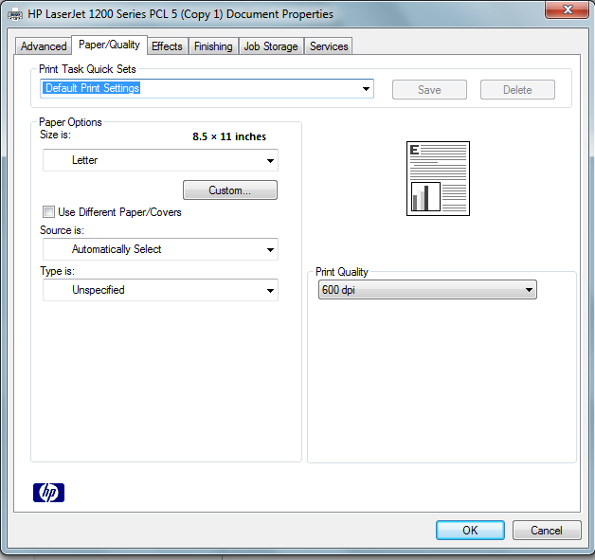
Printer Preferences

Slide 7
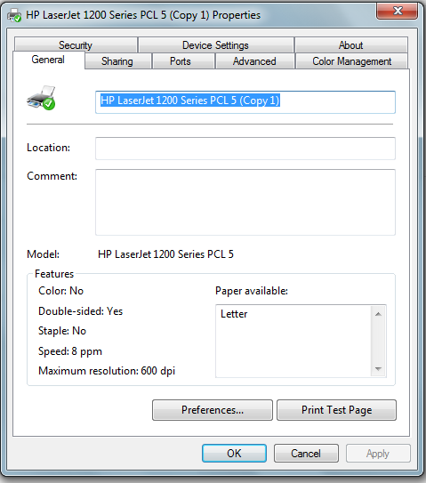
Printer Properties

Slide 8
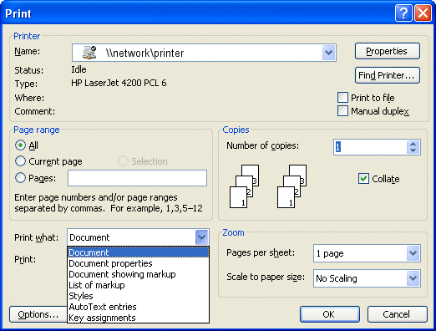
Print dialog box

Slide 9
Print dialog box options
Printer selection
  Name:
    Select the printer name
  Properties:
    Set the properties of printer such as paper quality, layout, etc.
  Print to file:
    Sends the print output to a file rather than printer
    Print file saves the necessary information about your document so that line and page breaks and font spacing remain the same.

Slide 10
Print dialog box options
Page range section
  All
    Print the entire document. By default, this option is selected.
  Current page
    Prints only the current page. Current page is where your cursor points
  Selection
    Prints only selected text
  Pages
    Prints the specific range of pages
    Such as print page 6,9 and 15 then type 6,9,15
    Prints pages from 6 to 15 then type 6-15
    Prints only page 15 then just type 15

Slide 11
Print dialog box
Copies selection
  Number of copies
    Specify the no. of copies of document required
  Collate
    Print a complete set/copy of the entire document before the first page of next copy is printed.
    If not selected, then all copies of each page will be printed

Slide 12
Zoom section
Pages per sheet
  Specify the no. of pages printed on a single sheet of paper
  By default, 1 page per sheet of paper.
Scale to paper size
  Adjust the document to fit the printer paper size
  By default, ‘No Scaling’ is selected.

Slide 13
Print Preview
Print preview allows to
  See the appearance of the document before printing
  Make corrections in the preview to change the appearance of the document
  Send documents directly to the printer by clicking Print icon on the toolbar
To view print preview, follow these steps
  Click Print Preview icon on the standard toolbar or
  Select Print Preview command from File menu

Slide 14
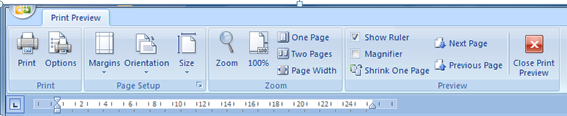
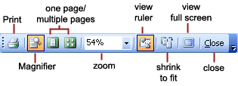
Print Preview toolbar

Slide 15
Print Preview toolbar
Print
  Send the document to the printer
Magnifier
  To enlarge/reduce the document view in Preview window
One page
  Display one page at a time in Preview window
Multiple pages
  Display multiple pages at a time
Zoom control
  Select different magnification from 10% to 400%

Slide 16
Print Preview toolbar
View ruler
  Display or hide the horizontal and vertical rulers
Shrink to fit
  Shrink the document to fit on one or less pages if the last page has only few lines of text
Full screen
  Display a document on full screen in Print Preview
Close
  Close the Print Preview
Help
  Get help about options of Print Preview toolbar

Slide 17
Editing in Print Preview mode
It is possible to edit document in print preview mode.
Click One Page button of print preview toolbar
Then start editing process

Slide 18
Changing the document margins
You can change margins in print preview, using horizontal and vertical rulers
The changes will apply to the whole document
The margins are changed by dragging the margin boundary

Slide 19
Using preset features
Preset features
  Default settings of your word document
  Set by the developer not user
  You can modify them
For example,
  Page margins=normal 1 inch
  Alignment= left
  Font= Calibri, size=11
  Page View= print layout
  Background= null
  Document name= document1

Slide 20
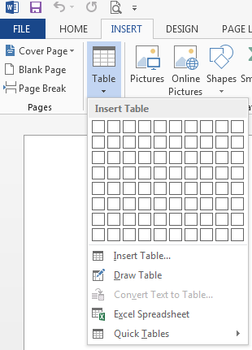
Tables
Tables
  Organize data in rows and columns
  Intersection of a row & column is called a cell.
  The data is written in the cells

Slide 21
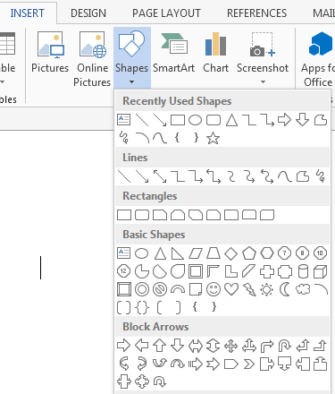
Shapes
Shapes
  Insert>>shapes
  Ready-made shapes
  Select a shape & draw it

Slide 22
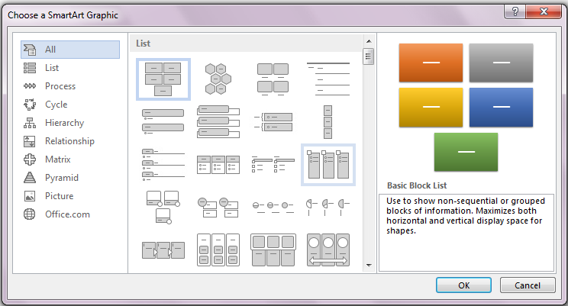
SmartArt Graphic
Insert>>SmartArt

Slide 23
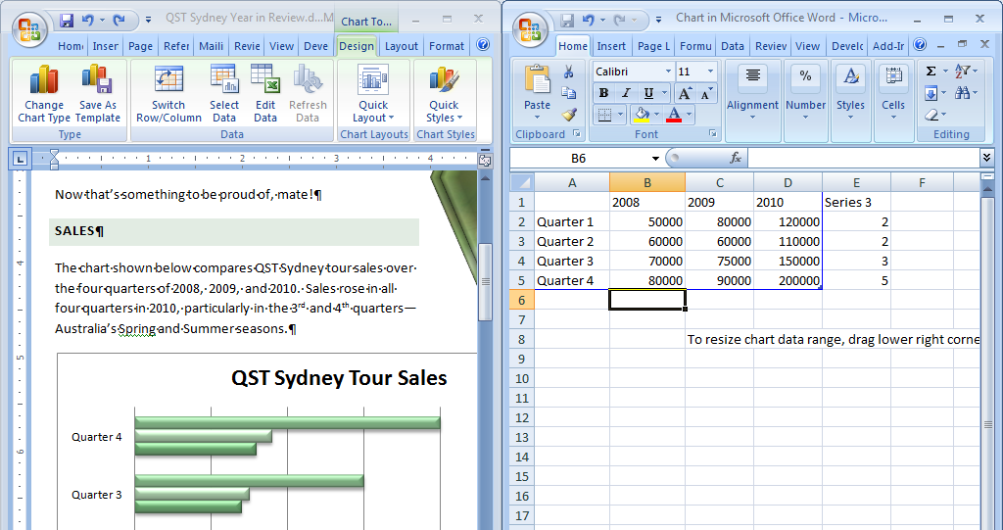
Editing charts
New data for 2008
Insert>>charts
A third bar is added to each data series

Slide 24
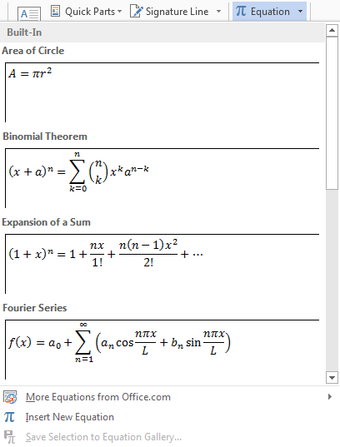
Inserting equations
Use the Equations feature to insert mathematical and scientific equations
You can also create your own equations that use a wide range of math structures
Insert >> equation

Slide 25
Working with sections
Multi-page documents often consist of two or more sections, each of which can be formatted differently
  Header text and page numbers can be different in each section
  Deselect the Link to Previous button when you change the text of a header in a new section

Slide 26
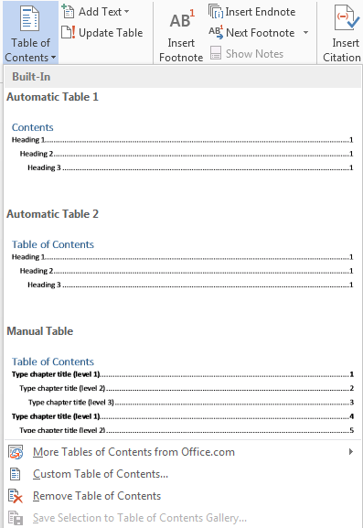
Table of Contents
Insert a table of contents to provide readers with an overview of topics and subtopics
  Word searches for headings,
  Sorts them by heading levels,
  Then displays the completed table of contents
Format headings and subheadings with Heading styles
References>>Table of contents

Slide 27
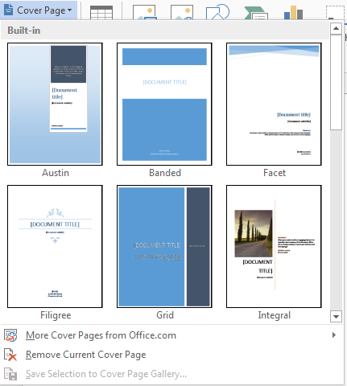
Adding a Cover Page
Use one of Word’s preset cover page designs
Add text to content controls
Remove unwanted content controls

Slide 28
Modifying a picture
Use Picture Tools Format tab to modify a picture in different ways
Apply a preset picture style
Further modify the style by
  Cropping it
  Changing the shape of the picture
  Modifying the picture border
  Apply picture effects

Slide 29
Activity-(20 minutes)
View and explore printer properties and print preferences.
View and explore print preview options.
Take a print of word document from your printer. Troubleshoot the problem if error in printing.
Insert a picture and modify it using Format options.
Insert & modify a chart in your word document.
Add a cover page to your document.
Create table of contents of a word document.

Slide 30
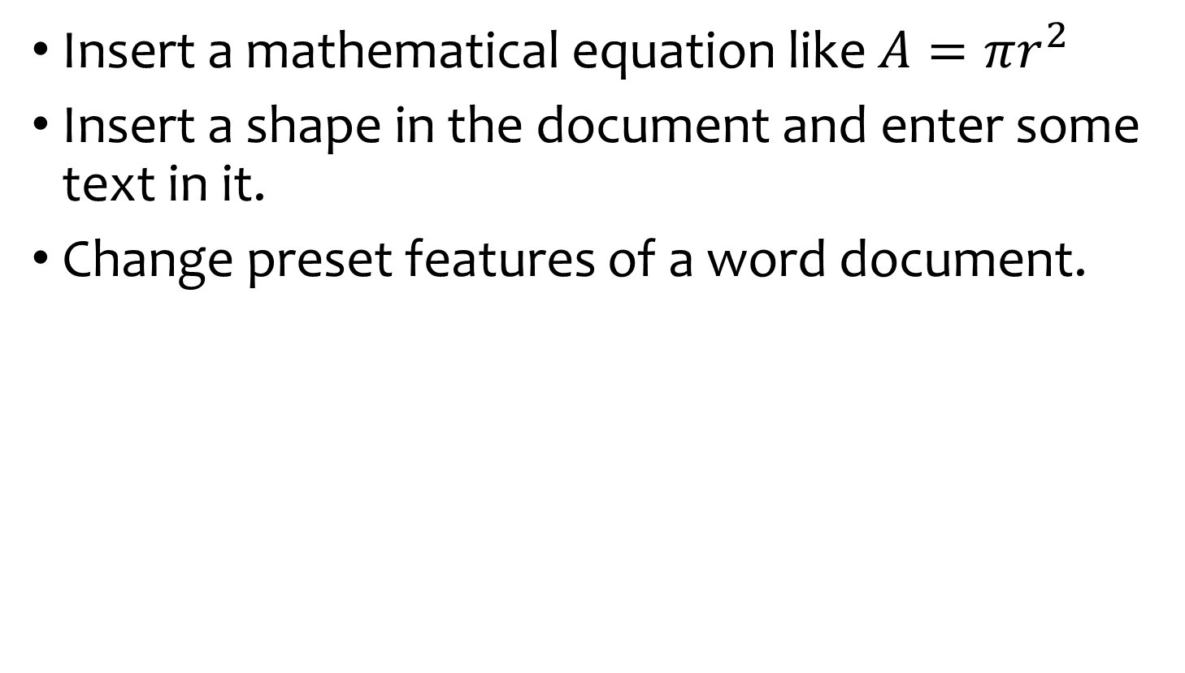
Activity-(20 minutes)
Insert a mathematical equation like $A=πr^{2}$
Insert a shape in the document and enter some text in it.
Change preset features of a word document.

Slide 31
Further reading
PM series- Introduction to information technology by Riaz Shahid
  Chapter 8: Microsoft Word

Slide 32
Thanks
End of Lecture 12

Slide 33
Allah Hafiz

