Slide 1
Using Productivity Applications- Word Processing
ADE100- Computer Literacy
Lecture 11
Sajid Riaz

Slide 2
Knowledge test
What is troubleshooting?
What happens when you install a program?
What is file compression?
What is the advantage of compressed files?
What do you mean by “extract all” in zip program?

Slide 3
Topics covered
General introduction to application window
Creating, saving and opening documents
Formatting, editing pages, text and paragraphs

Slide 4
Productivity applications
Productivity applications
  Help people to be more productive, creative and efficient
  Millions of people use them daily in their routine tasks
  Used for basic everyday tasks at home, school and work
Examples
  Word processing
  Spreadsheet programs
  Presentation/multimedia software

Slide 5
Word processing
Word processing
  Also called word processors
  Provide tools for creating text-based documents
  Enable you to add images as well
  Allow you to create long documents including chapters, table of contents, index, title page, etc.
  Embed sounds, video clips & animations
  Link different documents together like a chart from spreadsheet
  Create complex documents that update automatically like charts
  Create web documents with hyperlinks and graphics

Slide 6
Launching Microsoft Word
MS word can be launched from
  Desktop shortcut
  Quick launch
  Start menu
  From file

Slide 7
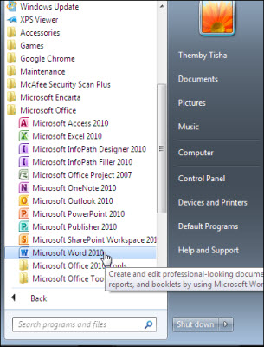
Launching MS word

Slide 8
Word processor’s interface
MS-Word is the most popular word processor.
The main editing window displays a document and several tools including
  Menu bar- displays titles of menus
  Toolbars- display buttons for commands
  Rulers- show position of text, tabs, margins
  Scroll bars- allows to scroll long documents
  Status bar- displays info related to your position in the document, page count, etc.

Slide 9
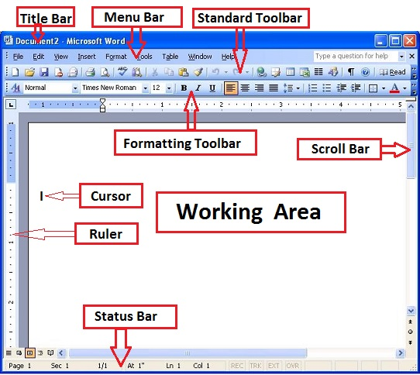
Microsoft Word Interface

Slide 10
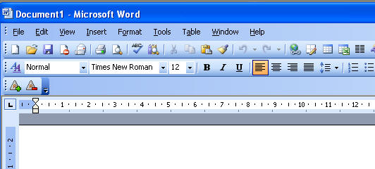
Menu bar

Slide 11
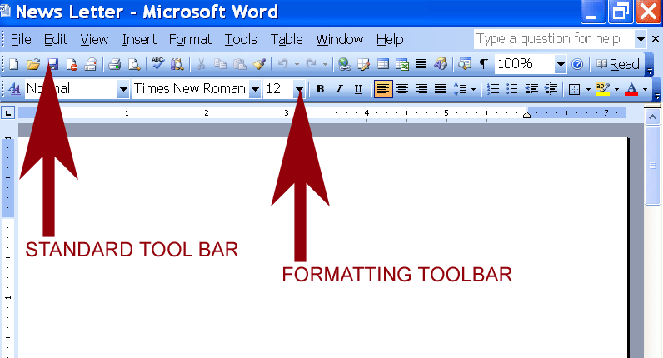
Toolbars

Slide 12
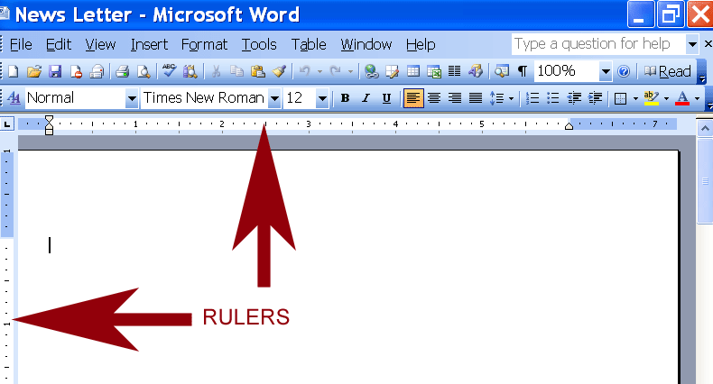
Rulers

Slide 13
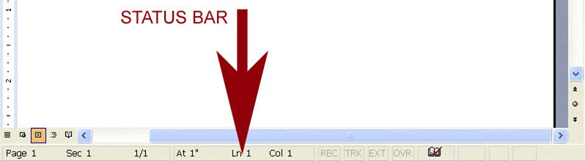
Status bar

Slide 14
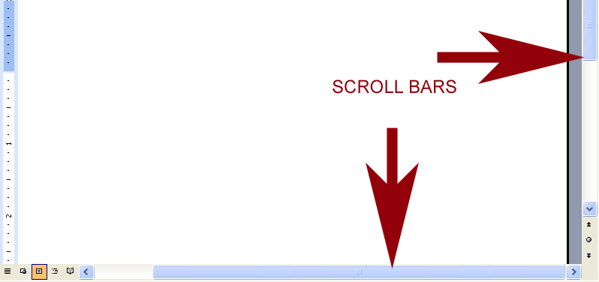
Scroll bars

Slide 15
Working with the word document
Creating a new word document
  Open File menu, choose NEW
  A blank screen will display where you can type text
  You may use shortcut CTRL+N

Slide 16
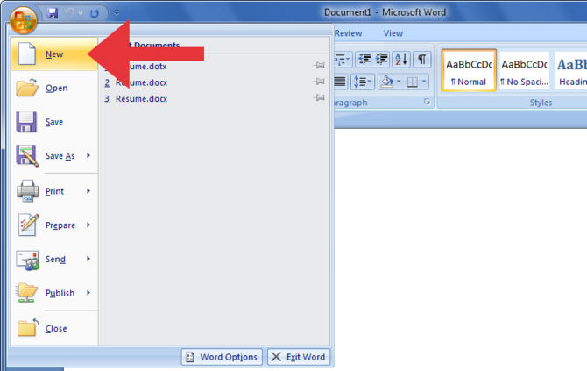
Creating a new word document

Slide 17
Opening a word document
Opening a word document
  Open File menu and choose Open
  You may use shortcut CTRL+O
  Open dialog box opens and select a file to open

Slide 18
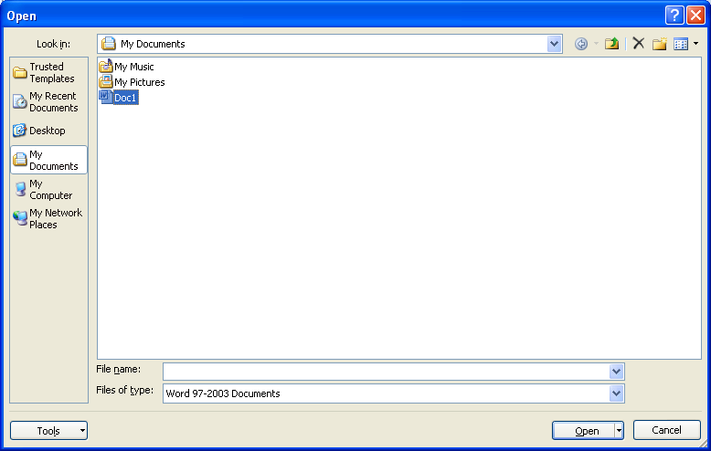
Opening a word document

Slide 19
Saving a document
Saving a file
  Transfer files from RAM to hard disk
  Open File menu, select Save
  You may use CTRL+S
  Save dialog box opens, give filename & location
  Default filename is taken from first line of text

Slide 20
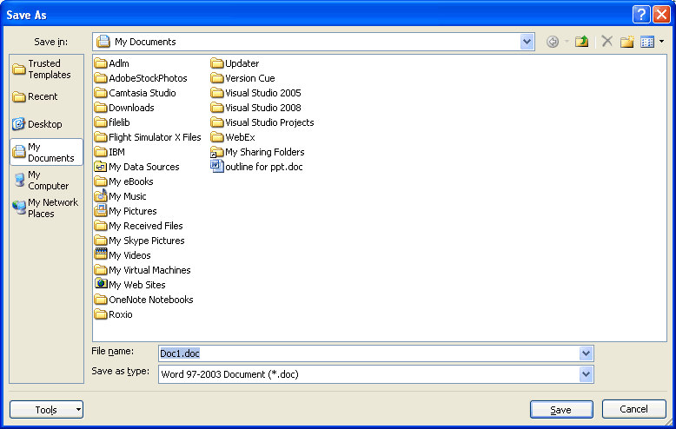
Saving a word document

Slide 21
Save As function
When you save a document,
  previous contents are overwritten by the new contents
Save As function
  Keeping copies of different versions of a file under different names
  Retains the old versions at the same time

Slide 22
Save Automatically
Microsoft Word XP
  From Tool menu, choose Options, click Save tab
  Select the Save AutoRecover info every: checkbox and in the minutes box, Set the no. of minutes

Slide 23
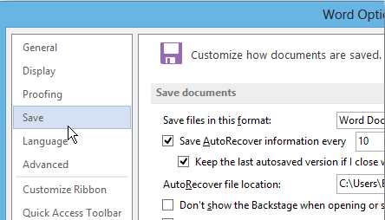
Save Automatically

Slide 24
Entering & editing text
Entering text
  Create a document by typing on the keyboard
  A blinking insertion point (cursor) displays starting position of text
  As you type the insertion point advances its position across the screen
Editing the document
  Changing an existing document
  Change the text without retyping the entire page
  You retype only the text need to be replaced

Slide 25
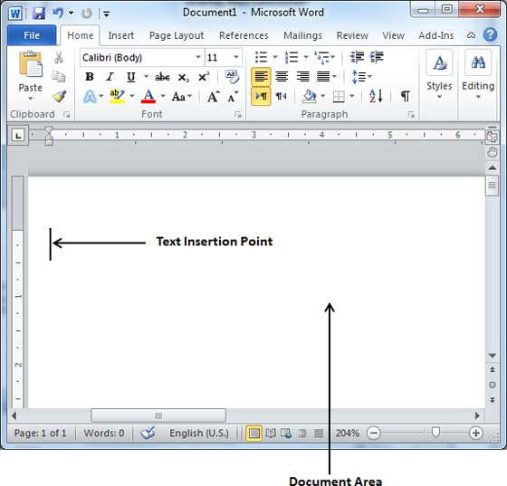
Insertion point

Slide 26
Insert & overtype modes of typing
Insert mode
  Existing text is moved to the right when additional text is added to a document
  Word uses insert mode as the main form of editing
Overtype mode
  The new text will replace the existing text
Switching between modes
  Double click OVR box on the status bar or press Insert key
  If OVR becomes dim then insert mode activates
  If OVR become bright then overtype mode activates

Slide 27


Insert & overtype mode

Slide 28
Text editing
Block of text
  A block is a contiguous group of characters, words, lines, sentences, paragraphs
  To mark text for editing or formatting you select it
Deleting text
  Use mouse or keyboard to select the text
  Color of selected text is changed & highlighted
  You can erase selected text by pressing DEL key or by overwriting text on the selected block

Slide 29
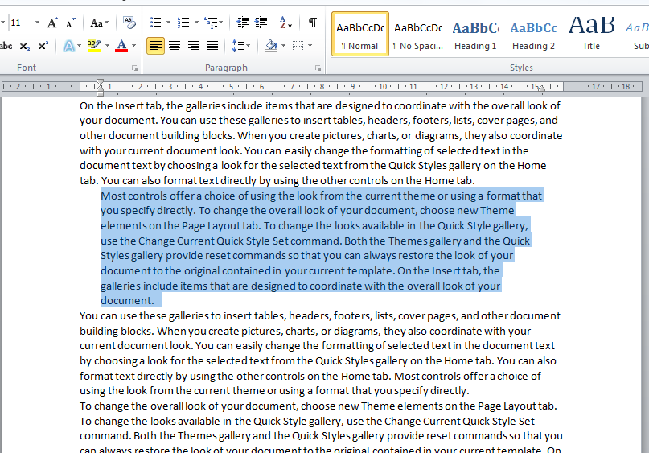
Text selection

Slide 30
Text editing
Copying text
  Select text you want to duplicate
  Choose Copy from Edit menu
  Place the cursor where you want to duplicate
  Then choose Paste from Edit
  If you want another copy then just click Paste
Moving text
  Select text you want to move
  Choose Cut from Edit menu
  Place the cursor where you want to duplicate
  Then choose Paste from Edit

Slide 31
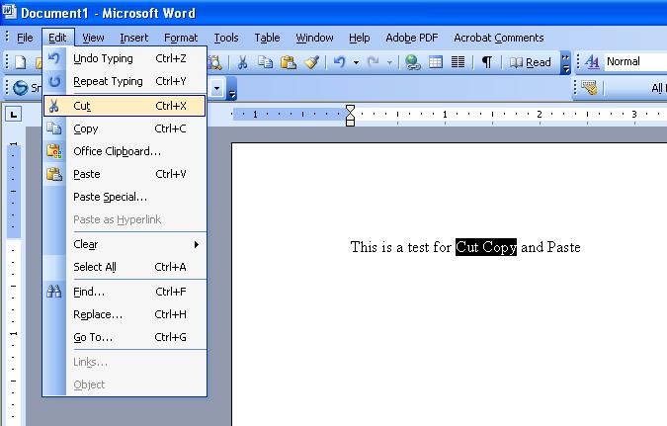
Edit menu

Slide 32
Text editing
Spelling & grammar check
  Spelling errors are pointed with a red wavy line under the word
  Grammatical errors are pointed with a green wavy line under the word
  Press F7 or choose Tools > Spelling and Grammar
Find and Replace
  Find a specific word or text in the entire document
  Choose Edit > Find or press CTRL+F
  After finding a word, use Replace command to replace it with the new text
  Choose Edit > Replace or press CTRL+H

Slide 33
Text editing
Undo & Redo
  Undo allows to reverse the last action if you do a mistake
  For example, to undo a deletion
  Choose Edit>>undo or press CTRL+Z
  Redo stores all the edits you have just undone
  Can also reverse your undo actions
  Choose Edit>>Redo or press CTRL+Y

Slide 34
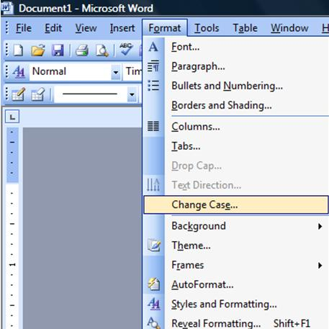
Text Formatting
Text formatting
  Controlling the appearance of text, the layout of text on page, use of pictures and graphics
Three kinds of formatting
  Character formatting
  Paragraph formatting
  Document formatting

Slide 35
Character formatting
Character formatting
  Settings that control the attributes of individual text characters such as font, font size & type style, changing character case.
  Font
    A named set of characters with same characteristics
    Popular fonts are: Arial, Times New Roman, Courier
  Font’s size
    Height of font, measured in points, 72 points=1 inch
  Type style
    Effects supplied to characters such as boldface, underline or italic.

Slide 36
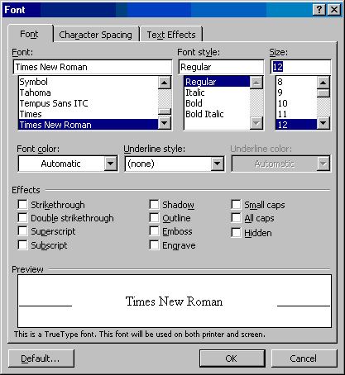
Character Formatting

Slide 37
Paragraph formatting
Paragraph formatting
  Settings applied only to one or more entire paragraphs
  Includes line spacing, paragraph spacing, indents, alignment, tabs, borders or shading
Paragraph mark (¶)
  Any text that ends with a special character
  Create when you press Enter key

Slide 38
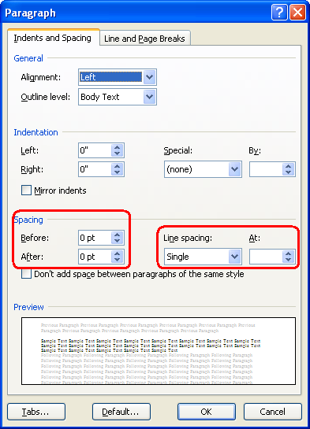
Paragraph formatting
Paragraph formatting
Left alignment-
  Aligns the text from left side
Right alignment
  Aligns the text or paragraph from right side
Center alignment
  Aligns the text or paragraph in the center
Justified alignment
  Aligns the text on both sides

Slide 39
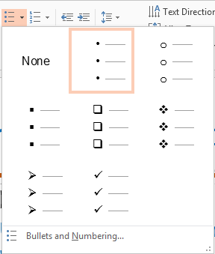
Paragraph formatting
Bullets
  Used to give listing or numbering your text or paragraph
Applying bullets
  Click the text where you want to apply bullets
  Open Format menu and choose Bullets and Numbering
  Select the bullets you want to apply

Slide 40
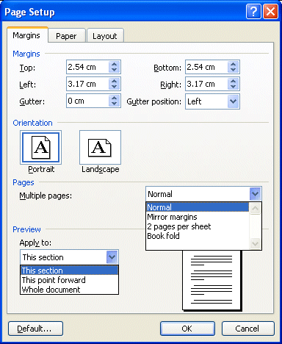
Document formatting
Document formatting
  Settings applied to entire document
  Include page size, page orientation, headers and footers, page breaks, page margins, page numbers
  May apply social formats like columns.
  May divide a document into sections and give each section its unique format

Slide 41
Document formatting
Page break
  Forces text retyped after the break to appear on the next page.
  It is useful for title pages or table of contents.
  Select Insert>>Page break from menu bar, or press CTRL+Enter
Page Header & Footer
  Header is printed at the top of each page
  Footer is printed at the bottom of each page
  Select View>>Header and Footer from the menu

Slide 42
Activity-(20 minutes)
Launch Microsoft word in different ways.
Create a new document. Save it with your name.
Save As the document with a different & same name.
Open an existing word document.
Activate & deactivate insert/overtype modes.
Delete some text then undo/redo it.
Find and replace some word in your document.

Slide 43
Activity-(20 minutes)
Change Font, its size and its style like Bold, Italic or underline.
View & explore paragraph formatting options.
Increase/decrease line spacing of a paragraph.
Apply bullets in your document.
Apply paragraph alignment options.
Apply document formatting like
  Page break, page header & footer
  Page margins, page size.

Slide 44
Thanks
End of Lecture 11

Slide 45
Allah Hafiz

