Slide 1
Troubleshooting, Software Installation & Protection
ADE100- Computer Literacy
Lecture 10
Sajid Riaz

Slide 2
Knowledge test
What is a computer network?
What is the difference between LAN & WAN?
What is firewall?
What is a computer virus and antivirus?
What is email spam?

Slide 3
Topics covered
Software installation
  Example: Installing an electronic dictionary
Utilities:
  What is file compression and why it is needed?
  File compression applications (WinZip and other programs)
Learning to compress files and folders using windows default options (zip, rar)

Slide 4
Troubleshooting
Troubleshooting is a form of problem solving
  Applied to repair failed products or processes
  Logical & systematic search for the source of a problem so that it can be solved,
  So the product or process can be made operational again.
In computer, troubleshooting is
  Identifying the source of a problem & solve it in the
    Computer program
    Computer system
    Computer network

Slide 5
Problems & their sources
Problem | Source
Diskette drive cannot write data to a disk | Disk is not formatted or disk is write protected or disk is damaged or disk is full
System date & time display is incorrect | Real-time clock battery need to be replaced
Computer is not responding to USB keyboard or mouse | Computer is in Standby mode, or system is locked
Poor performance is experienced | Processor is hot or hard drive is full or low memory or hard disk fragmented
Arrow keys of keyboard are not showing cursor movements | The NUM LOCK key may be ON.
System is not booting from CD/DVD | Boot-order is not correct or inserted non-bootable CD
Drive is not found | Cable is loose or diskette is seated/fixed properly
Printer is not printing | Incorrect driver is installed or printer is OFF

Slide 6
Software installation
Software Installation (or setup)
  Make the program ready for execution
  Code being copied from the installation files to new files on the local computer for easier access by the operating system.
  Code is generally copied in multiple locations
Programs often come with an installer
  A specialized program responsible for doing whatever is needed for their installation

Slide 7
Program un-installation
Program un-installation
  Usually involves more than just erasing the program folder
  For example, registry files and other deep code in the system may need to be modified/deleted for a complete uninstallation.
Un-installer
  A utility software designed to remove other software or part of it from a computer
  It is the opposite of an installer.

Slide 8
Copying & Installation
Some computer programs can be executed by
  Simply copying them into a folder stored on a computer and executing them.
  For example, GWBASIC
Other programs are supplied in a form
  Unsuitable for immediate execution
  Need an installation procedure
  Once installed, the program can be executed again and again, without the need to reinstall before each execution.

Slide 9
Common operations of installation
Common operations during installation are:
  Ensuring necessary system requirements are met
  Checking for existing versions of the software
  Creating or updating program files and folders
  Adding configuration data such as configuration files, windows registry entries
  Making the software accessible to the user, for instance by creating links, shortcuts or bookmarks
  Configuring components that run automatically such as windows services
  Performing product activation
  Updating the software versions

Slide 10
Installing a program
Insert a CD/DVD in your CD/DVD drive
Wait for CD/DVD auto play options
Choose setup file if it appears otherwise
  Choose open files and folders option to explore CD/DVD for your desired file
Select folder of your program to be installed
Then select and double click setup.exe or setup file
  Sometime you may find application setup with some other file name relevant to your program
Follow the steps given by the wizard & install your program successfully.
For help you can read messages on the wizards

Slide 11
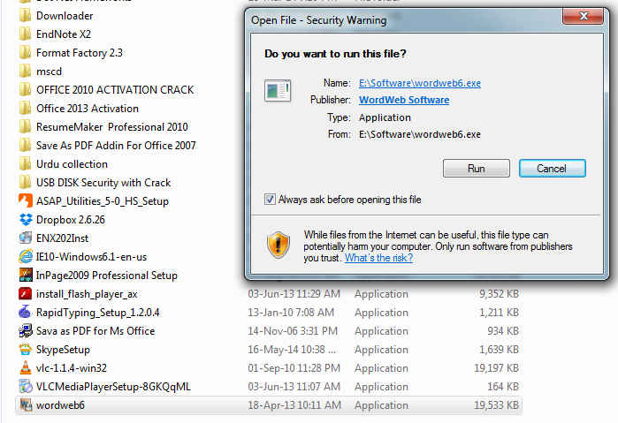
Installing a program

Slide 12
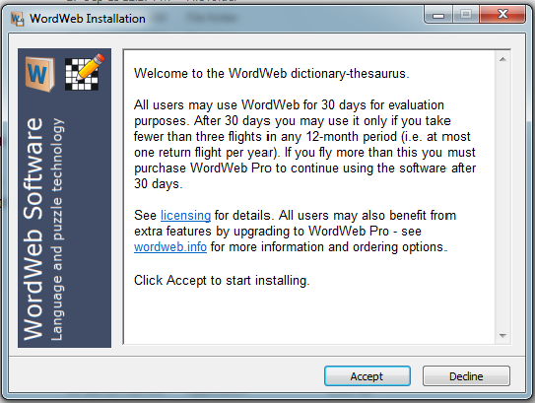
Installation 2

Slide 13
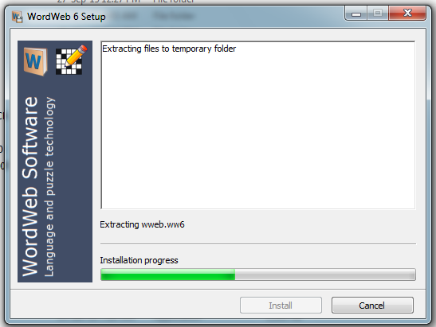
Installation 3

Slide 14
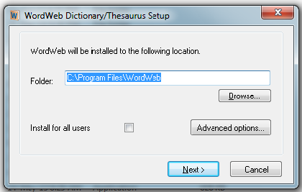
Installation 5

Slide 15
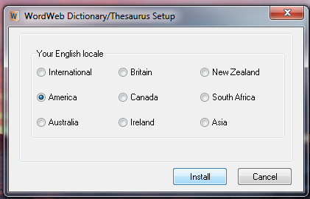
Installation 6

Slide 16
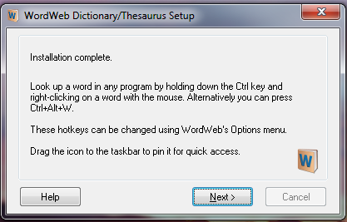
Installation 7

Slide 17
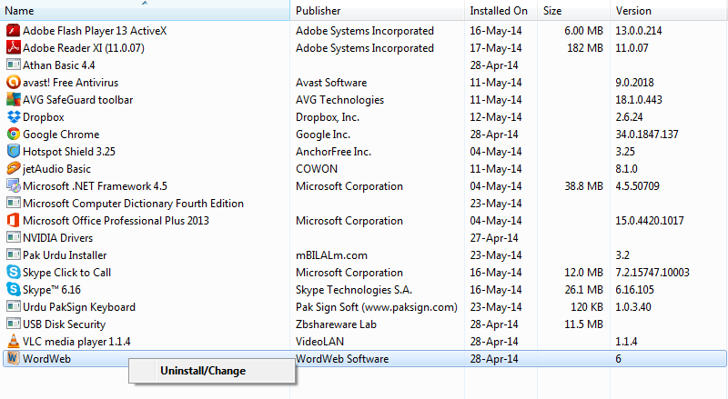
Uninstall a program- step 1

Slide 18
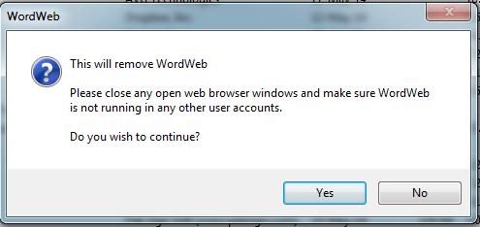
Uninstall- step 2

Slide 19
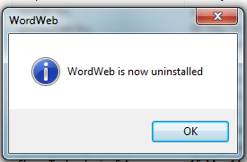
Uninstall- step 3

Slide 20
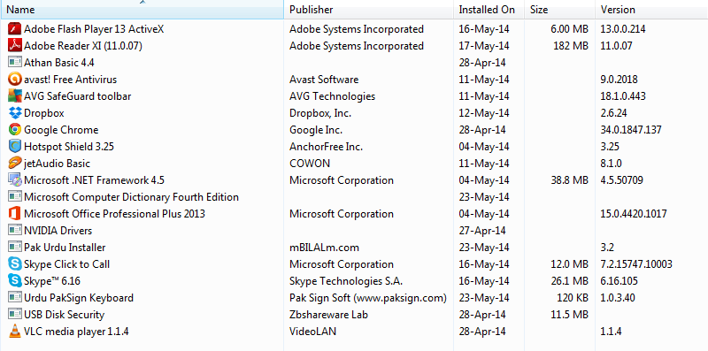
Uninstalled successfully

Slide 21
File Compression
Data file compression
  The process of reducing the size of a data file is popularly referred to as data compression
  Compression is useful because it helps reduce resource usage
  such as data storage space or transmission capacity
  Because compressed data must be decompressed to use
  This extra processing imposes computational or other costs through decompression

Slide 22
Uses
Audio compression
  Reduces the transmission bandwidth and storage requirements of audio data
Video compression
  Compress video file in different formats
  To store more files on a CD/DVD or hard disk

Slide 23
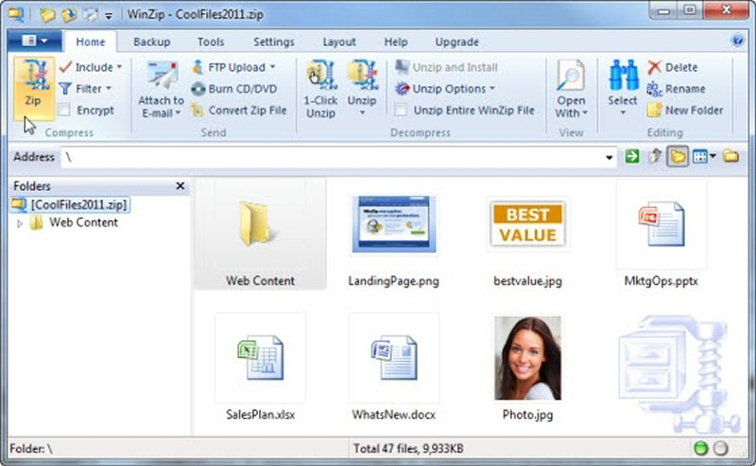
WinZip

Slide 24
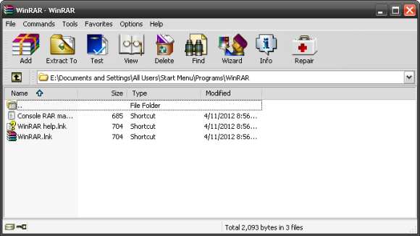
WinRAR

Slide 25
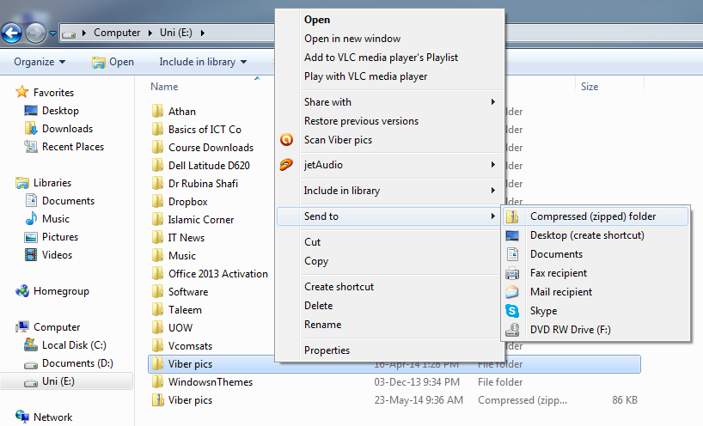
File compression using windows default options

Slide 26
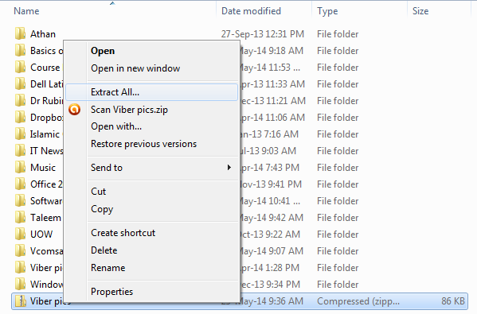
Extracting a compressed file using windows default options

Slide 27
Summary
Software installation
  Installing an electronic dictionary
  Uninstalling the electronic dictionary
Utilities:
  What is file compression
  Why file compression is needed
  File compression applications
    WinZip and other programs
Compressing files & folders using windows default options

Slide 28
Activity-(20 minutes)
Download a program from the internet & then Install/uninstall the program in your system.
View and explore the window of either WinZip or WinRAR program.
  Zip/unzip a folder using compression program
  Zip/unzip a folder using windows default options

Slide 29
Group discussion- (10 minutes)
Make a group of two or three students and discuss these topics.
  Discuss your past experiences about troubleshooting problems you or your family faced while using computer.
  Discuss how did you handle those problems.
  Share your ideas with other groups.

Slide 30
Thanks
End of Lecture 10

Slide 31
Allah Hafiz

