Slide 1
Computer Literacy
Associate Degree in Education (ADE)
Lecture 01

Slide 2
My introduction
Sajid Riaz
MSSE- IIU Islamabad
MCS- SUIT Peshawar
PGDIT- UCAT Rawalpindi
English diploma- NUML Islamabad
Lecturer, Computer Science
Global College of Sciences, Rawalpindi
University of Wah, Wah Cantt.
Bahria College Islamabad
IQRA University Peshawar

Slide 3
Teaching job requirements
Job requirements of a teacher are:
  Create your CV and write job application
  Send CV through email or apply online
  Prepare lesson plans, result sheets, papers
  Gather material for your lecture using internet
  Printing the required information
  Keep your knowledge up to date reading online material.
  Preparing your own notes for your class

Slide 4
Course introduction
Programme: Associate Degree Education (ADE)
Course Title: Computer Literacy
Course Code: ADE100
Credit Value: 3 Hours
Prerequisites: F.A./F.Sc.

Slide 5
Recommended books
Textbooks:
  Ann Ambrose, 2005. Computer Literacy Basics, Cengage Learning, CEP, Inc, Marly Bergerud BASICS Series
  Helene G. Kershner, 2011. Computer Literacy D.C. Heath, 1992, original from Pennsylvania State University
Reference books:
  Introduction to computers, 7th edition by Peter Norton
  PM Series- Introduction to Information Technology, by Riaz Shahid, CM Aslam & Safia Iftikhar, Majeed Sons publication.
  IT Series- Computer applications in business by Tasleem Mustafa, Tariq Mahmood, Imran Saeed & Wasi Ahmed.
Internet resources, computer magazines, newspapers

Slide 6
Course outline
Introduction to computers
  History, classification, hardware components
Operating System
  Computer software, using Microsoft Windows
Internet Basics
  Introduction to internet, browsing, web addresses & links
Computer Networks
  Types of networks, security issues like virus protection
Troubleshooting
  Software installation, file compression

Slide 7
Course outline 2
Word processing
  Tool used: Microsoft word
Spreadsheet
  Tool used: Microsoft Excel
Multimedia
  Tool used: Microsoft Power Point
Searching & Saving web resources
  Images, videos, audios
Communication through internet
  Sending and checking email

Slide 8
Course outline 3
Online collaboration applications
  Working with an online collaboration application e.g. Google docs
Using digital devices with a computer
  Using Digital cameras and other devices
  Transferring file to/from computer to/from digital devices e.g. camera & mobiles
Working in the information society
  Using computers at workplace, in community, education, entertainment, research
Computer ethics
  Computer crime, copyright law, fair-use guidelines and plagiarism
Computer-Assisted Instructions (CAI)
  Online education e.g. virtual university of Pakistan, computer as a teacher

Slide 9
Lecture 01
Topics:
Introduction to computers
History & classification of computers
Input devices

Slide 10
Topics covered
What is computer?
History and classification of computers
  Examples of computer
  Brief history of computers with timeline
Introduction to computers- learning about input devices
  Input devices

Slide 11
Knowledge test
What type of computers you have seen?
Which types of computers you used ever?
What is your concept about computer?

Slide 12
What is computer?
Computer
  An electronic device used to solve various problems according to a set of instructions given to it.
  Origin from the word compute means to calculate
  Converts data into information which is useful for us
  Used to perform mathematical work
  Calculation is not the only use of computer

Slide 13
Components of computer
Components of computer
  Computer is controlled by programmed instructions called software.
    Tells the computer what to do.
    For example, Microsoft windows, microsoft office, etc.
  Physical components of computer are called hardware.
    Hardware is lifeless without programs.
    For example, mouse keyboard, scanner, etc.

Slide 14
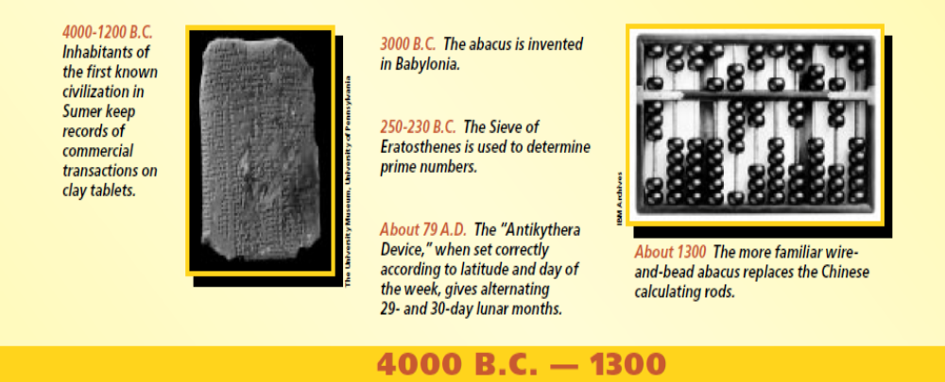
History of computers
Abacus- 1300
  First computing device
  Developed in 600 B.C.
  Perform simple addition and subtraction
  Consists of wooden beads which are moveable
  Calculation is done by moving these beads properly

Slide 15
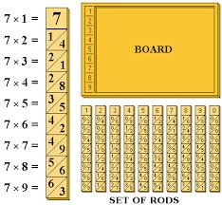
Napier’s Bone
John Napier’s Bone- 1614
  Another manual calculating device
  Cardboard multiplication calculator

Slide 16
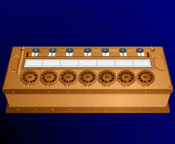
Pascal
Blaise Pascal- 1643
  First mathematical adding machine
  Only add & subtract numbers
  Division and multiplication was done by repeated addition and subtraction.

Slide 17
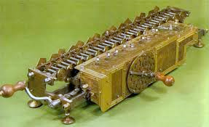
Von Leibniz
Von Leibniz- 1694
  A German scientist
  Developed a calculating machine in 1694
  First calculator that can multiply and divide also.

Slide 18
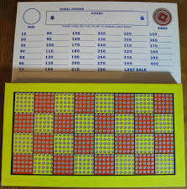
Punched board
Punched board- 1801
  A French engineer, Joseph
  Developed punch board system for power looms;
    A device that combined thread to make cloth using steam power.
  Used to create specific weaving pattern on cloth
  Later on it was used in computers

Slide 19
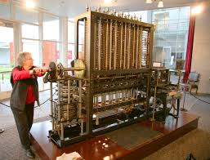
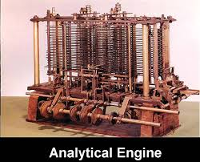
Charles Babbage
Charles Babbage- (1822-1842)
  A mathematician
  Invented “Difference Engine” in 1822 for arithmetic calculations
  Developed an automatic “Analytical Engine” in 1842
    Perform 60 additions per minute.

Slide 20
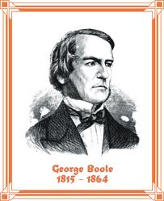
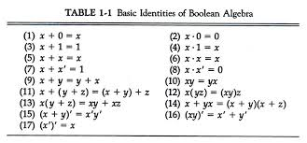
George Boole
George Boole- 1854
  Simplified binary system of algebra
  His law states that: “Any mathematical equation can be stated simply as either true or false.”

Slide 21
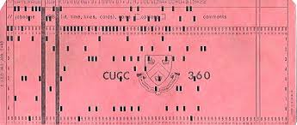
Herman Hollerith
Herman Hollerith- 1896
  He applied the idea of punchboards in computers
  He used punch cards for input and output in computers.

Slide 22
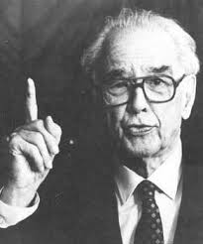
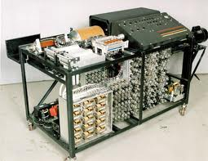
Atanasoff
Atanasoff- 1939
  Professor at Lowa university
  Invented an electronic computer called Atanasoff-Bery computer
  Applied Boolean algebra to computer circuitry

Slide 23
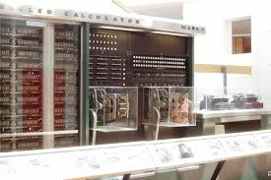
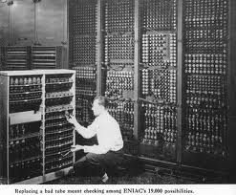
Popular old models of computers
Mark I (1937-44)
  Also known as Automatic Sequence Controlled Calculator.
  Designed by Howard A. Aiken of Harvard university
  First fully automatic calculating machine.
ENIAC (1943-46)
  Electronic Numerical Integrator and Calculator
  Invented by J. P. Eckert and John Mauchly in 1946
  First electronic computer

Slide 24
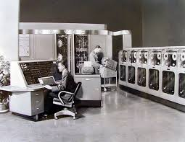
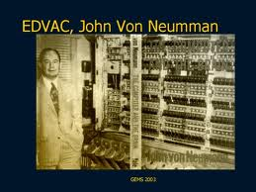
Popular old computer models 2
UNIVAC (1951)
  Universal Automatic Computer
  First digital computer
  Used in business and industries
EDVAC (1946-52)
  Electronic Discrete Variable Automatic Calculator
  Developed by Von Neumann
  Could store data and instructions

Slide 25
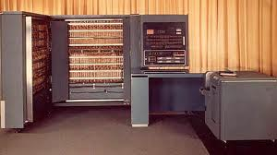
Popular old models 3
Commercial computers- 1952
  First commercial computer was IBM-701

Slide 26
Examples of computers
Personal computers
  For individual or single user
Mainframe computer systems
  For organizations

Slide 27
Computers for individual use
Personal computer
  Any computer system used by a single person
  Also called microcomputers due to their small size
Six types of personal computers- PCs:
  Desktop computers
  Workstations
  Notebook computers
  Tablet computers
  Handheld computers
  Smart phones

Slide 28
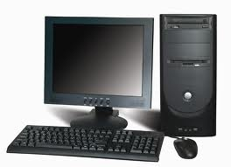
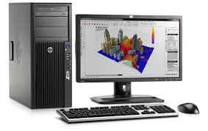
Computers for individual use
Desktop computers
  The most common type of computer
  Sits on the desk or floor
  Performs a variety of tasks
  The main component is “system unit”
  Two variations: Desktop model and tower model
Workstations
  Specialized computers for engineers & designers
  Optimized for science or graphics
  More powerful than a desktop computer
Notes:
Insider information
System units are commonly called cases. Many computer enthusiasts customize or ‘mod’ their cases with windows and lights. See www.casemodgod.com for examples of cases and products.
Sun Microsystems makes the most popular workstations on the planet. Sun’s systems are used in diverse applications such as medical imaging and CGI (computer generated image) animation.

Slide 29
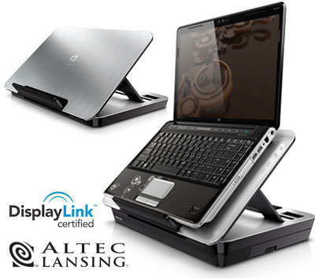
Computers for individual use
Notebook computers
  Small portable computers
  Weighs between 3 and 8 pounds
  About 8 ½ by 11 inches
  Typically as powerful as a desktop
  Laptops because people frequently set them on lap
  Can include a docking station
    A docking station can make a notebook computers feel like a desktop system with a full size monitor, keyboard and other features.
Notes:
Discussion point
Have students contrast desktop and notebook computers. Focus on the pros and cons of each type of computer.

Slide 30
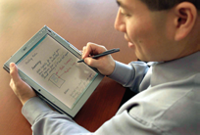
Computers for individual use
Tablet computers (Tabs)
  Newest development in portable computers
  Offer all the functionality of a notebook
  Input is through a pen called stylus or digital pen
  Run specialized versions of office products
Notes:
Teaching tip
The tablet PC was designed to simulate a piece of paper. Users interact with the tablet as if it was an unlimited paper notebook.
For more information
See www.microsoft.com/windowsxp/tabletpc/evaluation/tours/default.mspx for an example of the Tablet PC in action.

Slide 31
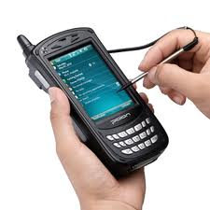
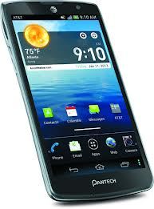
Computers for individual use
Handheld computers
  Very small computers to fit in your hand
  Popular type is Personal Digital Assistants (PDA)
  No larger than a small appointment book i.e. note taking or contact (phone/address) management
Smart phones
  Hybrid of cell phone and PDA
  More powerful than cellular phones
  Web surfing, e-mail access
Notes:
Teaching tip
At this point, refer the students to the productivity tip on page 13. This tip helps the student determine what type of PC is best for them.

Slide 32
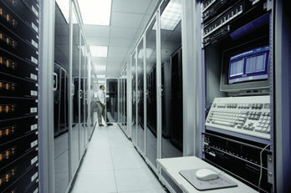
Computers For Organizations
Mainframes
  Used in large organizations
  Handle thousands
  of users
  Users access through a terminal- dumb or intelligent
    Dumb terminal does not store or process data.
    Intelligent terminal does little processing but does not store data.

Slide 33
Input devices
Input devices
  Used to feed or enter data into the computer
Most common devices
  Mouse, keyboard, scanner, joystick, webcam, digital camera, barcode reader, digital voice recorder

Slide 34
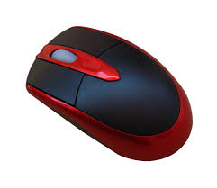
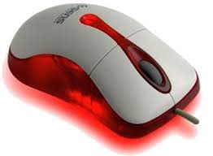
The Mouse
Allows users to select objects
  Pointer moved by the mouse
Mechanical mouse
  Rubber ball determines direction and speed
  The ball often requires cleaning
Optical mouse
  Light shown onto mouse pad
  Reflection determines speed and direction
  Requires little maintenance

Slide 35
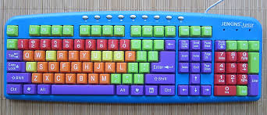
The Keyboard
The most common input device
  First peripheral used with computers
    Still primary input device to enter text and numbers
  A standard keyboard has 100 keys
  Must be proficient with keyboard
  Skill is called typing or keyboarding
    The ability to enter text and number with skill and accuracy
  Standard keyboard layouts
    IBM Enhancement Keyboard with 100 keys in five groups

Slide 36
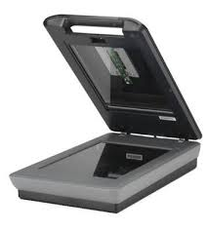
Scanner
Image scanners
  Converts printed media into electronic
  Reflects light of the image
  Sensors read the intensity
  Filters determine color depths
  Primary additive colors are red, green, blue (RGB)
Optical character recognition (OCR)
  Converts scanned text into editable text
  Each letter is scanned
  Letters are compared to known letters
  Best match is entered into document
  Rarely 100% accurate

Slide 37
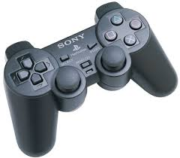
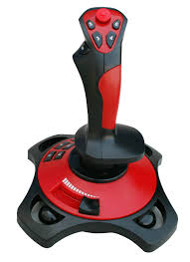
Joystick
May be used with applications other than games.
Enable the user to fly or drive through a game, directing a vehicle or a character.
Popular in racing and flying games.

Slide 38
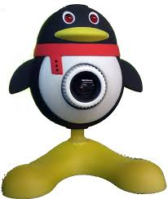
Webcam
Webcam
  A video camera connected to a computer
  Allows its images to be seen by internet users
  Uses USB cable for connection
  Captures still pictures and make videos
  Internet is required to share your video
  Allows computers to act as videophones or video conference stations
  Very cheap source of videotelephony

Slide 39
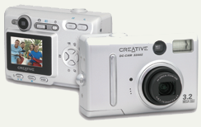
Digital camera
Digital cameras
  Capture images electronically
  No film is needed
  Image is stored as a JPG file
  Memory cards store the images
  Used in a variety of professions

Slide 40
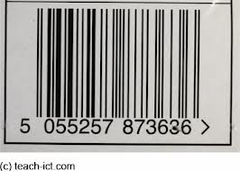
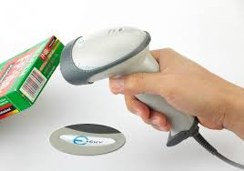
Bar-code reader
‘Bar codes’ are patterns of printed bars which identify the product.
Converts bar codes into numbers
  UPC- Universal Product code
Computer find number in a database
Works by reflecting light
  Amount of reflected light indicates number

Slide 41
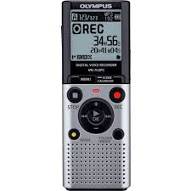
Digital voice recorder
Digital voice recorder
  Converts sound into a digital file that can be moved from one electronic device to another
  Play back by a computer, tablet or smart phone and stored like any other data file.
  Records voice to a memory chip
  It normally stores binary numbers (100100) of audio signals

Slide 42
Five tips for course
Learn to play with computers and not to fear that you will break the computer.
There is no shame in making mistakes. Mistakes are positive learning experiences .
  Remember: More risk, more profit.
Don’t cram information. Learn how to use computer.
  Try to use computers and internet. Once you get started you will find your way.
Work in pairs, help others or learn from others.
Don’t fear from typing. With the passage of time you will learn it.

Slide 43
Thanks
End of Lecture 1

Slide 44
Allah Hafiz

